Slide 1


Testing in Production
Your Key to Engaging Customers
Session #801
Seth Eliot, Senior Test Manager
Software Test Professionals Conference – March 23, 2011
Notes:
Best viewed with Animation active (Slide Show view should work nicely)
Rev History
2011 Feb 27 – Original (1.1 includes hidden slides)
2011 Feb 28 – add “Scenarios ⇨ TiP” slide, re-work iteration slide
2011 March 5 – rename “Scenarios ⇨ TiP” to “Scenarios are to TiP, as…” and rework it. Rework “Giddy Customers?” slide
2011 March 17 – add more information about the long tail
2011 March 20 – several tweaks. Kill the “many aspects of TiP” slide
2011 March 22 – removed some slides for brevity. Minor alterations

Slide 2
Contents
Introduction
Scenarios
Testing in Production (TiP)
The Scenario – TiP Connection
Data Mining
Online Experimentation
Active User Feedback
Prototypes
Conclusion
Latest version of this slide deck can be found at:
http://setheliot.com/blog/software-test-professionals-conference-2011/

Slide 3
Introduction
Examples
Scenarios
Testing in Production (TiP)
High Quality Product
Delighted Users
Notes:
Quality
Dual Approach
Stress the relation as I….
….show the examples

Slide 4


Who am I?
Software QA Manager
Amazon Digital Media
Microsoft Experimentation Platform
Culture Shift
  Services
  Data Driven
Microsoft Bing
Notes:
This talk is about how we produce quality services, and use data in that process

Slide 5
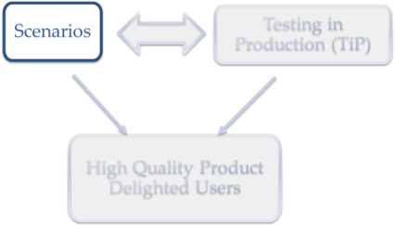
Scenarios
An Introduction

Slide 6
Ditch the Requirements –
Focus on the Customer Instead
Conformance to Requirements
Fitness for Use
Giddy Customers
Crosby, 1979
Juran, 1988
Now
Static requirements are fragile
Requirements are hard: GIGO
If they are there at all….
http://bit.ly/seth_stp_scenario
Notes:
Scenarios are alternative to Statics Requirements Doc
What’s wrong with statics requirements is…
Now=2007 (iPhone), 2010 (Kinect)
Cut: If they are even understood

Slide 7
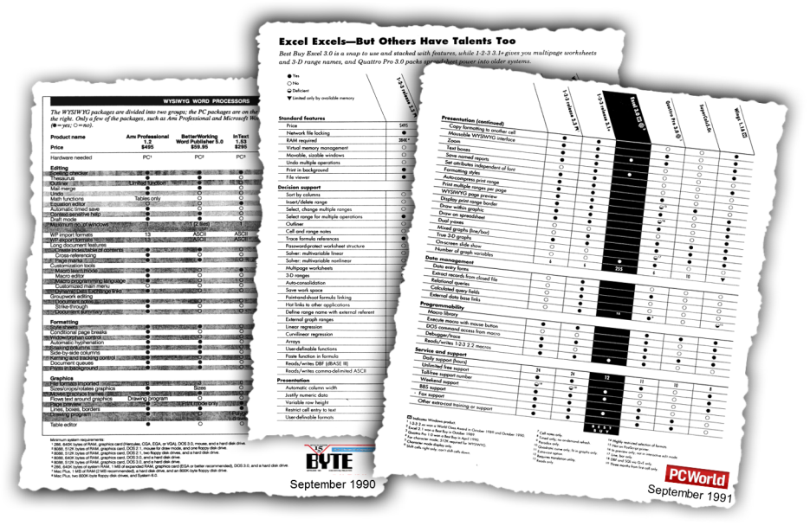
Will We Win On “Feature Wars”?

Slide 8
Giddy Customers?
Conformance to Requirements
Fitness for Use
Giddy Customers
Useful
Solves a Need
Usable
easy and intuitive
Desirable
Enjoy
Crave
efficient
discoverable
learnable

Slide 9
Scenario
A narrative Story
Told with the Customer’s voice
  Tells what they want to achieve
Based on real Research
Intentionally Implementation-Free
That taps into Emotion and reveals Insight
Notes:
Microsoft Best Practices

Slide 10
An Example Scenario
A narrative Story
    Danielle is an aspiring author. She composes her works, consisting of short form and long form fiction, directly on her laptop computer. Her work is her livelihood so data loss is devastating. Since she is composing on the fly anything that interrupts her flow of creativity frustrates her, so meta-tasks like spelling and formatting should be handled as transparently as possible. She often shares unfinished versions of her work with peer reviewers for feedback, and ultimately needs to share her finished works with editors and potential publishers

Slide 11
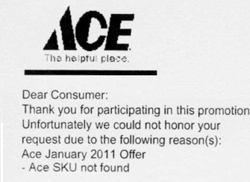
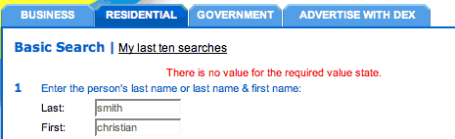
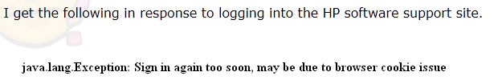
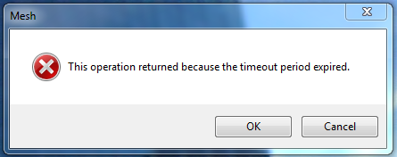
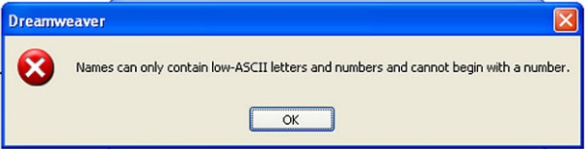
We Are Not The Customer
Told with the Customer’s voice
Notes:
Why tell with customers voice? B/C we are not the customer!
http://www.instructionaldesign.org/bad_error_messages.html
http://blog.isthereaproblemhere.com/2010/03/sign-in-again-too-soon.html
http://blog.isthereaproblemhere.com/2010/02/pwalshwfdi-names-can-only-contain-low.html

Slide 12
Who is the Customer?
Based on real Research
What Do Real Users Need?
Ask / Watch / Study them
For proposed website changes at Microsoft
[Kohavi, et al; 2009]
Research enables us to weed out the 2/3rd of ideas that do not work
1/3 | 1/3 | 1/3
Positive Ideas | No Statistical Difference | Negative Ideas
Notes:
there is no correlation between what people in the organization think will work and what actually does work

Slide 13

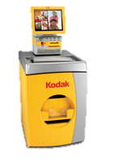


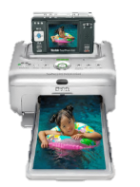



Intentionally Implementation-Free
print photos and put in album
automatically file share photos directory with grandparents
print photos and give to them
John wants to share the latest kid pictures with grandparents
easy to use kiosk in a retail outlet
put photos on a website
email pictures
print photo books, cards
easy template for emailing
plug camera directly into
a printer
email slideshow
online
slideshow
see pictures for people in my social network
show pictures on TV screen
send photo via instant messaging
put photos on a CD
13

Slide 14
Intentionally Implementation-Free
print photos and put in album
automatically file share photos directory with grandparents
print photos and give to them
John wants to email the latest kid pictures with grandparents
easy to use kiosk in a retail outlet
put photos on a website
email pictures
print photo books, cards
easy template for emailing
plug memory card directly into a printer
email slideshow
online
slideshow
show pictures on TV screen
see pictures for people in my social network
send photo via instant messaging
put photos on a CD
14

Slide 15
An Example Scenario - Revisited
That taps into Emotion and reveals Insight
      Danielle is an aspiring author. She composes her works, consisting of short form and long form fiction, directly on her laptop computer. Her work is her livelihood so data loss is devastating. Since she is composing on the fly anything that interrupts her flow of creativity frustrates her, so meta-tasks like spelling and formatting should be handled as transparently as possible. She often shares unfinished versions of her work with peer reviewers for feedback, and ultimately needs to share her finished works with editors and potential publishers
Why Emotion…?
Notes:
Implementation? Word with tools. Cloud sharing and sync?

Slide 16
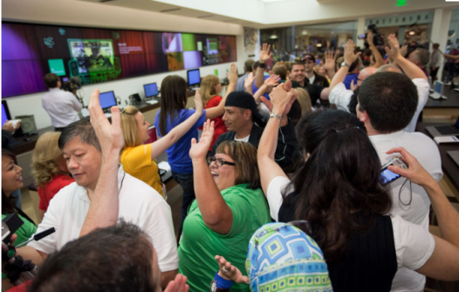
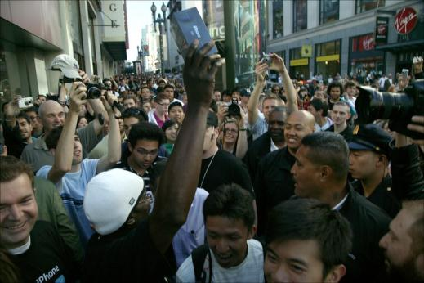
This is Emotion!
Microsoft Store Launch,
Scottsdale, Oct 2009
Ship products customers crave
iPhone Launch, San Francisco,
June 2007
Notes:
Photo Credits:
Microsoft Store: http://www.microsoft.com/presspass/presskits/windows7/launchSlideshow.aspx
iPhone: http://www.mccullagh.org/photo/1ds-17/first-iphone-sold

Slide 17
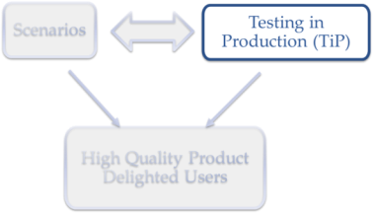
Testing in Production (TiP)
An Introduction

Slide 18
Testing in Production (TiP)
TiP is primarily for Services (this includes Websites)
Production
  Data Center where V-curr runs
  Real world users / Real world traffic
Testing
  Functional and Non-Functional
Notes:
SERVICES (will define more precisely later)

Slide 19
Fire the Test team and just put it in production…???
BUFT
TiP
Even over here Test team guides what to test and how
Let’s try to be in here
  Leverage the diversity of production,
    Provide coverage to find bugs that our internal tests (BUFT) aren’t finding.
  But be smart and mitigate risk.
Notes:
Not Fire Team, but balance BUFT/TiP

Slide 20

What is a Service?
You control the deployment independent of user action.
You have direct monitoring access.
Deploy
Detect
Remedy
  “It is not the strongest of the species that survives, nor the most intelligent, but the one most responsive to change.” - Charles Darwin
Examples:
  Google: All engineers have access to the production machines: “…deploy, configure, monitor, debug, and maintain” [Google Talk, June 2007 @ 21:00]
  Amazon: Apollo Deployment System, PMET Monitoring System - company wide supported frameworks for all services.
  Microsoft: Big Red Switch
Notes:
Responsive = deploy, detect, patch cycle
Amazon almost any engineer can deploy the website

Slide 21
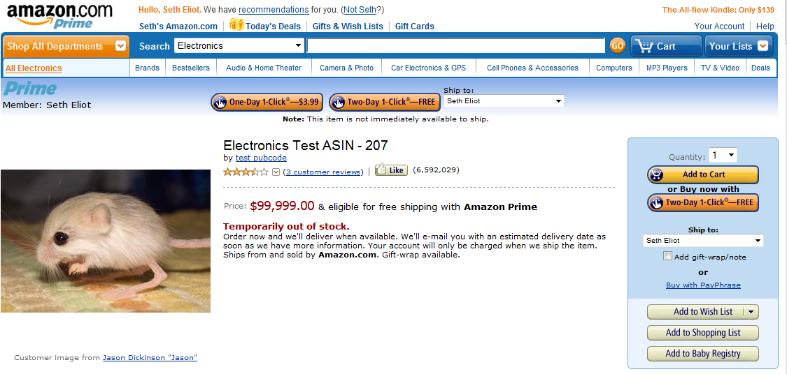
TiP is Not New
But leveraging it as a legitimate Test Methodology may be new.
Later… many examples how we do this right
Go to Amazon.com and search for {test ASIN} ☺
Notes:
Amazon, Wizards of the Coast, MSFT Health Vault
TiP done badly – user visible, possibly impacting (buy an ASIN)
http://www.amazon.com/Electronics-Test-ASIN-207/dp/B002ZB79H4

Slide 22
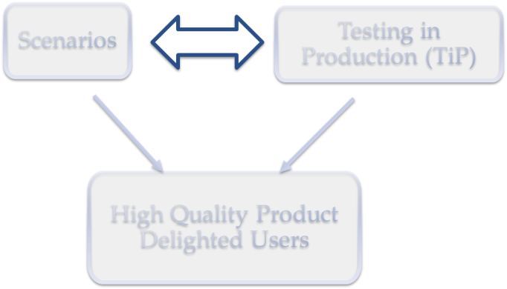
The Scenario – TiP Connection

Slide 23
How Do You Test Scenarios?
Scenario
Design
TiP
(B)UFT
Scenario
  defines user intent
  TiP is user driven
Design
  defines system function
  UFT is function driven
TiP is How You Test Scenarios
UFT is How You Test Design
Notes:
BUFT: pull the levers, twist the knobs

Slide 24
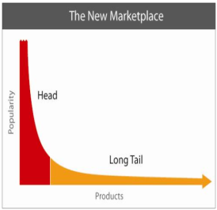
Leverage the Long Tail
BUFT
TiP
Static Reqs
Scenarios
The Long Tail of real world usage
Products -> Use Cases
  [Anderson, July 2006]
Notes:
Why try to anticipate user behaviors?
Scenarios aim for the head, but encompass parts of the tail

Slide 25
Leverage the Long Tail
After missing a connecting flight Jane wants to notify colleagues and expedite her arrival at her destination meeting by finding a new flight….
Mobile device shall support e-mail
The Long Tail of real world usage
Products -> Use Cases
  [Anderson, July 2006]
Notes:
Book a new flight
Auto-notify meeting attendees
Tell colleagues about new arrival time

Slide 26





Testers Are Not the Customer
TiP uses real users / Scenario uses real research
Notes:
UFT = Tester as Customer
TiP = Real Customer + Tester insight

Slide 27
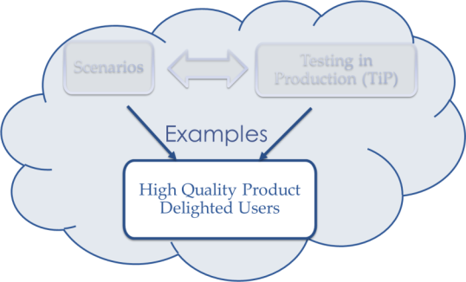
Examples of TiP and Scenarios
Real Users
  Data Mining – Passive User Feedback
  Active User Feedback
Experimentation (A/B Testing)
Iterative Prototyping
Notes:
Following this, I will start the examples

Slide 28
Data Mining
With Examples

Slide 29


Data Mining
Looks at Large Data Sets
In this case Data from
  Real Users
  Systems Used by Real Users

Slide 30
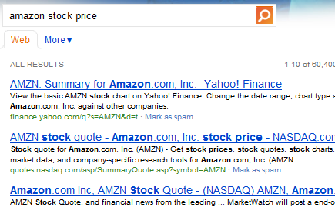
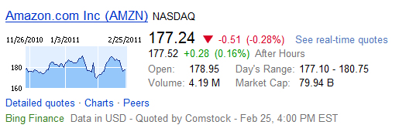
Example: Favor Long Tail Over Test Cases
???
q = {amazon stock price}
Any scenarios begin with “Larry needs to find the price of his favorite stock”?
pattern = {[company_name] stock price}
where (Finance Answer Did Not Fire)
This works… | …but this does not
{expedia stock price} | {expedia.com stock price}
{Comcast stock price} | {Comcast Corporation stock price}
{Bed Bath and Beyond stock price} | {Bed Bath & Beyond stock price}
    [Unpingco, Feb 2011]
Notes:
Left Column = UFT, right column = TiP
Even best tester cannot anticipate EVERYTHING

Slide 31
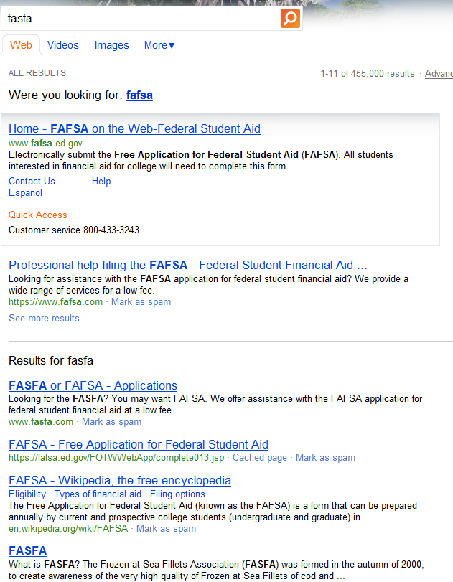
Example: Speller Split Screen
Top Pane
Result 1 and Result 2 from Corrected Query
Bottom Pane
Result 1 through Result 10 from Original Query
Notes:
- Speller Split Pane

Slide 32
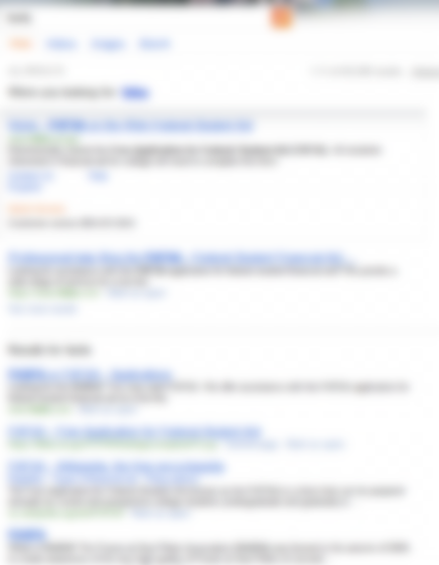
Example: Speller Split Screen
If (TopPane Clicks > 95%) → ???
Just alter query…
Learn from user action to
Anticipate user intent
If (BottomPane Clicks > 95%) → ???
Leave query alone…
    [Unpingco, Feb 2011]
Notes:
- Bug Miner finds this automatically

Slide 33
Example: Speller Split Screen
Some Top Results
Query | Correction | Top Clicks | Bottom Clicks | Make Correction | Keep Original
googlecom | google.com | 99.7% | 0.3% | ✓
yah | yahoo | 99.8% | 0.2% | ✓
fasfa | fafsa | 90.5% | 9.5% | ✓
utube music | youtube music | 90.4% | 9.6% | ✓
facebookcom | facebook.com | 98.4% | 1.6% | ✓
imbd | imdb | 96.3% | 3.7% | ✓
evony | ebony | 0.5% | 99.5% |  | ✓
century link | centrelink | 2.0% | 98.0% |  | ✓
yout | youth | 3.8% | 96.2% |  | ✓

Slide 34
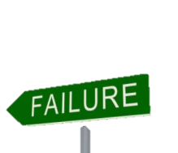
Automated Failure Analysis
Systems can run fine in the lab
  TiP Replaces imperfect lab with rich production.
Find Faults in Production
  Crashes
  Error Aggregation
Auto File Bug with…
Telemetry Captured
  Logs
  Crash Dumps
  User actions that lead to problem
Failure blocks ALL Scenarios from being fulfilled
Notes:
User data → system data
Error Aggregation to find real issues. Single occurrences may be a fluke

Slide 35
AFA Example: Cosmos AutoBug
Microsoft Cosmos
  >10K Machines per Data Center
  More info: http://bit.ly/cosmos_blog
AutoBug: Error Aggregation and Crash Detection
Service | Aug Release | AutoBugs Fixed | Sept Release | AutoBugs Fixed | Nov Release
S1 | 495,952,928 | 1 | 4,215,476 |  | 2,396,548
S2 | 10,107,128 |  | 4,130,825 |  | 2,765,910
S3 | 47,960 |  | 38,782 |  | 0
S4 | 39,495,893 |  | 41,507,524 |  | 28,517,958
S5 | 293,042 |  | 403,239 |  | 568,981
S6 | 62,029,022 |  | 108,220,120 | 4 | 76,796,685
S7 | 547,276,342 |  | 1,034,032,213 | 3 | 417,558,505
S8 | 154,046,954 |  | 300,026,351 |  | 110,671,176
S9 | 189,924,567 |  | 417,903,048 | 3 | 56,429,723
S10 | 278,999 |  | 661,982 | 1 | 357,056
S11 | 403,643,186 |  | 4,995,264,188 | 2 | 494,706,072
Notes:
1 DC – 7 days

Slide 36
Online Controlled Experimentation
With Examples

Slide 37
Online Controlled Experimentation
This is an “A/B” test
…the simplest example
A and B are Variants
  A is Control
  B is Treatment
Notes:
TEXT before DIAGRAM (gives context to explain diagram)
REAL Users
Can have multiple Treatments
Can divide %

Slide 38
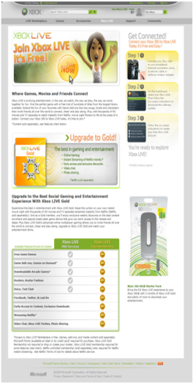
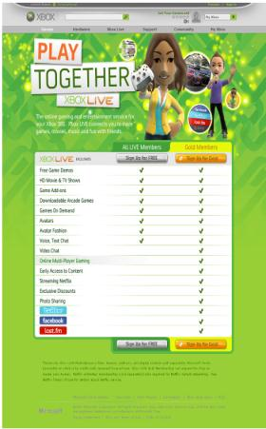
Example: Microsoft Xbox Live
Goal: Sign More People up for Gold Subscriptions
A
B
http://www.xbox.com/en-US/live/joinlive.htm
Which has higher Gold Sign-up…???
Control
Treatment
Neither
Which has higher Gold Sign-up…???
Control
Treatment – up 29.9%
Neither
Research reveals
Latent Demand
Notes:
Latent Demand for Gold Subscriptions
Jan 2010
Subscriptions for all three types of Gold memberships (3 months, 12 months and month to month) saw a significant increase for Treatment
Signups for Silver decreased (but not as much as gold increase)

Slide 39


Example: Amazon Shopping Cart Recs
Amazon.com engineer had the idea of showing recommendations based on cart items [Linden, Apr 2006]
  Pro: cross-sell more items
    increase average basket size
  Con: distract people from checking out
    reduce conversion
A marketing senior vice-president was dead set against it.
Ran an Experiment…
Notes:
Website/UX
The Experiment was a success

Slide 40
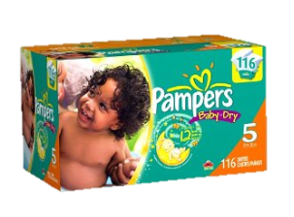
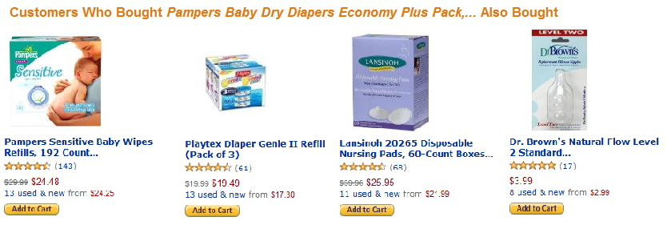
Amazon Shopping Cart Recs
The Scenario
  Maria is a new mother. She needs to keep a steady supply of diapers in the house. With the new baby she can’t easily get to the store. With the new little one joining the family, money is tighter and she also needs to stay within her budget And there are so many other things she needs other than diapers to keep her baby happy and healthy.

Slide 41
Active User Feedback
With Examples

Slide 42
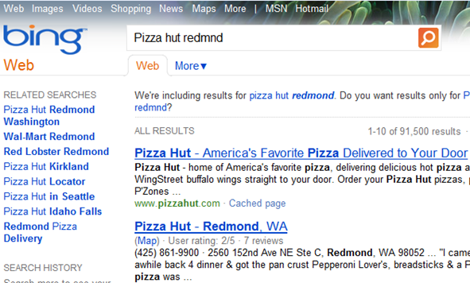
What’s a DSAT?
We’re not firing local answers when we spell correct

Slide 43
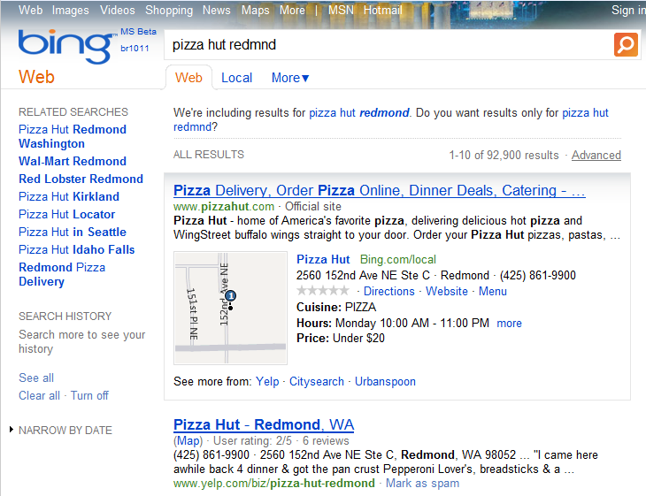
That’s Better!

Slide 44
Example: Crowd Source DSATs
Submit
Auto Analysis
Manual Analysis
Tracking
Submit
By Tool, By e-mail
>10,000 in Jan from Bing alone
Auto Analysis
Ad
Related search
Speller
Image result
Algo result
Each DSAT reveals a Scenario.
Our solutions need to focus on intent.
Notes:
We are not the customer?
Old Trick - startups

Slide 45



Crowd Source User Testing
On-Demand Scalable “Workforce”
Pay users to walk through scenarios on your site.
Con
Like other “Interviews”, there is bias
  uTest may be more biased but more detailed – Testers not Users
Pro
Cheap and scalable
Notes:
uTest is another option, but for scenario f

Slide 46
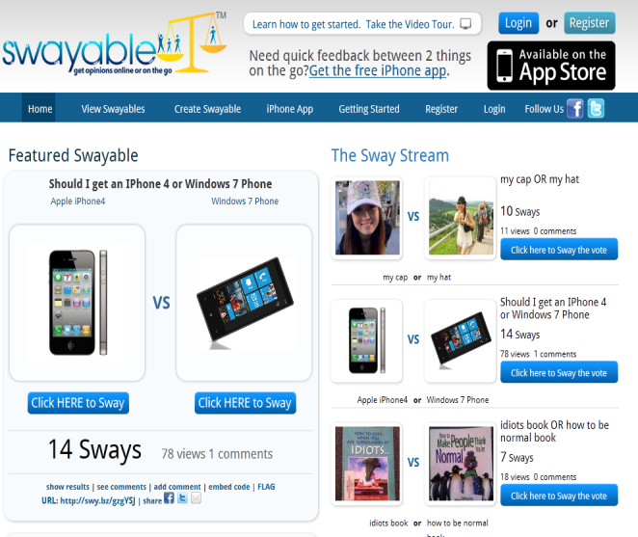
Example: Crowd Source User Testing
Notes:
This is an example-squared
Swayable is crowd sourcing products….

Slide 47
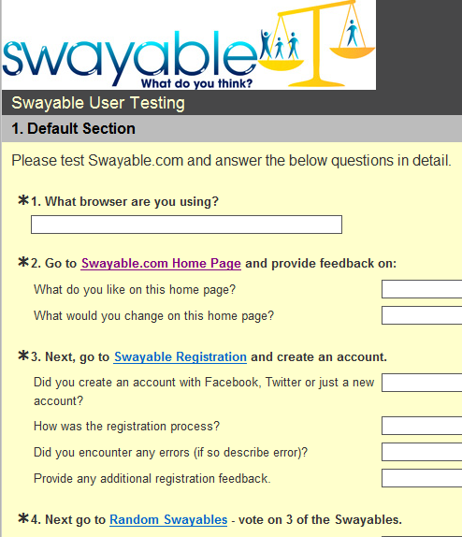
Example: Crowd Source User Testing
Paid 0.90 per feedback
Errors in workflow
Functional bugs
Design feedback
Dead links
Removed components to make it quicker/easier
[Swayable, Oct 2010]
End to end testing with real customers
Notes:
…and they use crowd sourcing to test themselves

Slide 48
Prototypes
With Examples

Slide 49
Prototypes
Focused
  used to test a specific idea or question
  focus on what you don’t know
Rapid
  don’t waste time on unnecessary detail
  fastest way to get customer feedback early
Disposable
  built to be thrown away
  not robust, not maintainable

Slide 50
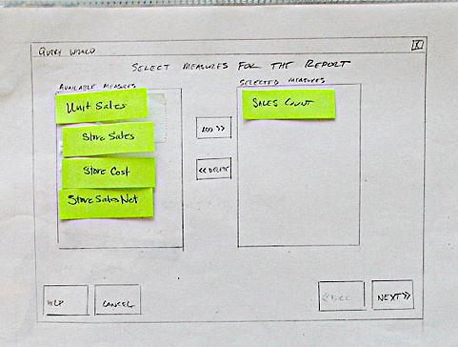
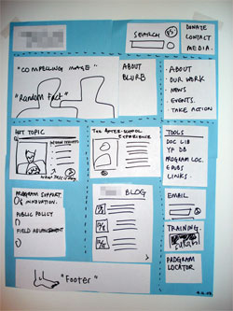
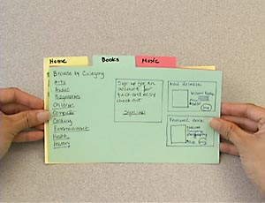
Paper Prototypes
Notes:
This is TiP – it is in front of real users

Slide 51

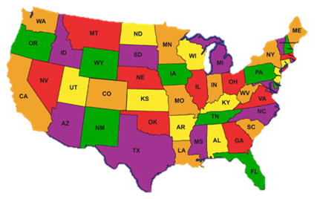




Code Prototypes
Launch a new Service – Everyone sees it
Exposure Control – only some see it
By Browser
By Location
By Percent
(scale)
Notes:
Cheap and rapid – limit testing / limit risk

Slide 52
Exposure Control
Saves you from having to BUFT if product is a dud
Prototype New Idea
Small Dev / Small Test
Release to segment of users
Bad Idea
Move on to a new idea
“To have a great idea, have a lot of them”
-- Thomas Edison
Fail Fast – Fail Cheap
Notes:
finding an error in requirements is 10 to 100 times cheaper than changing features in a finished product (Boehm, 1981)(McConnell, 2004)

Slide 53
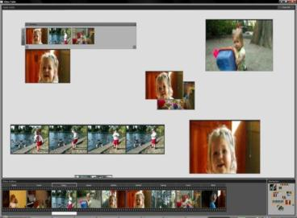
Example: Prototype – Video Light Table
Rapid
About 3 days to write
Written using C# and WPF.
Expression Blend was used for all visuals, and VS for coding.
No real video engine backing the prototype
This was just a UI study
Just operates on image sequences.
Minimal informal testing
[Schormann, May 2008]
Focused
Try out a light-table paradigm for consumer-centric, snippet-based video sharing
Disposable
throw-away code… written as such from the start
Notes:
Mix 2007 keynote, Metalliq Top Banana
Blend: interactive, WYSIWYG front-end for designing XAML-based interfaces for WPF

Slide 54
Ramp-up and Deployment
Notes:
Dangerous New b/c Even tested code is "untested" w/r/t production

Slide 55

Example: Ramp-up and Deployment: IMVU
“Meet New People in 3-D”
[v-next is deployed to] a small subset of the machines throwing the code live to its first few customers
if there has been a statistically significant regression then the revision is automatically rolled back.
If not, then it gets pushed to 100% of the cluster and monitored in the same way for another five minutes.
This whole process is simple enough that it’s implemented by a handful of shell scripts. [Fitz, Feb 2009]
Notes:
100 million registered users, 6 million unique monthly visitors
*Not a prototype – not throw-away*
- But same concept…quick easy changes exposed to a small audience

Slide 56
Conclusion
Examples
Scenarios
Testing in Production (TiP)
High Quality Product
Delighted Users
Notes:
Scenarios and TiP both powerful methodologies
Work synergistically

Slide 57
Resources

Slide 58
More Information
seth.eliot@microsoft.com
Seth’s Blog: http://bit.ly/seth_qa

Slide 59
References
Google Talk, June 2007
Google: Seattle Conference on Scalability: Lessons In Building Scalable Systems, Reza Behforooz
http://video.google.com/videoplay?docid=6202268628085731280
Kohavi, et al; 2009
R, Kohavi, T. Crook, R. Longbotham; Online Experimentation at Microsoft
http://exp-platform.com/expMicrosoft.aspx
  Anderson, July 2006
Chris Anderson, The Long Tail
http://www.longtail.com/about.html
    Unpingco, Feb 2011
Edward Unpingco; Bug Miner; Internal Microsoft Presentation, Bing Quality Day Feb 11, 2011
Linden, Apr 2006
Greg Linden’s Blog: http://glinden.blogspot.com/2006/04/early-amazon-shopping-cart.html
Swayable, Oct 2010
Lindsey Harper’s Blog: 5 Lessons Learned: User Testing with Amazon’s Mechanical Turk
http://harperlindsey.com/2010/10/28/5-lessons-learned-user-testing-with-amazon%E2%80%99s-mechanical-turk/
Fitz, Feb 2009
Timothy Fitz, IMVU, Continuous Deployment at IMVU: Doing the impossible fifty times a day,
http://timothyfitz.wordpress.com/2009/02/10/continuous-deployment-at-imvu-doing-the-impossible-fifty-times-a-day/
Schormann, May 2008
Christian Schormann, Video Table: A Concept Study , http://electricbeach.org/?p=79
With Special Thanks to
The Microsoft Engineering Excellence Team: Alex Blanton, Austina De Bonte, Michael Corning, Kent Sullivan
Scott Marks for the Automated Failure Analysis data for Cosmos

Slide 60
END
Session 801
Testing in Production,
Your Key to Engaging Customers
Seth Eliot
Thank you for attending this session.
Please fill out an evaluation form.

Slide 61
More Examples

Slide 62
Example: Amazon ordering pipeline
Amazon's ordering pipeline (checkout) systems were migrated to a new platform.
Team had tested and was going to launch.
Quality advocates asked for a limited user test using Exposure Control.
Five Launches and Five Experiments until A=B (showed no difference.)
The cost had it launched initially to the 100% users could have easily been in the millions of dollars of lost orders.
Fail
Fail
Fail
Fail
Pass
Notes:
Many services tests are A/B where you hope to show no statistically significant difference, i.e., A=B
Dev’s did not produce bad quality – Production Systems need Production Testing.

Slide 63
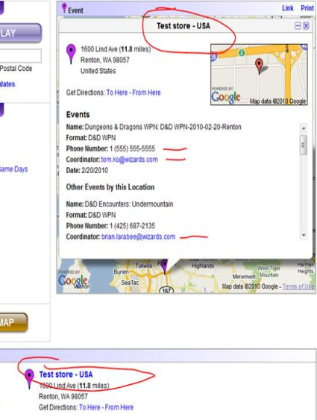
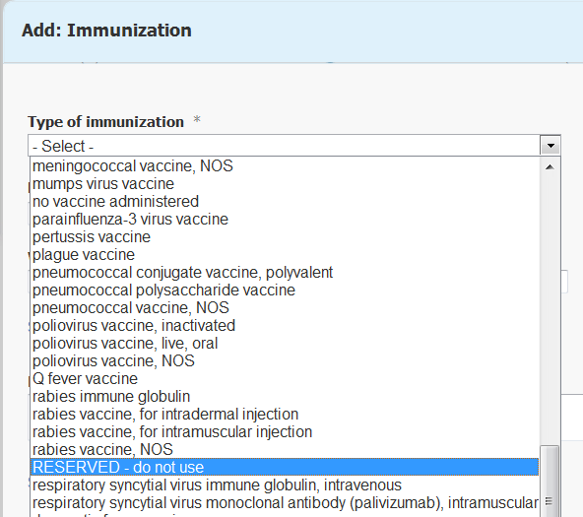
TiP is Not New (cont.)
But leveraging it as a legitimate Test Methodology may be new.
Later… many examples how we do this right
Notes:
Wizards of the Coast, MSFT Health Vault
TiP done badly – user visible, possibly impacting (buy an ASIN)

Slide 64
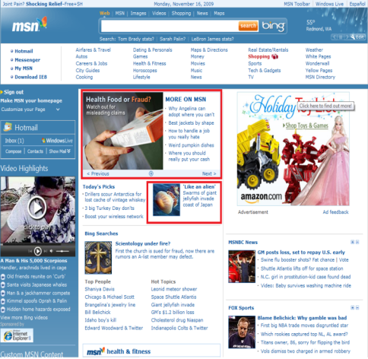
Example: Man vs. Machine
Goal: Increase Clicks on Page per User
HOPS = Headline Optimization System
Which has higher page clicks per user…???
Control - Editor Selected
Treatment – HOPS
Neither
Which has higher page clicks per user…???
Control - Editor Selected
Treatment – HOPS +2.8%
Neither
Research reveals
how to meet customer needs
Notes:
in US, Dec 2009
HOPS = Headline Optimization Service
HOPS automatically selected and ranked the headlines with highest number of clicks
Experiment was run before new MSN launch

Slide 65
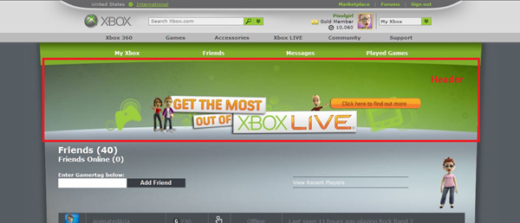
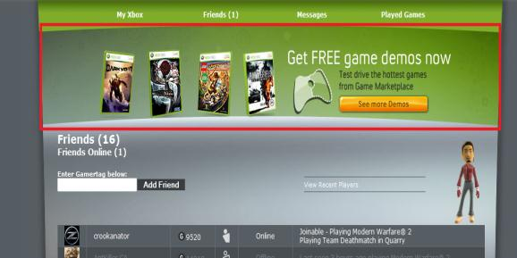
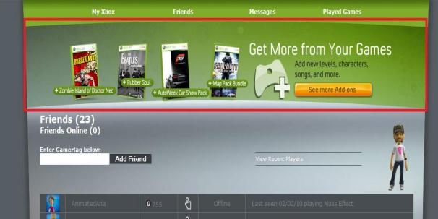
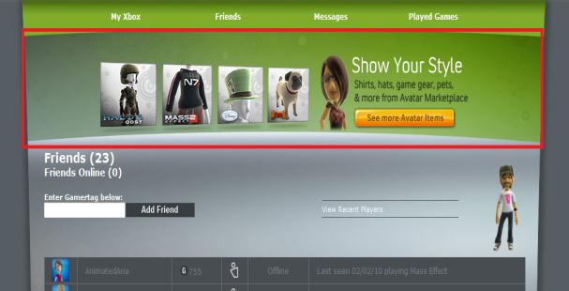
Example: Microsoft Xbox Marketplace
Goal: Increase Total Points Spent per User
A
http://marketplace.xbox.com/en-US
Which has higher Points Spent…???
Control
T1: Game Add-Ons
T2: Game Demo
T3: Avatar Gear
None
Which has higher Points Spent…???
Control
T1: Game Add-Ons
T2: Game Demo
T3: Avatar Gear
None
Promoted content up,
but at expense of others
B
C
D
Notes:
Each Treatment increased purchases of content promoted,
but cannibalized others
promoting products whose expected value is high
personalization
Control promoted Xbox live

Slide 66
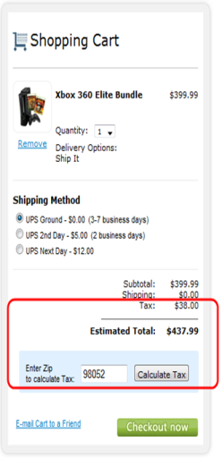
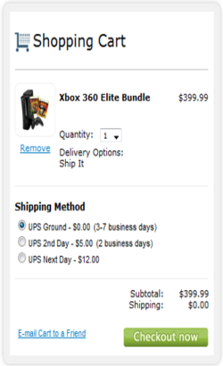
Example: Microsoft Store
Goal: Increase Average Revenue per User
A
B
http://store.microsoft.com/home.aspx
Which increased revenue…?
Control
Treatment
Neither
Which increased revenue…?
Control
Treatment – up 3.3%
Neither
Notes:
Website/UX
July 2009
Defer Tax calculation

Slide 67

Example: Google Talk
Use an “Experimentation Framework”
Limit launch to
  Explicit People
  Just Googlers
  Percent of all users
Not just features, but it could be a new caching scheme
[Google Talk, June 2007 @ 20:35]
Notes:
biased populations – OK for TiP, careful about your metrics

Slide 68
Example: Google Talk Shadowing
Google Talk Server provides Presence Status
  Billions of packets per day
Orkut integration
  Started fetching presence without showing anything in UI for weeks before launch
  Ramp-up slowly from 1% of Orkut PVs
GMail chat integration:
  Users logged in/out: used this data to trigger presence status changes w/o showing anything on the UI
[Google Talk, June 2007 @ 9:00]
Notes:
Server failures, wrong values

Slide 69
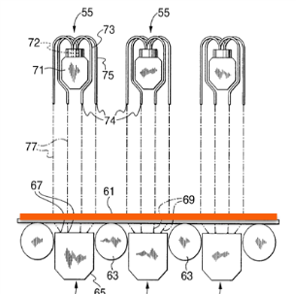
Example: USS Cooling System Shadowing
Based on steel alloy, input speed and temperature, determine number of laminar flows needed to hit target temperature.
System A: A Human Operator
System B: An Adaptive Automation
B has no control, just learn until matches operator.
Notes:
If Operator is wrong (rarely) throw out data.
“no control” = no control over the laminar flows

