Slide 1



Indistinguishable from magic
How cloud services,
      big data,
        and mobile
…enable software success and customer delight
Seth Eliot
Principal Knowledge Engineer, Engineering Excellence
September 11, 2014
Presentation to

Slide 2




About Seth
Digital media services
A/B testing of services
Big-Data processing platform
Quality
Cloud Services
Data-Driven Engineering
Notes:
Take-away: I have been working with services and how we use data for software quality for a while.

Slide 3

Any sufficiently advanced technology is indistinguishable from magic.
(umulig å skille fra magi)
Arthur C. Clarke
Notes:
Explain the title
This is really a talk about technology
So advanced that it is magic, and magic delights our customers
Tie forward to check cashing story
Once upon a time…. Wait in line
Then ATM – my first ATM <click>
Now mobile check cashing <click>

Slide 4
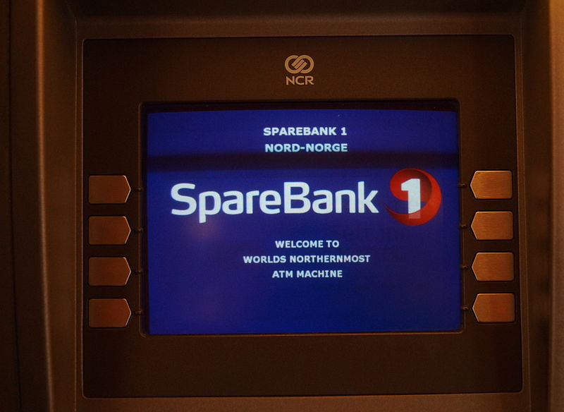
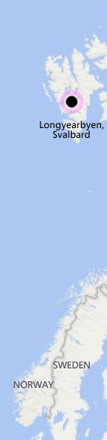
Notes:
located in the post office at Longyearbyen
Consumer facing technology a key part of user experience retail banking -- I still remember the first time I used an ATM, my Freshman year at college - it immediately became an integral part of my life -- It was how I obtained my parents money to spend on school supplied…and beer and pizza
It was how I chose my bank in a new city - and I stayed (loyalty) with that bank for 20 years until I left

Slide 5
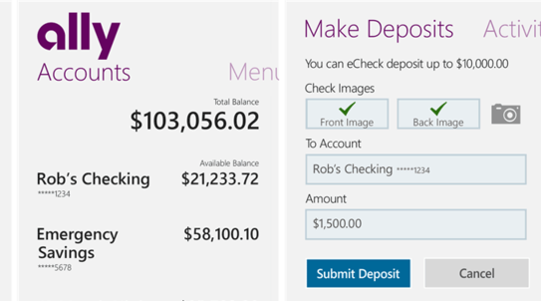
Notes:
Mobile check caching is awesome - it is magic
Customers have expressed that this is a differentiator
My bank offers this on MY phone - so I am loyal
The SERVICE of the ATM now MOBILE
My wife is suspicious of this new technology - I assured her it was safe -- we even keep the check!
She finally tried it
Did not take the photo correctly and worried for 3 days if it worked
Using DATA mining
could the bank have identified her as a first time user?
Could they detect a spike in her accessing her account / balance?
Based on this they could have provided superior service
Sent an assurance email
Given her an option to contact a rep
Had a rep contact her
To improve the experience
I am a happy customer, how do we make my wife one?
DATA is the key to bringing this magic to everyone

Slide 6
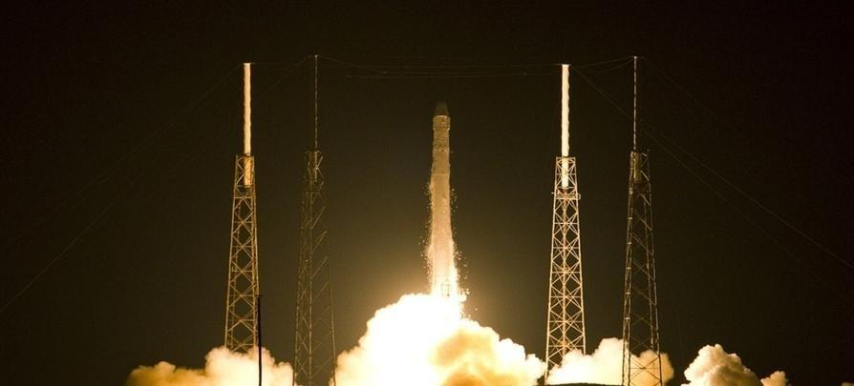
…what we take for granted today would seem like magic –
being able to talk to people over long distances,
to transmit images,
flying,
accessing vast amounts of data like an oracle.
These are all things that would have been considered magic a few hundred years ago.
Elon Musk
Notes:
Magic may seem a bit silly, but it is really a proxy for the IMPACT of technology
Elon identifies technologies/magics I want to talk to you about
Photo
SpaceX Falcon 9 Rocket Lifts Off From Cape Canaveral
http://www.rsvlts.com/2012/05/22/spacex-lifts-off-from-cape-canaveral-5-high-quality-photos/
SpaceX – Founded by Elon Musk

Slide 7






Three magics
Omnipresence
Cloud services
Each with their own powers
Data
110010
101110
000101
Mobile
Notes:
Will talk about three magics
(title probably tipped you off)
[CLICK] Services/Wand – Enable everything else
Data/Fairy dust(magic powder) – Lots of little bits come together to make something powerful; It’s everywhere
Mobile / Winged boots – Speedily brings the power wherever you want to go
Powerful in their own right
Combine for immense power → business value and customer success
Each
Each have their own powers, but one of these powers they all share
[CLICK] Omnipresence – they are everywhere, and growing

Slide 8
Cloud services
Magic 1

Slide 9


Cloud services
Software as a Service (SaaS)
End-users’ view of the cloud
Consumer or enterprise
Notes:
Cloud services include three tiers or layers
We will focus on the end-user services – SaaS
By end-user we mean both consumer (Outlook.com, OneDrive) and enterprise (O365, Sharepoint Online)
End-User = Service software consumer
- Consumer OR Business
As opposed to service provider which can use IaaS and PaaS

Slide 10

Omnipresence
It is everywhere
…and growing
Notes:
The first power, as it will be for all our magics, is Omnipresence

Slide 11












Many, many consumer services
Twitter
Xbox Live
Skype
OneDrive
bing
Yammer
Outlook.com
Notes:
It is obvious how cloud services have become part of our lives as consumers
But how about enterprise?

Slide 12
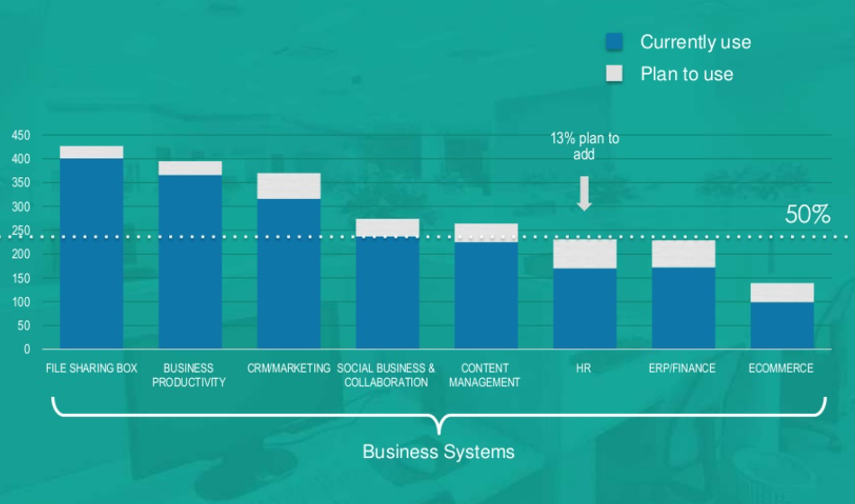
SaaS use and growth
Notes:
SaaS is being used by business
Can see which areas are being used
Which are used most
SaaS is growing
http://www.mjskok.com/resource/2013-future-cloud-computing-3rd-annual-survey-results
June 2013
Survey of 855 respondents
Plan to use = next 12 months
The 3rd Annual Future of Cloud Computing Survey, sponsored by North Bridge Venture Partners and GigaOM Research

Slide 13
“On tap”
Like a utility
  Self-service
  Reliable
  Low cost

Slide 14
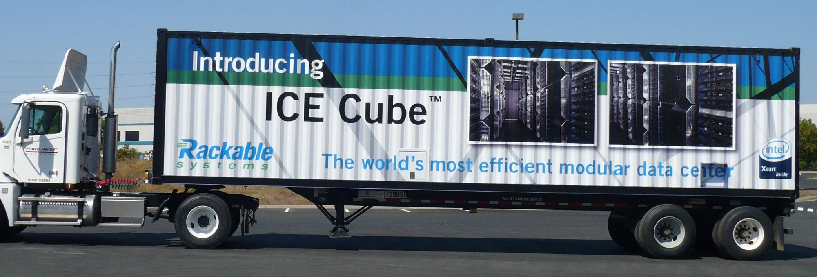
We run the datacenter for you
Hardware Power Security | Supply Chain Personnel
Notes:
Cargo Container Data Center

Slide 15
Economies of Scale
Larger datacenters have almost 50% lower Total Cost of Ownership (TCO) per server
MAIN DATA CENTER COST BUCKETS
ANNUAL TCO/SERVER DECLINES W/SCALE
Server hardware costs (~45% of total costs)
Facility & operations (~25%)
Hardware labor costs (~15%)
Power costs (~15%)
47% Savings
Notes:
Power Usage Effectiveness (PUE) for Data Center (PUE = Total power / IT equipment power – lower better, 1.0 = perfect)
Industry average 2.0
Microsoft Chicago:1.22
Microsoft Quincy 1.15 [Microsoft DC, 2011]

Slide 16
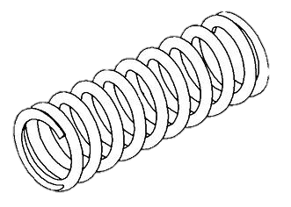
Elasticity
Use as much
…or as little
…as you need

Slide 17
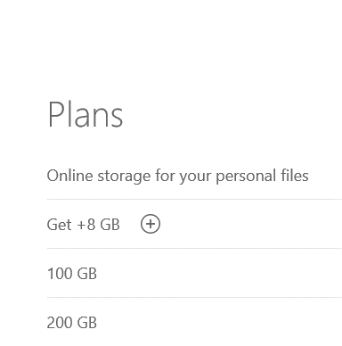
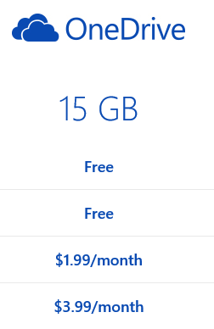
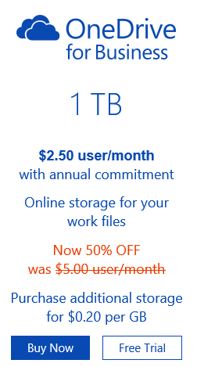
Scalable services…
Pay for what you need
Often a “freemium” model
Notes:
Freemium – start with basic free service and charge for additional value add

Slide 18
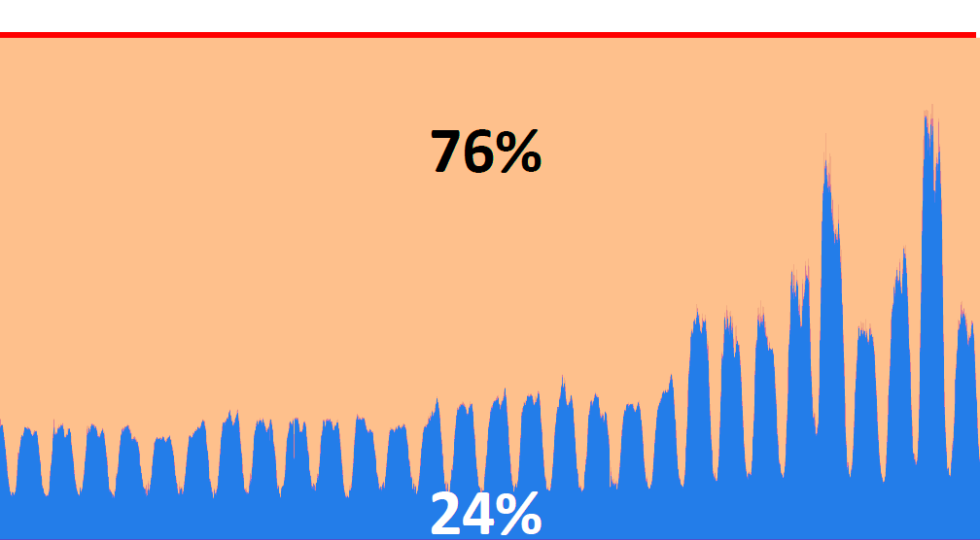

…provided in a scalable manner
Provisioned Servers (includes buffer)
Total Services Load
M Tu W Th F →
Notes:
Usage varies by time of day
Usage varies by time of year
Amazon.com is a service PROVIDER
Providing services using a traditional means unused capacity
Unused capacity is wasteful – higher COGS
Solution:
November 10th 2010 full migration to EC2
Reduced spending on server capacity
Fleet scales dynamically in increments as small as a single host
Traffic spikes handled with ease
Cultural change – aim for small server footprints
Source: Velocity 2011: Jon Jenkins, "Velocity Culture" , June 2011; http://www.youtube.com/watch?v=dxk8b9rSKOo

Slide 19

Continuous improvement
Unlock data
Deliver improvements

Slide 20


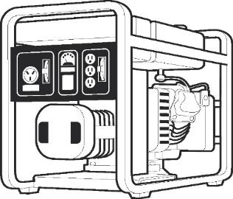

How services are different
“Box product” is like a…
Service is like a…
Power generator
Power utility
Who runs it? | Customer | Company
How monitored? | Sporadic customer contact | Continuous data
When updated? | Infrequent | Continuous
Notes:
Failure is certain in a service – how we minimize MTTR is what is important
Continuous Data + continuous updates enable this us to minimize MTTR
MTBF: runs a long time, we are not responsible for quick restoration of service, the customer is
MTTR: Failures will happen; what is important is how fast you can restore service to end users

Slide 21

Services enable continuous improvement using data
Deploy
Data
Improve
This is an iterative cycle.
Services can do this.
Other software can also

Slide 22
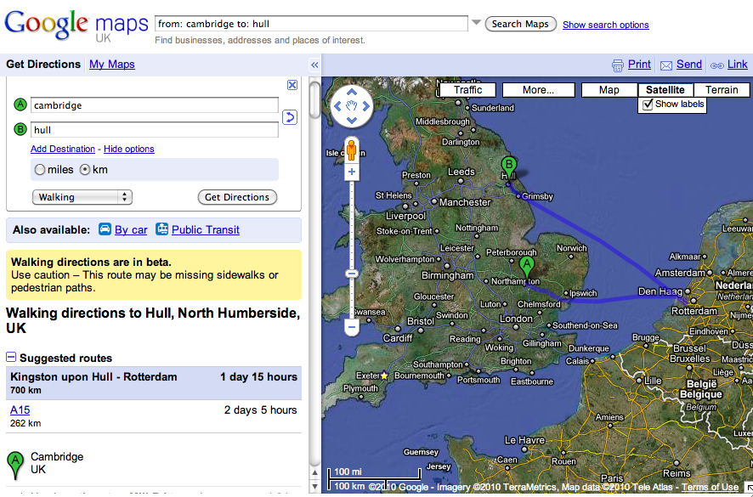
“Walking Directions”
This route may be missing sidewalks
Notes:
You cannot find this bug pre-prod
Would you test walking directions between A and B for every combination in the world?
It is trivial to find in production
With the Right telemetry
Google can know when this happens in Prod and report it
CLICK Google knows that this route may be missing sidewalks!
Remember: only in production do you find:
The true diversity of Real users and usage
The true complexity of the production environment
-----------------------------------------
“Find this with a unit Test…” – James Whittaker - http://www.youtube.com/watch?v=cqwXUTjcabs&feature=BF&list=PL1242F05D3EA83AB1&index=16

Slide 23
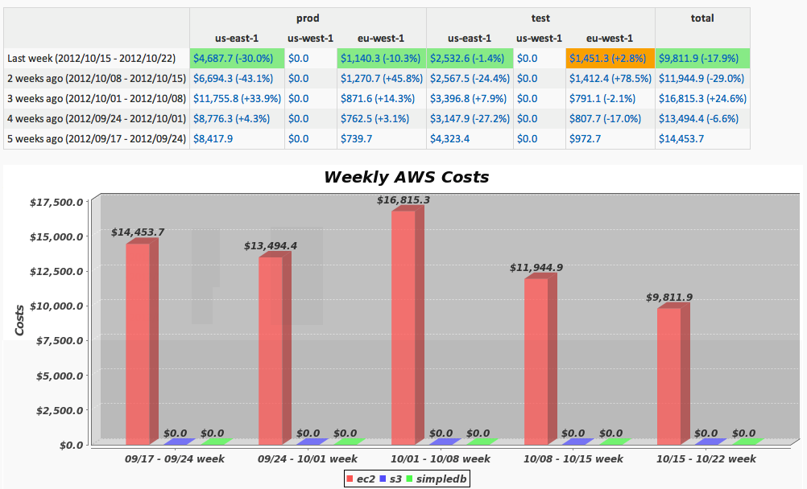
“…a lot of times the teams are not really aware of the cost run-ups“
Coburn Watson, Cloud Performance Engineering, Netflix
Netflix uses innovative means to surface cloud costs
Notes:
Direct impact on COGS
Low cost passed on to users → customer satisfaction
Weekly email to service owners – 4-week cost trend on EC2, S3, and SimpleDB
Optimizing Costs with AWS, Coburn Watson, AWS Invent, Nov 2012
http://youtu.be/iKg0CJt4JPQ
http://www.slideshare.net/cpwatson/aws-reinvent-optimizing-costs-with-aws

Slide 24



Magic
Powers
Cloud services
Powers
Omnipresence
“On tap”
Elasticity
Continuous improvement

Slide 25
Data
Magic 2
110010
101110
000101

Slide 26
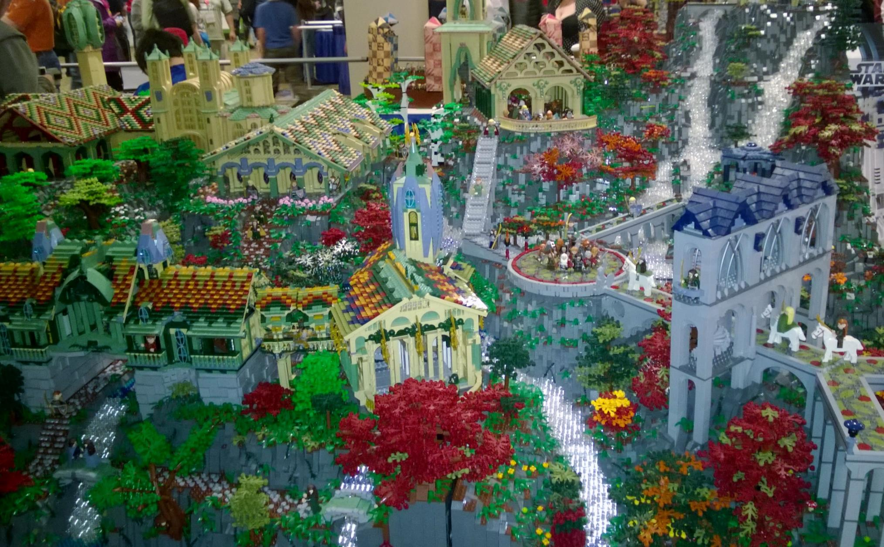
Notes:
Lego Rivendell (photo by Seth Eliot at 2014 Emerald City Comicon)
More than 50,000 pieces
A masterpiece created from simply components (lego bricks)
The Answers you seek about quality from various bits of data combined
Lego Bricks are at once simple, but also widely varied (color, shape size)
Similarly data are often simply numerical quantities, but widely varied as to what they represent: counts of errors, measures of time, percent failures, customer sentiment
But the execution of the plan is not always prescriptive, and requires human perception: art and science

Slide 27
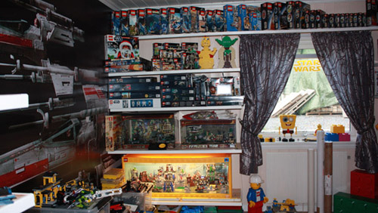
Guinness world record
Largest collection of Star Wars Lego
Jon Jessesen, Vika, Norway
Notes:
(just for fun)
Star Wars LEGOs have proven wildly popular, to the point that the largest collection of Star Wars interlocking plastic brick sets consists of 272 sets, as of Sept. 18, 2012, and belongs to Jon Jessesen (Norway) in Vika, Norway. The sets total 119,368 individual pieces.
http://www.guinnessworldrecords.com/news/2014/2/ten-records-to-get-you-ready-for-the-lego-movie-54833/

Slide 28

Omnipresence
Almost everything emits data
…and it’s growing
Notes:
The first power, as it will be for all our magics, is Omnipresence

Slide 29
Internet of MANY things
(predicted)
Notes:
There are a lot of device out there
Most are mobile
Just b/c it is connected does not mean it emits data, but it CAN
Connected Devices
2003: http://www.infoworld.com/t/platforms/forrester-ceo-web-services-next-it-storm-873
2012: http://www.forbes.com/sites/quora/2013/01/07/how-many-things-are-currently-connected-to-the-internet-of-things-iot/
2020: Ericsson estimated 50 Billion connected devices world wide by 2020 http://www.slideshare.net/EricssonFrance/vision-2020-50-billion-connected-devices-ericsson?WT.mc_id=Blog_MachLearn_General_DI

Slide 30
All the data in the world
2011
1.8 ZB
1 ZB= 1 trillion GB
2009
0.5 ZB
Notes:
2009: `Richard Wray (2009-05-18). "Internet data heads for 500bn gigabytes". The Guardian. http://www.guardian.co.uk/business/2009/may/18/digital-content-expansion.
2011: http://www.emc.com/collateral/analyst-reports/idc-extracting-value-from-chaos-ar.pdf
2006 = 0.2 ZB

Slide 31

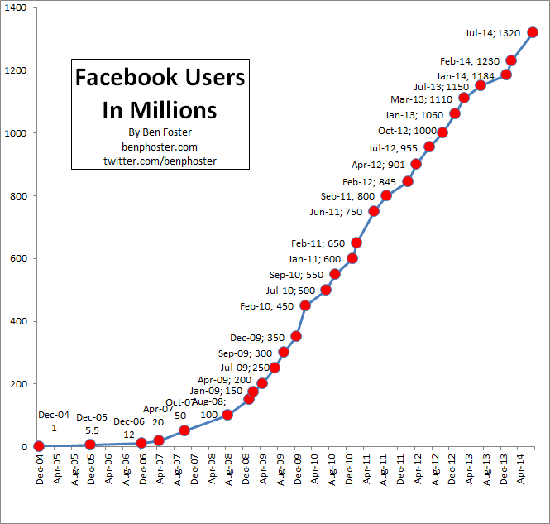



Social: data plus services
June 2014
1.32B monthly active users
81% on mobile
350 million photos daily
Notes:
You do not have social networks without
User data
Services where users can share that data
This also ties into mobile
- Most pictures from mobile
Data:
http://newsroom.fb.com/Company-Info/
http://newsroom.fb.com/Products/
Graph: http://www.benphoster.com/facebook-user-growth-chart-2004-2010/
3.2 billion Likes and Comments per day (March 2012)

Slide 32

Unlock secrets
Gain insights from the past and present

Slide 33
Ctrl-t a b
Notes:
In VS Ctrl-T transposes 2 characters
Wanted to re-purpose ctrl-T, so use the data to see how often it is used (Will it be missed)
It is used often!
But…..
What follows most of the time is ctrl-T (transpose again) or ctrl-Z (undo) – which undoes the action
Many users used it – few actually did so on purpose

Slide 34
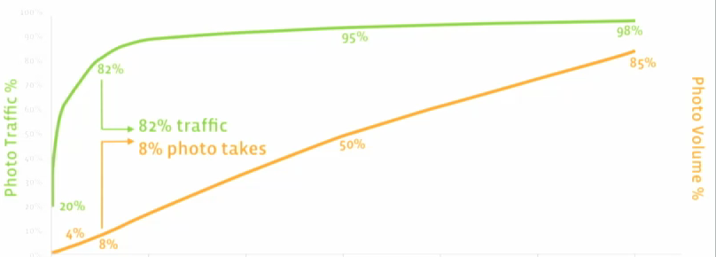

← Newer photos Photo Age Older photos →
Measure
82% of traffic is focused on 8% of newest photos
Results
  Reduced cost of cold storage rack to 1/3rd of traditional rack
  Reduced cost of new datacenter to 1/5th of a traditional datacenter
  270W of energy saved per sq. ft
Improve
Designed new datacenters and software to manage new photo storage categories – hot, warm, cold
Notes:
how the service provider uses the data to improve the service
Most reads (traffic) is on newer photos
82% of reads for the newest 8% of photos
Source: Facebook, Jay Parikh Presentation at Open Compute Summit Winter 2013, Wired, Data Center Knowledge, Accenture analysis
http://new.livestream.com/ocp/winter2013/videos/9502681

Slide 35
A/B Testing
Controlled experimentation
“It was very humbling to see how bad we were at predicting which features are going to work with users or not”.
- Ronny Kohavi, GM, Bing
Notes:
Kohavi quote: http://www.exp-platform.com/Pages/2012RecSys.aspx

Slide 36
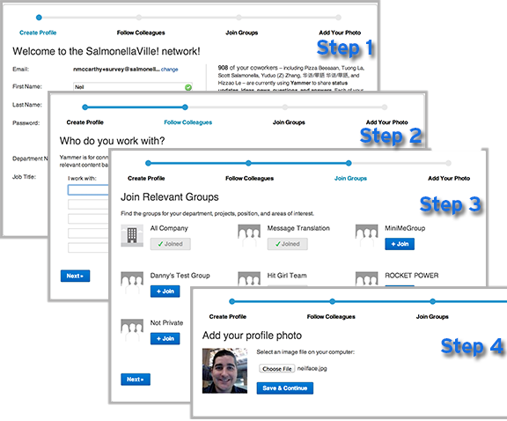
A/B Testing
What happens to new user retention when you shorten the signup flow?
It goes down!
Don’t ship that feature
Notes:
Data unlocks secrets that often counter preconceived notions
Shorter signup makes it easier to signup
But experiment showed user retention went down.
Can “guess” why (less committed), but all you really have is the result data
Source: https://medium.com/yammer-product/13eeb6435a73

Slide 37

Predicts future
Predictive analytics
Machine Learning

Slide 38

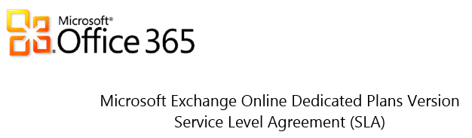
EXO prioritizes availability
Monthly Uptime Percentage | Service Credit
< 99.9% | 25%
< 99% | 50%
< 95% | 100%
“Downtime” is defined as any period of time when users are unable to send or receive email via all supported mailbox access
Notes:
Exchange cares about uptime
They have a direct financial commitment tied to it
http://download.microsoft.com/download/0/4/0/04054360-DC5E-4AB8-B3AB-6BF01BB3946C/Exchange%20Online%20SLA_Office%20365%20Dedicated%20Plans_Oct%202012.docx

Slide 39
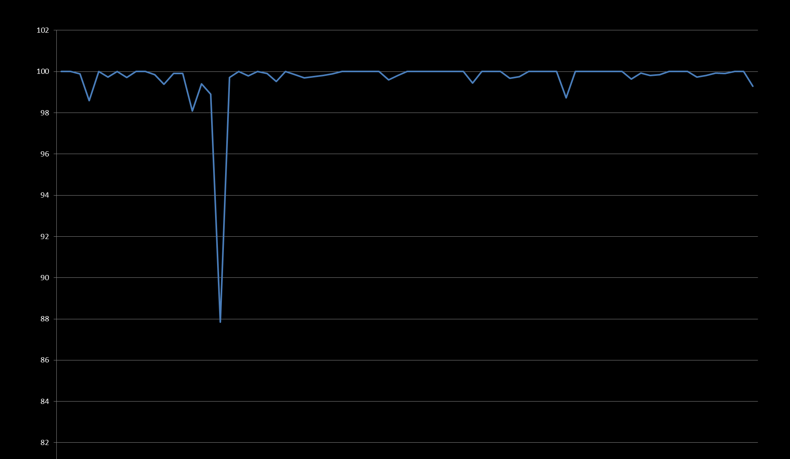

Availability
Exchange Online availability
Predict
dips 24 hours ahead of time
Time

Slide 40
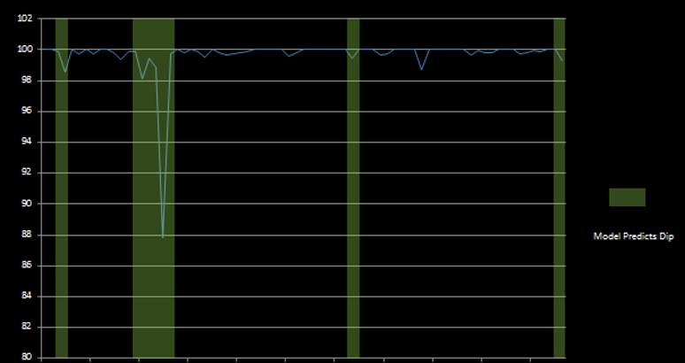
Availability
Exchange Online availability
Predict 75% of dips 24 hours ahead of time
Time
Notes:
Microsoft Exchange Online
Availability Big Data from
Over 8000 Servers instrumented
…to collect 1000 Metrics
- This is passive (analytic) application logging used in a proprietary formula to calculate availability
Machine Learning – It’s about fitting your data to a model
Think about simple linear regression y=mx + b, it is like that but can get much more advanced
ML Model considered past failure and also latency
Increasing trend in latency indicative of possible future failure

Slide 41
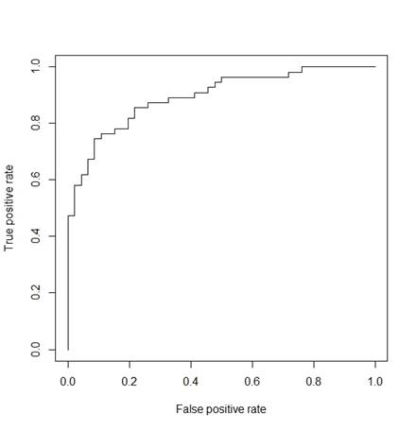
Predict data center failures
SMART data used to predict disk failures
(Self-Monitoring, Analysis and Reporting Technology)
60%
5%
Notes:
SMART data has been around for a while (2004 as a specification)
The Azure cloud leverages commodity hardware to support a profitable business model.
Azure Fabric has to be fault tolerant to provide a robust customer experience
Note highlight
We are able to predict 60% of drives that will actually fail with only 5% “good” drives falsely tagged
WE can predeict 40% of the drive failures with almost no false positives

Slide 42


Any size
Big data
…or little data
Notes:
We have seen several big-data examples already
Lets define big data
Then see some little data examples

Slide 43
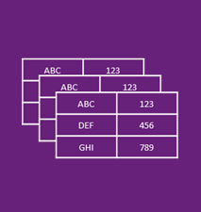
What is Big Data?
Volume
MB ⇨ GB ⇨ TB
Velocity
PB ⇨ EB ⇨ ZB
Variety
Value
ABC | 123
DEF | 456
GHI | 789
ABC | 123
DEF | 456
GHI | 789
ABC | 123
DEF | 456
GHI | 789
Notes:
So while not all of our Data magic needs to be Big Data, it is worthwhile understanding what Big Data Is
3 V’s
Volume
Velocity
Variety
4th V – Value – what’s the value? Insight → Customer delight
------------------------------------------
Ultimately it is about Big Insights
- Again Hubbard: When you have high uncertainty, you need very little data to make an impactful reduction in it.
3 V’s - http://radar.oreilly.com/2012/01/what-is-big-data.html
Volume
Cannot be handled by conventional RDBMS
Velocity
everything’s instrumented
Speed of feedback is important
IBM: The Road: could you cross a busy road with just a snapshot (not live data)? http://vimeo.com/20718357
Variety
Structured: DB
Unstructured: Tweets
How about XML? One good rule of thumb is if the data structure (or lack thereof) is not sufficient for the processing task at hand, then it is unstructured.

Slide 44
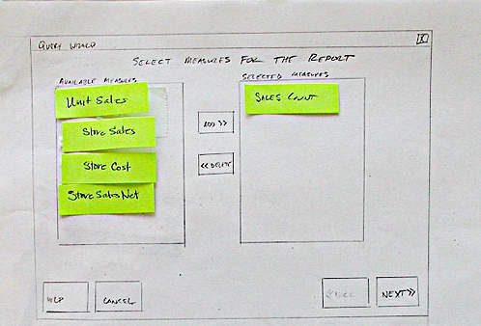
Little data is powerful also
User research
  Relatively small data set
  Fail Fast or…
  Double-Down
Notes:
“Cheap” prototypes enable us to get data and iterate
This is also a form of measurement
Fail-Fast on bad ideas
Double-Down on good ones

Slide 45

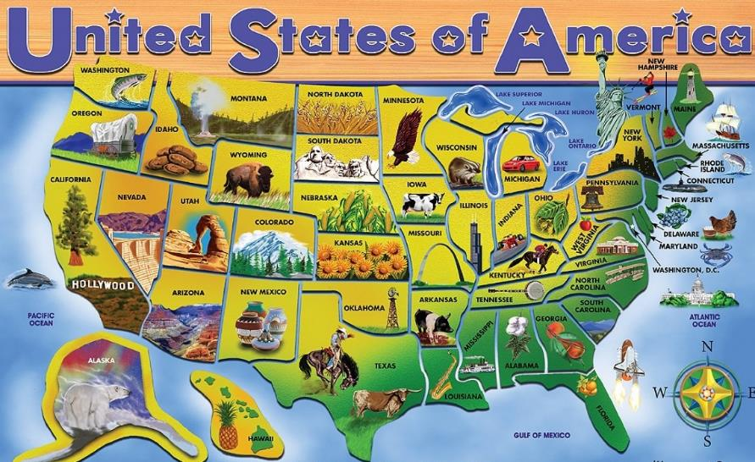
How Gilles spent his vacation
Kindle First Gen
2007

Slide 46
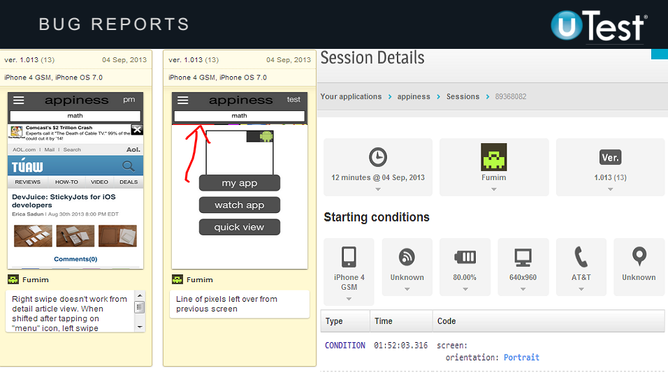
Notes:
uTest expands this into bigger data
1000s of crowd-sourced testers in the field
Automated screen shot and environment data collection from devices

Slide 47
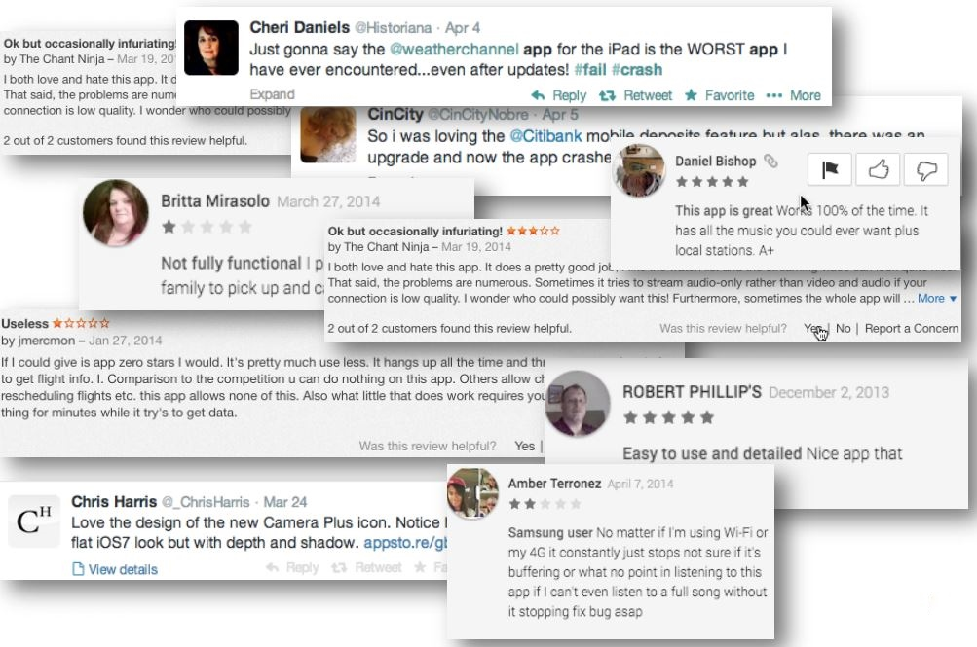
Notes:
Not just testers
Users voluntarily provide us with lots of data
These are reviews for mobile apps
http://applause.com
http://www.applause.com/mobile-analytics

Slide 48
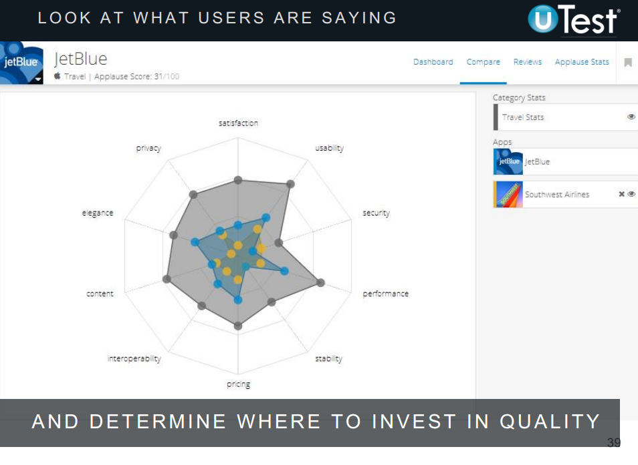
Notes:
The question is, how do we make use of it?
Here Natural language processing and clustering is provided to give actionable information on app quality
JetBlue beats Southwest on Satisfaction and Pricing
But still has some work to so on (perceived) security
http://applause.com
http://www.applause.com/mobile-analytics

Slide 49
Magic
Powers
Data
Powers
110010
101110
000101
Omnipresence
Unlock secrets
Predicts future
Any size

Slide 50
Mobile
Magic 3

Slide 51

Mobile is a force multiplier
Services goes with the user
Data goes with the user
….wherever they go
Notes:
“force multiplier” –dramatically increases effectiveness
Services in your pocket
One of the world’s two indices of all knowledge, in your pocket

Slide 52
Omnipresence
The purpose of mobile…
Notes:
The purpose of mobile is to be able to go anywhere

Slide 53
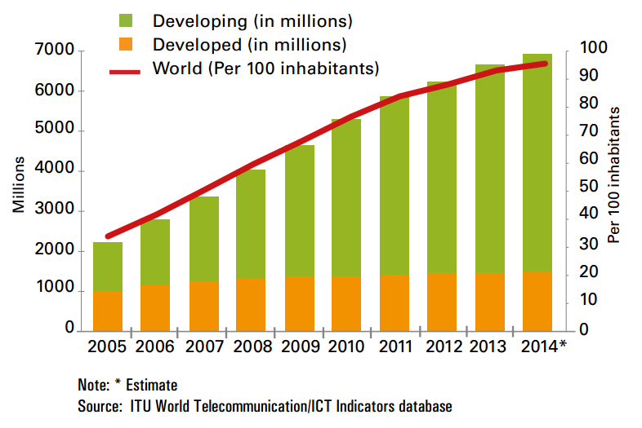
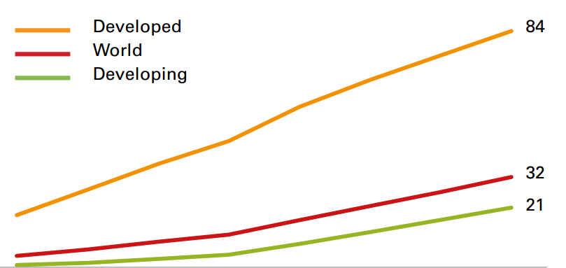
Mobile subscriptions worldwide
Cellular
Broadband
Notes:
There are a lot of device out there
There are also WiFi mobile devices in addition to above (World: 32 per 1000 inhabitants; Developed world: 84 per 100)
The IoT adds many more devices – even if not mobile then distributed
Source:
http://www.itu.int/en/ITU-D/Statistics/Documents/facts/ICTFactsFigures2014-e.pdf
2011: 5.9 billion; 2012: 6.2 billion; 2013: 6.7 billion; 2014: 6.9 billion.

Slide 54
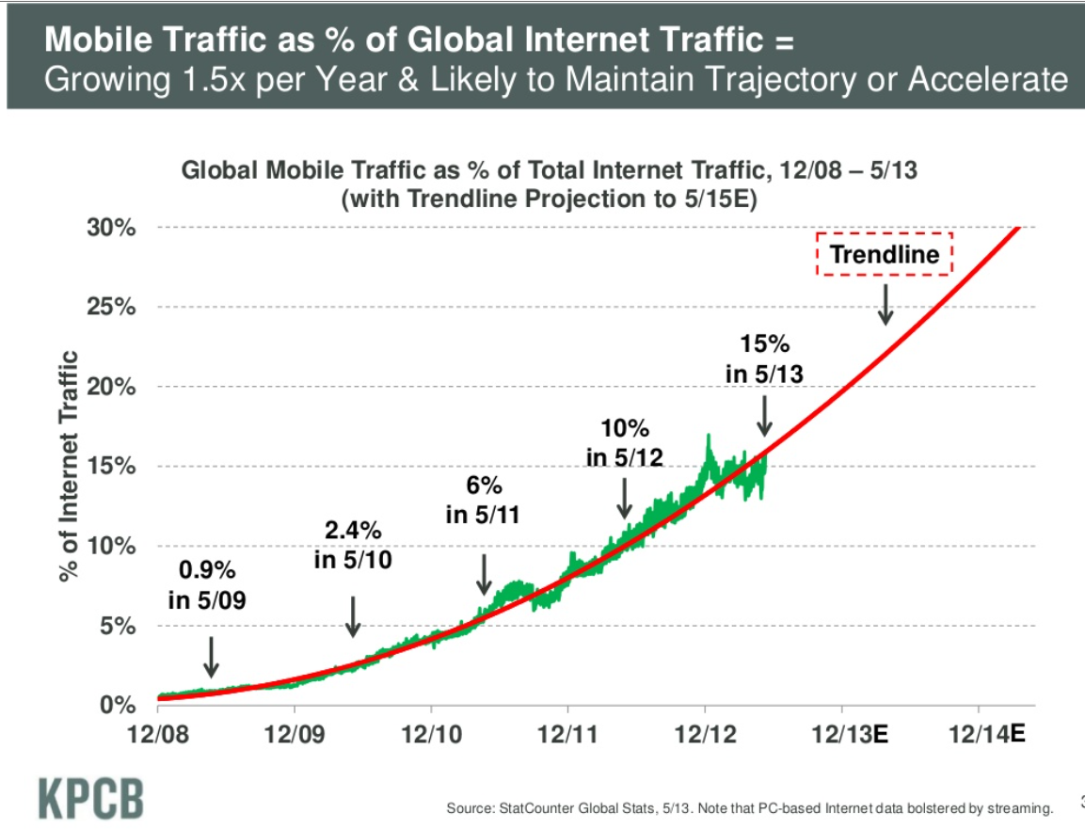

It’s about the mobile data
Notes:
Again those does not include WiFi enabled mobile devices
2013 Internet Trends
Source: http://www.slideshare.net/kleinerperkins/kpcb-internet-trends-2013

Slide 55
Sees all
Crowd-source data to improve users’ experiences
Notes:
Although users are becoming more accepting
Privacy still needs to be addressed
That is outside the scope of this talk

Slide 56

Data from users
Win-win sharing
Social
Wisdom of crowds
Notes:
From Users

Slide 57
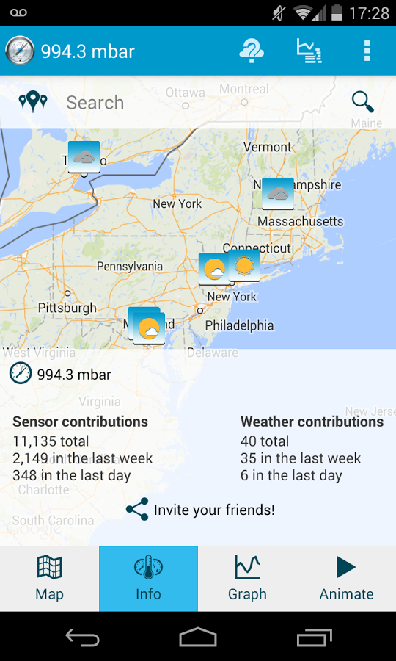
Data from sensors
Crowd sourced weather
  Humidity
  Pressure
  Temperature
  GPS
Plus user submitted observations
Notes:
From Sensors.
The COMBINATION (Sensors + users) is powerful
https://play.google.com/store/apps/details?id=ca.cumulonimbus.barometernetwork
http://developer.android.com/guide/topics/sensors/sensors_environment.html

Slide 58

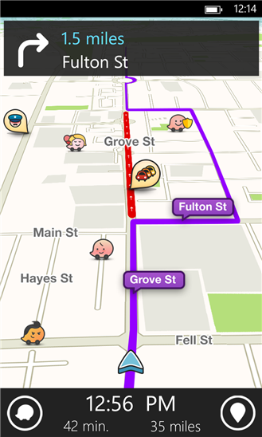
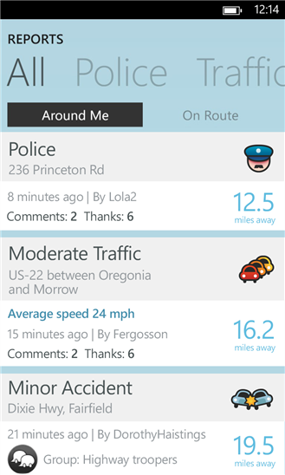
Power of crowd-sourced data
Waze
Outsmarting traffic, together
48MM Users
1B+ Miles Driven per Month
Notes:
Perhaps more directly user impacting than weather
https://www.waze.com/
Combination of user contributed data
Plus sensor (GPS) data

Slide 59
Tells all
Mobile taps into the world of information

Slide 60
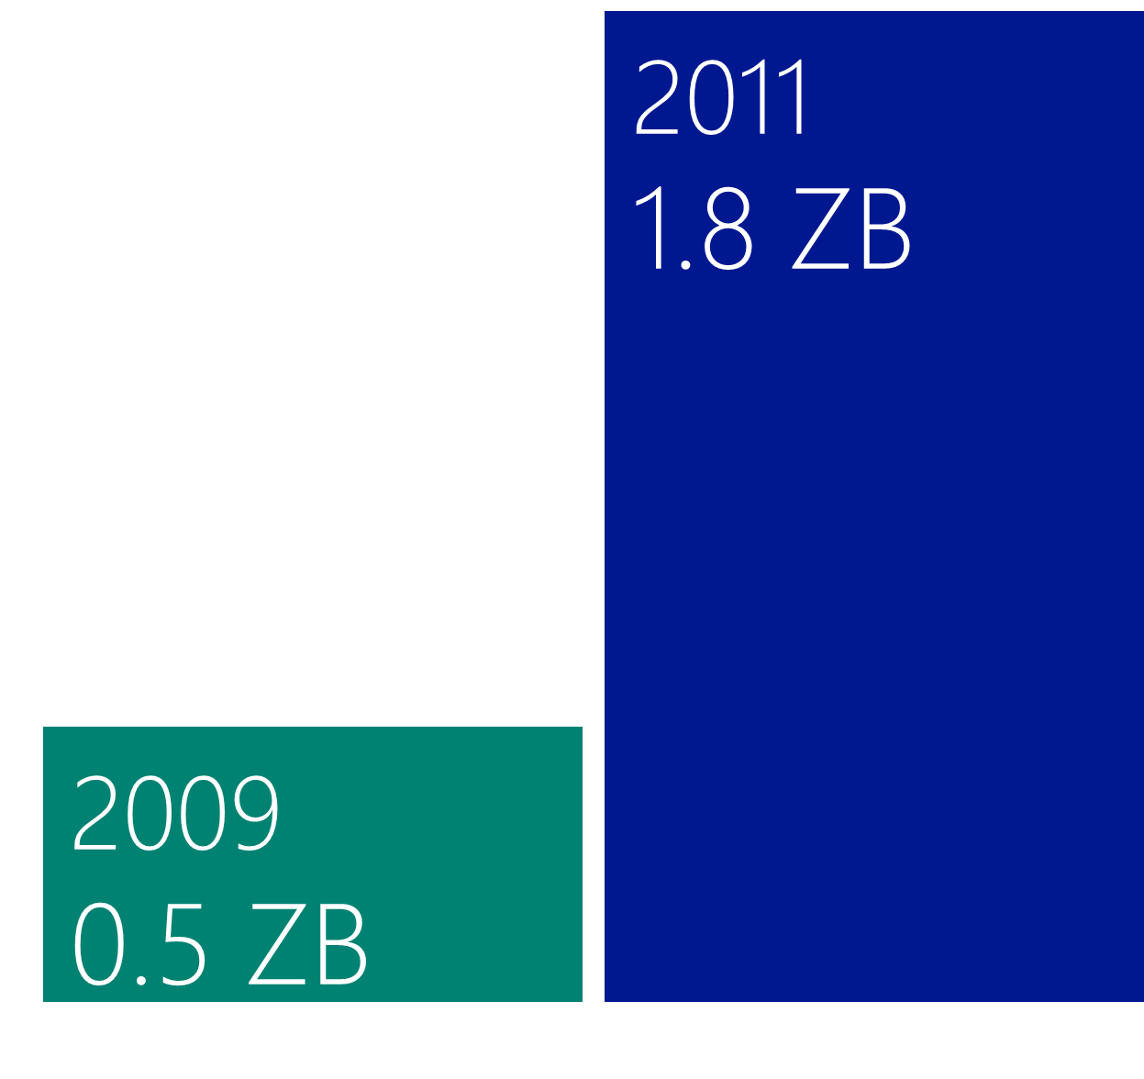


Data from the web
Via search engines
bing
and their APIs

Slide 61
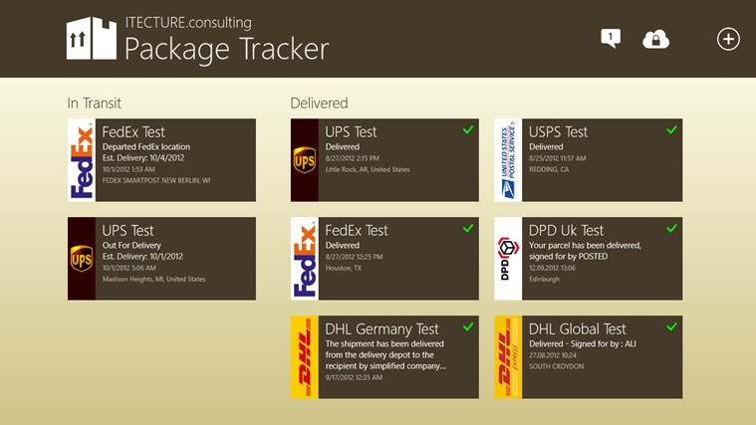
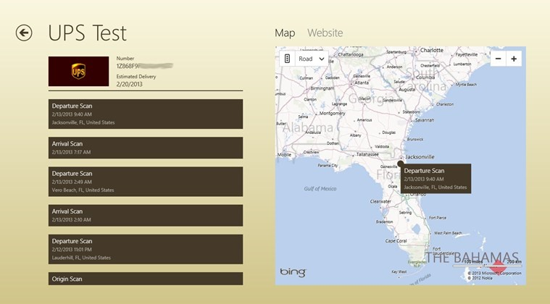



Bing indexes the world
Apps put that in our pockets
Notes:
Perhaps a bit prosaic,
But this app can appeal to business as well as retail users
Note: it is actual a tablet (Win 8) app

Slide 62

Magic
Powers
Mobile
Powers
Omnipresence
Sees all
Tells all

Slide 63

Three technologies indistinguishable from magic
Mobile
Cloud services
Each with their own powers
Combined to greater power
Data
110010
101110
000101
Notes:
Will talked about three magics
All Omnipresent
The magic of data is insight, about the past and about the future
Data is enabled by Cloud Services – Magically on tap and elastic, allowing continuous improvement
And Services and Data are brought to the user, wherever they go by Mobile – which sees all and tells all

Slide 64
Indistinguishable from magic
Thank you!
How cloud services,
      big data,
        and mobile
…enable software success and customer delight

