Slide 1
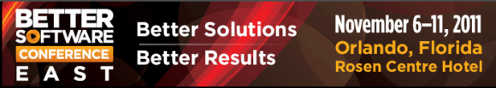
Leaping into “The Cloud”
Rewards, Risks, and Mitigations
Ken Johnston, Principal Test Manager, Bing
Seth Eliot, Senior Knowledge Eng., Test Excellence
Better Software East – November 9, 2011
Notes:
2.0 – 21 Sept - Consolidation of Ken and Seth’s work, added intro. Re-worked Risks and Mitigations
2.1 – 22 Sept – moved cost slides to “Getting into the Cloud”
*** Submitted for BSC East CD
2.2 – 27 Sept – added [Google Cluster, 2008] citation; Corrected Netflix Simian Army citation; Clarify Microsoft Exchange example
3.0 – 09 Oct – Seth’s changes from Sept 30 Review
3.1 – 20 Oct – Ken’s additions + Changes from 20 Oct review and walk-through
3.2 – 20 Oct – Seth action items from 20 Oct review
5.0 – 9 Nov – Ken addition of TOA, other edits
5.1 – 9 Nov – Seth stye cleanup, minor edits. Added “How Does The Cloud Help?” transition slide

Slide 2

About Us
Seth
Microsoft Engineering Excellence: Best practices for services and cloud
Bing: Massive, distributed, data processing service
Microsoft ExP: Data Driven Decision Making
Amazon.com: Video, Music, and Kindle eBook services
Ken
Principal Test Manager Bing
Office 2010, MSN, Hosted Exchange
Director of Test Excellence

Slide 3

What Do You Know?
Just beginning with cloud
Who has a major project coming up
Who has already implemented a cloud service
Anything ever gone wrong

Slide 4

Introduction
About Clouds
Cloud Rewards
Getting Into The Cloud
5 Amazing Cloud Case Studies
  Rewards, Risks & Mitigations
Testing in The Cloud
The latest version of this slide deck can be found at:
http://www.setheliot.com/blog/bsc-east-2011/

Slide 5
About Clouds

Slide 6

The Cloud in Three Steps
Standardized IT capability or service
  No customizing for each customer
  Economies of Scale - rote, repeatability
Pay Per Use
  The power of zero
Self-Service Deployment
  Fully Automated
[Staten, 2010]
Notes:
Utilities analogy
Explain References convention here
Power of zero may be diminished for SaaS and LT contracts

Slide 7

The Cloud’s
Secret Sauce
Virtualization
Elasticity
Happiness
Power
Notes:
Virtualization: enables abstraction of stuff you do not want to worry about
message is being able to slice and dice arbitrarily and abstract away underlying infrastructure
Elasticity: The Power of Zero – no use = no cost
- Not just cost, but tap into POWER on demand

Slide 8



Three Layers of of Clouds
Cloud Category | The Cloud handles... | Examples
Cirrus | 16,500 to 40,000 ft
Altocumulus | 6,500 to 23,000 ft.
Cumulus | Surface to 10,000 ft
Notes:
Builds with next slide
Cirrus & Altocumulus photo credit: http://en.wikipedia.org/wiki/List_of_cloud_types
Cumulus = XP background ☺

Slide 9
Three Layers of of Clouds
Cloud Category | The Cloud handles... | Examples
SaaS: Software | e.g., Office Application Functionality | Microsoft Office Web Apps Google Docs
PaaS: Platform | Relational Database Management Systems | Microsoft SQL Azure Amazon RDS
 | Frameworks and Runtimes | Microsoft Windows Azure - .NET Google App Engine – Java, Python
 | Messaging Queue | Microsoft Azure Queue Amazon SQS
IaaS: Infrastructure | Servers | Amazon EC2 - Linux, Windows Rackspace Cloud Servers - Linux
 | Storage | Amazon S3 / SDB - BLOB / Table Microsoft Windows Azure Storage
 | CDN | Windows Azure CDN Amazon CloudFront
 | Network | Amazon Virtual Private Cloud
XaaS = …as a Service
Notes:
It’s a STACK
Start with SaaS – easiest to relate: Gmail, Office web apps. Hosted Exchange
Then IaaS – best physical/virtual analog
Then PaaS
Use Key examples that we can refer back to throughout the presentation
Not a clear delineation
Servers (IaaS) have OS (PaaS)
CDN and Table storage (IaaS) are more then just ‘I’, the include software (P)
SquareSpace is hosting (PaaS) plus tools (SaaS)

Slide 10
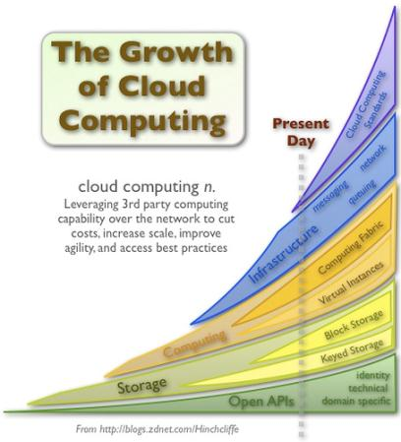
Are Clouds for Real?
Unparalleled Market Growth
Massive Adoption [R&M, 2010]
  Global cloud computing to grow from $37.8 billion 2010 to $121.1 billion in 2015
  CAGR of 26.2% from 2010 to 2015.
  Annual US Federal cloud computing spending to hit $7 billion landmark by 2015
  CAGR: Compound Annual Growth Rate
[Hinchcliffe, 2009]

Slide 11
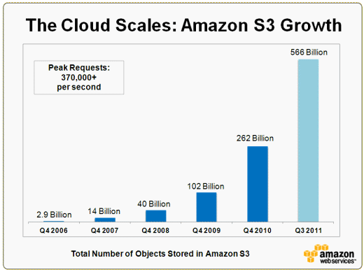










Really? Are Clouds for Real?
Massive Investments
  Cloud To Command 90% of Microsoft's R&D Budget [Forbes, 2011]
    ~8.6 Billion in 2011
Amazing Growth
  [Amazon Growth, 2011]
Steep competition
  90 Cloud Computing Companies to Watch in 2011 [CCJ, 2011]
Notes:
Amazon doubles objects stored in 9 mos
Many names you’ll recognize and some you wont

Slide 12
Cloud Rewards
The Promise of the Cloud

Slide 13


Promises, Promises…
The Cloud Makes Many Promises
You are Empowered to Leverage These
You Have an active role
Cloud Promise + Your Actions = Rewards
Notes:
Responsibilities and Rights respectively
Their Promise + Your Design = Reward

Slide 14


Rewards, A 40,000 ft. View
On demand capacity | Elasticity
Lower Cost | The Cloud is your data center
Disaster Recovery | Backups
Fault tolerance | Redundancy
Ease of management | Automation and APIs
Rewards Guaranteed | Don’t rely on SLA
Easy Integration | Many Services - One Provider
Notes:
Elastic Scalability – fundamental advantage. Already mentioned, reinforce here
The Cloud makes a lot of promises
But you need to take actions to take advantage of them

Slide 15
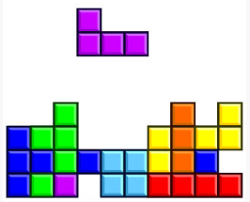
Lower Cost -
The Cloud is your data center
Lower Cost…
Asset Utilization
  Data center server utilization averages 5%-20% [Berkeley 2009]
Hardware Costs
  Data center performance - only increases with additional investment.
Power Efficiency
  Power Usage Effectiveness (PUE) for Data Center
  Industry average 2.0
  Microsoft Chicago:1.22
  Microsoft Quincy 1.15 [Microsoft DC, 2011]
Continued….
Notes:
PUE = Total power / IT equipment power – lower better, 1 = perfect

Slide 16
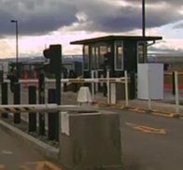

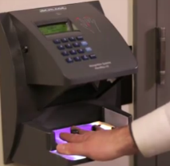
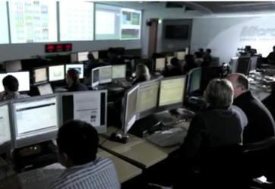
Lower Cost - The Cloud is your data center (cont)
Security
  Network security devices
  Security software licenses
  Staffing
  Regulatory compliance
  Physical security requirements
Supply Chain Management
  Ordering servers and components costs money and time
Personnel
  Operating data centers
  Scaling and managing physical growth
Notes:
Hassle of running your own DC – cover 3 points and out
Pictures are all from Microsoft Data Centers

Slide 17

Disaster Recovery & Fault Tolerance
Service Robustness Enabled by The Cloud
Multiple, smaller servers for Redundancy
Handle load spikes via Elastic Scalability
Backups leverage IaaS storage
Use the tools via API – Automate
But how about when clouds turn stormy?
Notes:
Smaller servers - power of abstraction

Slide 18
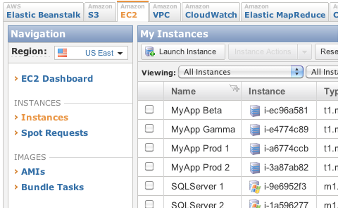
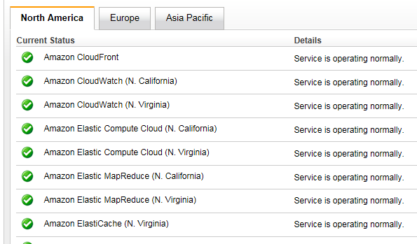
Ease of management -
Automation and APIs
APIs
  Configure Instances, Load Balancers.. Everything
  Monitor via Amazon CloudWatch
Notes:
CloudWatch (make this it’s own slide?)
Alarms, graphs, and stats
EC2: CPU utilization, data transfer, and disk usage activi
Load Balancers: request count and latency
RDS: freeable memory and available storage space
SQS: messages sent and received
Application: CUSTOM metrics
Azure Status: http://www.microsoft.com/windowsazure/support/status/servicedashboard.aspx

Slide 19
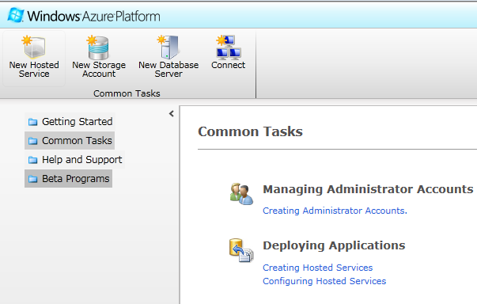
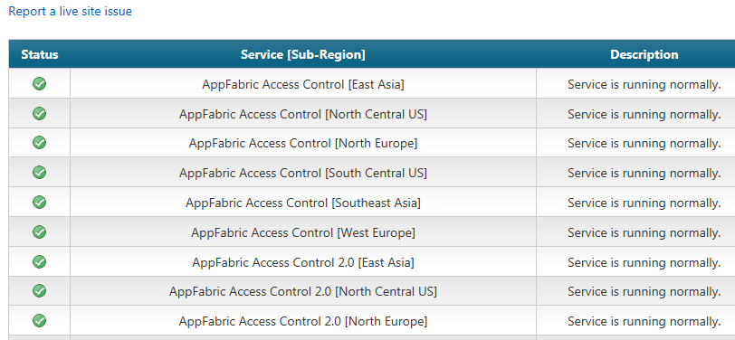
Ease of management -
Automation and APIs
APIs
Hosted Services
  creating, updating, and deleting; returning properties; updating and managing deployments
Monitoring:
  Windows Azure Diagnostics: configurable service metrics put in BLOB
  Windows Azure Profiling: real-time pre-selected metrics in Visual Studio
Notes:
Windows Azure Diagnostics (http://msdn.microsoft.com/en-us/library/gg433048.aspx)
Perf Counters:
System: CPU, Memory, Disk
Application: request count
Trace and Debug
Amazon status: http://status.aws.amazon.com/

Slide 20
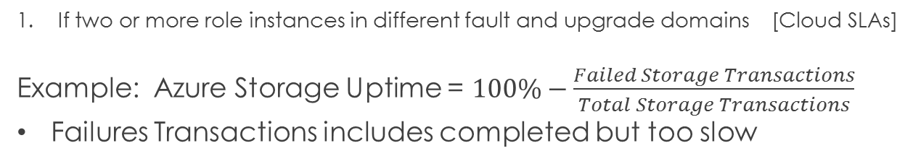
Rewards Guaranteed - Cloud SLAs
 | Microsoft | Amazon | Rackspace | Google
Service | Azure Compute | EC2 | Cloud Servers | Apps for Business
SLA | 99.9% 99.95%¹ | 99.95% | 100% | 99.9%
Service Credit | 10%-25% | 10% | 5%-100% | 3-15 days
Storage | Azure Storage | S3 | Cloud Files
SLA | 99.9% | 99.9% | 99.9%
Service Credit | 10%-25% | 10%-25% | 10%-100%
If two or more role instances in different fault and upgrade domains [Cloud SLAs]
Example: Azure Storage Uptime = $100\%−\frac{Failed Storage Transactions}{Total Storage Transactions}$
Failures Transactions includes completed but too slow
Notes:
Service Credits are calculated as a percentage of the total charges paid by you for Amazon S3 for the billing cycle in which the error occurred
If in a given month, the uptime percentage < SLA, then customer gets x% service credit, in dollars, for that month

Slide 21
SLAs, What are They Good For?
Service Credits will likely not compensate for lost business and negative customer impact.
Providers pay out service credits, but the cost in publicity is more.
  The market will reward those that keep their SLAs
  But Enterprise cloud users cannot afford to bet on the wrong provider.
99.9% uptime = 9 hrs/yr down
Must architect defensively
  More when we get to case studies
Notes:
SLA sets expectations, rest is up to you

Slide 22
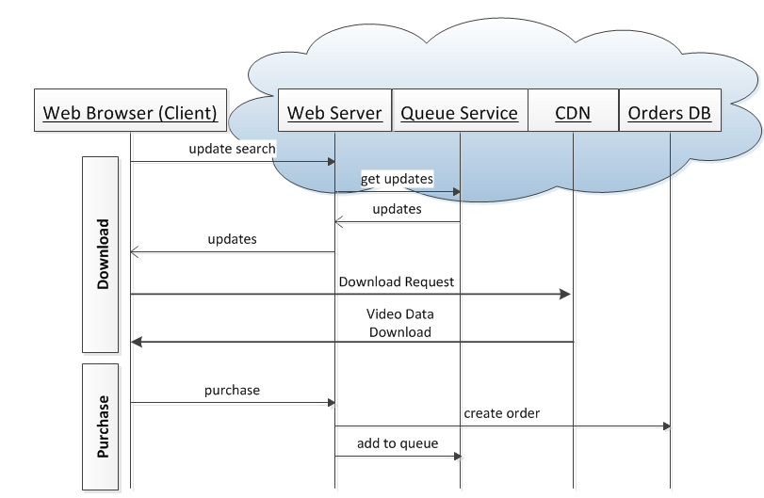
Easy Integration -
Many Services, One Provider
A Video Download Service
Your Application, plus:
Storage
Databases
Web Servers
CDN
….all in the Cloud
Availability and
Interoperability
within a single
cloud provider
Simpler than building full solution.

Slide 23
Getting Into The Cloud
Plan Pick and Execute

Slide 24
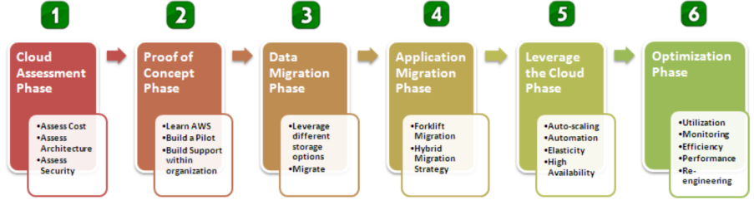
Plan Your Cloud Migration
Model courtesy of Amazon
  Six step model
  Plan, proof of concept, execution, optimize
Leaping into the Cloud is mostly about planning and execution

Slide 25
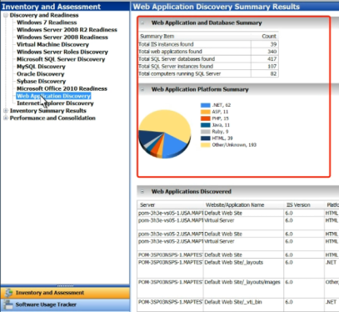
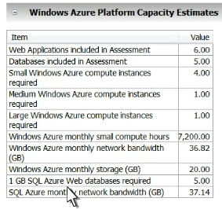
Plan for each Application
The cloud providers want you there
Microsoft Azure
  Microsoft Assessment and Planning (MAP) Toolkit [MAP Toolkit]
    Automatically finds your web apps, web servers and DBs
    Estimates what you need
      Azure compute instances
      SQL Azure DBs
      Bandwidth
      Storage

Slide 26
Execute you plan
Proof of Concept
  Build a trial version in the cloud
  Plan for data Migration and App Migration
To do this, you will need to pick a cloud provider

Slide 27
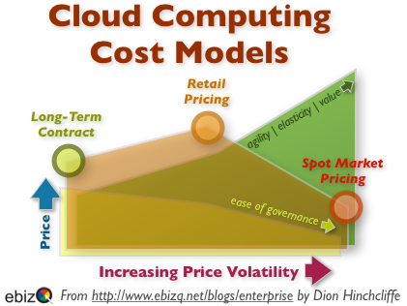
Pick the Services you need
Types of Services you need (Window/Linux)
Type of Contract
  Different pricing
  Different SLAs
Security Levels
  FISMA Compliant – Federal Information Security Management Act [FISMA, 2002]
  Other Security compliance
Dynamic Pricing Models

Slide 28
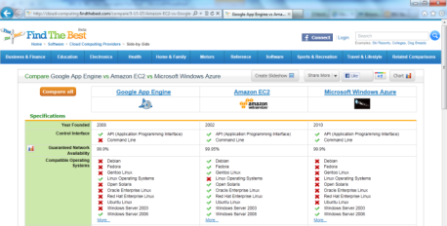
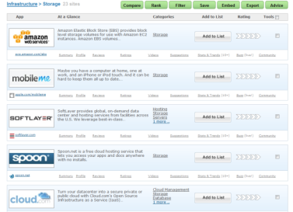
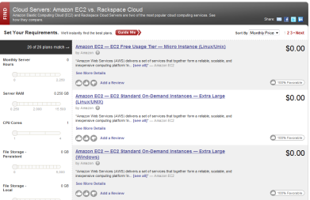
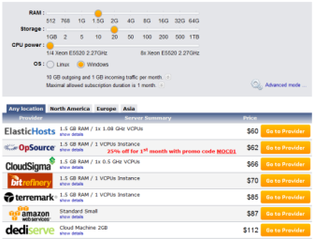
Pick the Right Cloud Provider
Handy Cloud Computing Price Comparison Engines [Cloud Tweaks, 2011]
FindTheBest.com
ServDex.com
CloudSurfing.com
Cloudarade.com
Notes:
Cloud Comparison Tools

Slide 29
5 Amazing Cloud Case Studies
  Rewards, Risks & Mitigations
Notes:
Amazon - Savings of Elasticity
Bing Travel / FareCast - Business Continuity Perils
SmugMug - Design for Business Continuity
Netflix - Design for Fault Tolerance
Amazon - Security

Slide 30
Reward
Risk
Mitigation

Slide 31
Reward
Risk
Mitigation

Slide 32
Reward
Risk
Mitigation

Slide 33
Reward
Risk
Mitigation

Slide 34
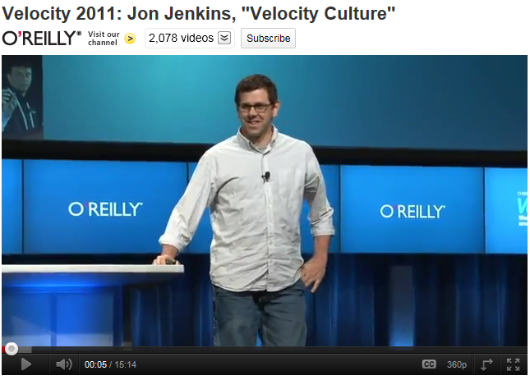
Amazon.com Elasticity and Cost Savings
Reward
Risk
Mitigation
[Jenkins, 2011]

Slide 35
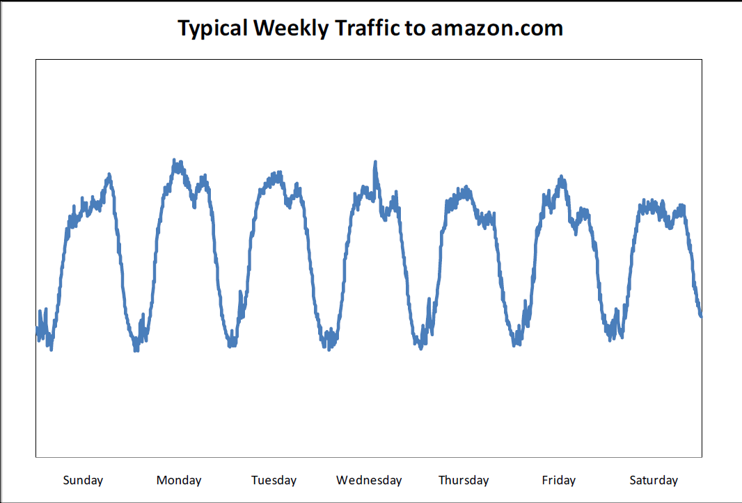
Website Traffic is Spikey
Reward
Risk
Mitigation

Slide 36
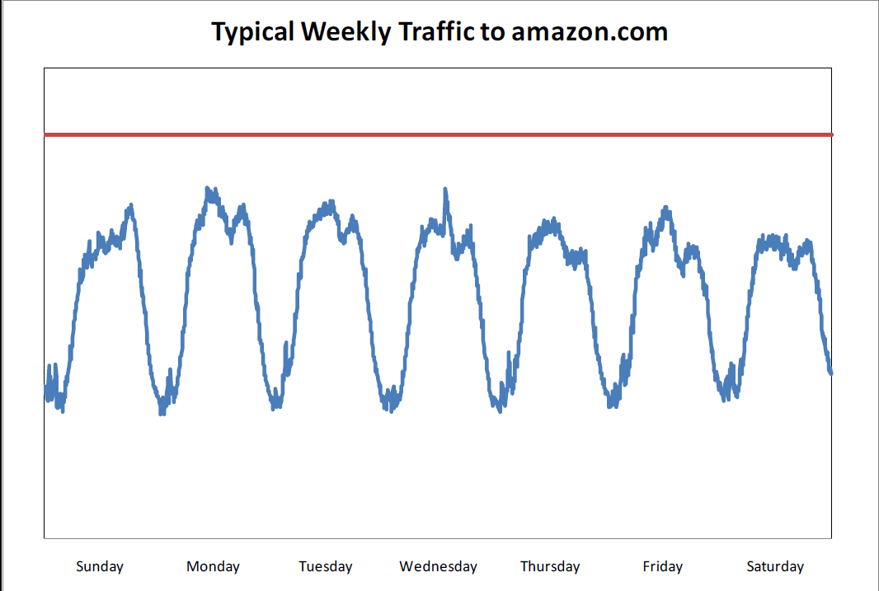
Add a Buffer
Reward
Risk
Mitigation

Slide 37
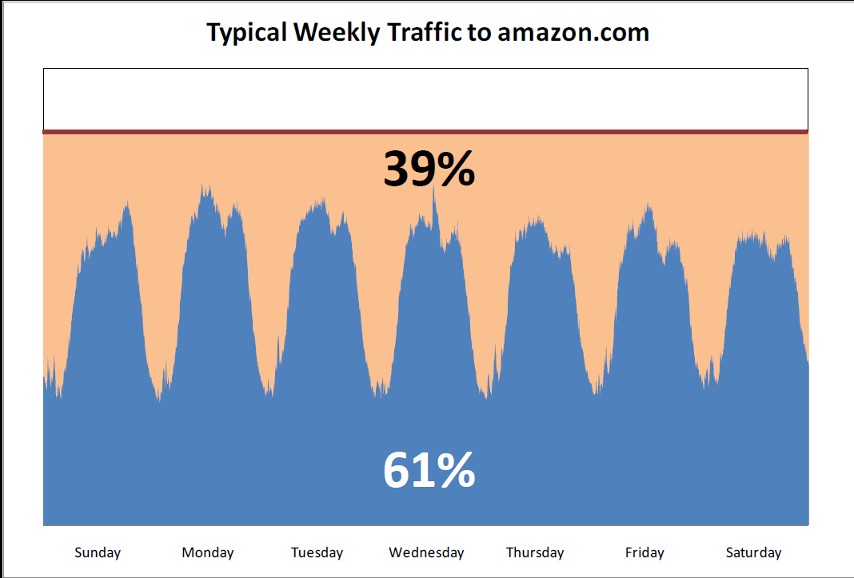
Major Waste!
Reward
Risk
Mitigation

Slide 38
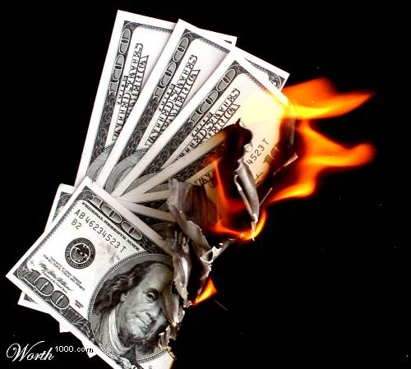
But it’s Even Worse
Reward
Risk
Mitigation

Slide 39
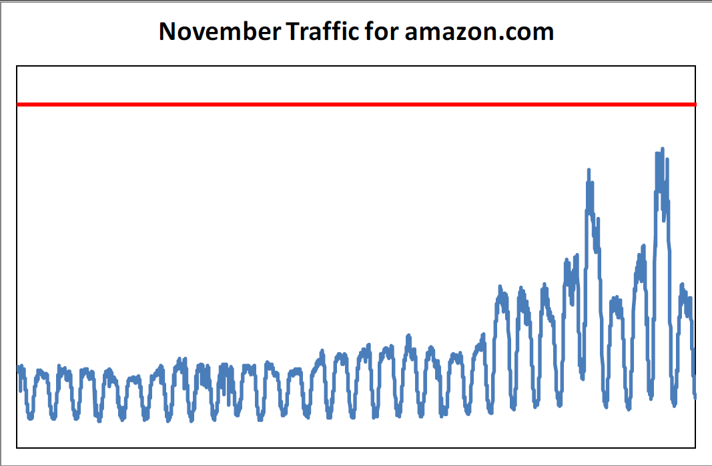
Seasonality Spikes
Reward
Risk
Mitigation

Slide 40
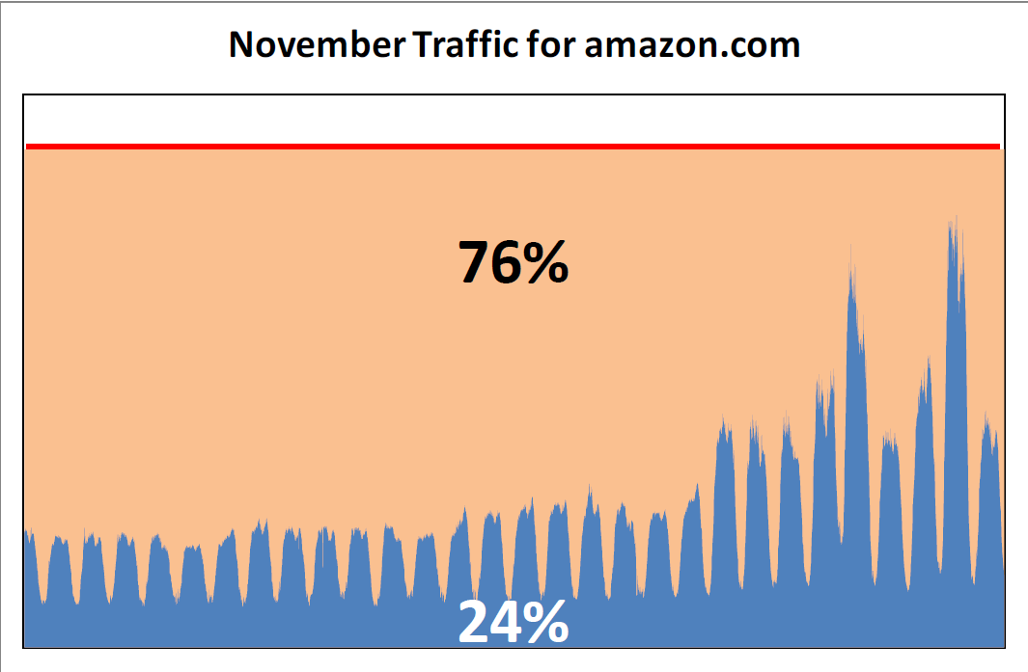
Big Waste
Reward
Risk
Mitigation
Notes:
Ken TBD

Slide 41
Let’s Move to the Cloud
Reward
Risk
Mitigation
November 10th 2010 full migration to EC2
Reduced spending on server capacity
Fleet scales dynamically in increments as small as a single host
Traffic spikes handled with ease
Cultural change – aim for small server footprints
Notes:
So does Amazon, Google…..

Slide 42
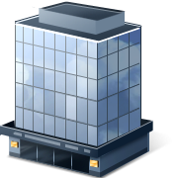

Business Continuity
Reward
Risk
Mitigation
Notes:
RISK
This is your Office…In it is your data center…..
(drought? Sure…can cause power outages…)

Slide 43
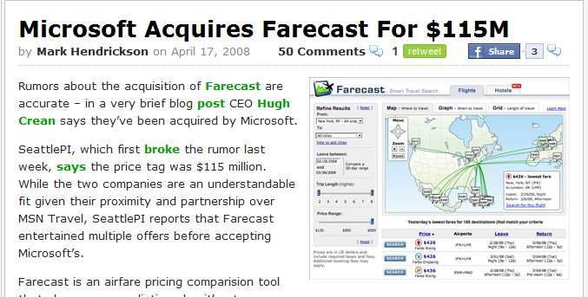
A Cautionary Tale
Reward
Risk
Mitigation
April 2008
Farecast becomes Bing Travel

Slide 44

No Safety Net
Reward
Risk
Mitigation
Service housed in a single Datacenter.
No Budget for 2nd DC Buildout.

Slide 45
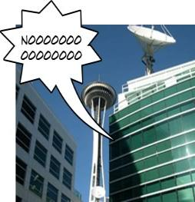
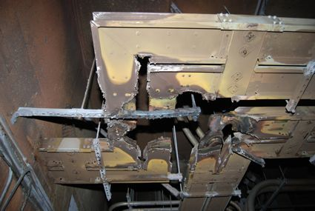
July 2009
Disaster Strikes!
An Electrical Fire @ Fisher Plaza
Reward
Risk
Mitigation
TV Stations, Radio Stations, Online Games, & Bing Travel

Slide 46

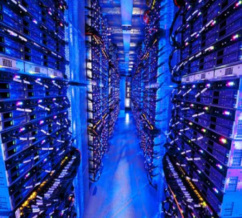
Bing Travel is now
Reward
Risk
Mitigation
2+ Datacenters

Slide 47
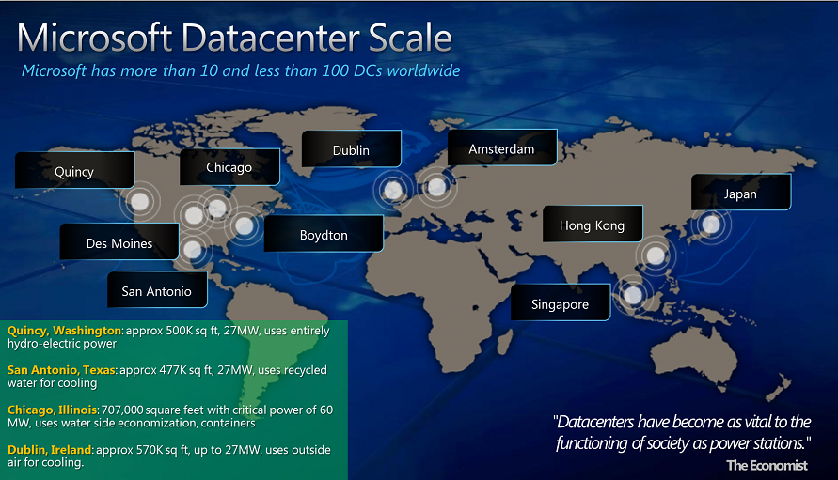
Microsoft has Geo-Redundancy
Reward
Risk
Mitigation
Notes:
So does Amazon, Google…..

Slide 48
…Therefore YOU have
Geo-Redundancy
Reward
Risk
Mitigation
…in The Cloud
Windows Azure Traffic Manager
  Automatically load balance traffic to the best data center
Amazon S3 Storage
  “data is replicated over multiple locations such that failure modes are independent of each other. The locations are chosen with great care to achieve this independence”
  [Amazon geo, May 2010]
RackSpace Cloud???
  Three full copies of data across multiple "zones" within the same data center
Notes:
REWARD
S3: Werner Vogels, Amazon CTO
RackSpace not geo-redundant.. Leads to next slide to design around this.

Slide 49

…Or Do You?
Reward
Risk
Mitigation
April 21, 2011 –
Again, you are responsible for good design
Skynet begins it’s attack against humanity
http://en.wikipedia.org/wiki/Skynet
Credit to Don MacAskill for pointing this out
Notes:
RISK Part 2
This slide builds with the next – careful if you move anything

Slide 50




…Or Do You?
Reward
Risk
Mitigation
April 21, 2011 – Amazon AWS EC2/RDS Outage
Took down
But one website had reason to be Smug
  …minimally impacted, and all major services remained online during the AWS outage
Netflix stayed up too… more later…
Again, you are responsible for good design
Notes:
RISK Part 2
This slide builds with the previous– careful if you move anything
EC2: Elastic compute cloud
RDS: Relational DB Service

Slide 51

…Or Do You?
Reward
Risk
Mitigation
April 21, 2011 – Amazon AWS EC2/RDS Outage
Took down
But one website had reason to be Smug
  …minimally impacted, and all major services remained online during the AWS outage
Netflix stayed up too… more later…
Again, you are responsible for good design
You must…
Design for Redundancy
Notes:
This slide builds with the previous– careful if you move anything

Slide 52
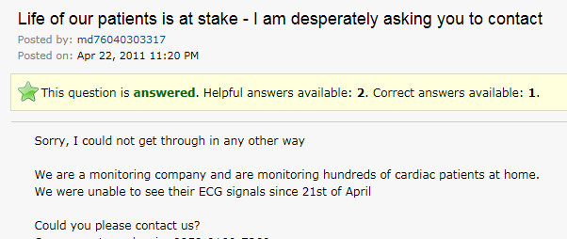
Don’t Be This Guy
Reward
Risk
Mitigation
Notes:
RISK Part 2

Slide 53

How Did SmugMug Do It?
Reward
Risk
Mitigation
Availability Zones (AZs)
Failures Should Not Span AZs
  In this case they did!
SmugMug uses Three AZs
Designed to fail and recover
  Any of our instances, or any group of instances in an AZ, can be “shot in the head” [SmugMug April 2011]
Incident Response
  We updated our own status board, and then I tried to work around the problem…. 5 minutes [later] we were back in business
Notes:
MITIGATION
Image only – Ask Audience What is This?

Slide 54

Fault Tolerance
..or What Do You Need to Worry About When Running Your Own Data Center
Reward
Risk
Mitigation
Servers and Server Hardware
Networks and Load Balancers
Data and Data Replication
Authentication and Connectivity
For Example….

Slide 55
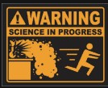
First Year -New Data Center
Reward
Risk
Mitigation
Failure is Always an Option
1 Power Distribution Unit failure (500-1000 machines)
1 rack-move (500-1000 machines)
1 network rewiring (rolling 5% of machines)
20 rack failures (40-80 machines)
8 network maintenances (~30-min connectivity losses)
12 router reloads
3 router failures
Dozens of minor 30-second blips for DNS
1000 individual machine failures
1000s of hard drive failures
[Google Cluster, 2008]
Notes:
Imagine how much this will cost you?
RISK
Caveat: Google does use lower quality hardware at a MUCH lower cost…
“Failure is Always an Option” – Adam Savage (although earlier reference here: http://www.angryflower.com/crisis.html)

Slide 56
How Does The
Cloud Help?
Reward
Risk
Mitigation
The Cloud is better
Fault-tolerant hardware and network infrastructure
Advanced Ops personnel and processes
State of the art: Power, Cooling, Security
The Cloud is not better
but gives you better tools to….

Slide 57

Embrace Failure
Reward
Risk
Mitigation
[http://despair.com]
Notes:
MITIGATION
Refer Back to SmugMug Slide

Slide 58
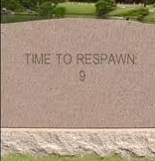
Embrace Failure
Reward
Risk
Mitigation
Design For Failure
Each System has to succeed, even on its own
  Small Stateless Services
  Recommendation System Down? Show popular titles instead of personalized picks
Assume host failures happen
  Remember, “shot in the head”
  Cloud Advantage: Re-Spawn!
Short Timeouts and Quick Retries – Fail Fast
  Co-tenancy can introduce variance in throughput at any level of the stack.
  Requires Idempotent Interfaces
Research and Test with Full Scale / Real Data
  Cloud Advantage: Elasticity
[Netflix AWS, Dec 2010]
[Twilio AWS, Apr 2011]
Notes:
MITIGATION
Refer Back to SmugMug Slide

Slide 59


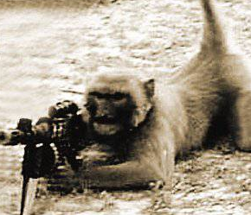
Monkeys with Rifles
Reward
Risk
Mitigation
Netflix Simian Army
  Chaos monkey randomly disables production instance in AWS
  Chaos Gorilla simulates an outage of an entire Amazon AZ
  Janitor Monkey, Security Monkey, Latency Monkey…..
Microsoft Host Sniper takes out servers on Office Web Apps
[Netflix Army, July 2011]
Notes:
Comment: surprisingly easy to find images of monkeys with rifles

Slide 60

Reward
Risk
Mitigation

Slide 61

Security
Reward
Risk
Mitigation
"...every cloud customer retains responsibility for assessing and understanding the value and sensitivity of the data they may choose to move to the cloud. As the owners of that information, cloud customers also remain accountable for decisions regarding the protection of that data wherever it may be stored."
[Microsoft Security, 2010]
For Example….

Slide 62
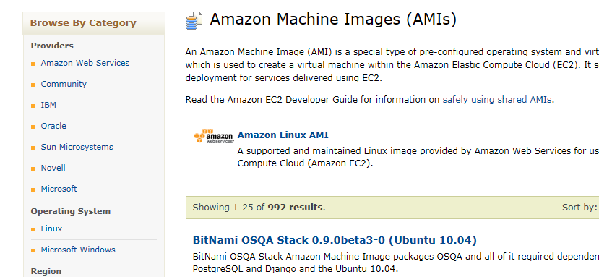
Amazon AMIs
Reward
Risk
Mitigation
Amazon Machine Image
Create and share virtual server configurations
Like Open Source –Give a little, Get a lot
Notes:
REWARD: Flexibility, re-usability, leverage work of others (open-source)

Slide 63


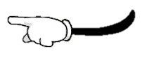
AMI Key Vulnerability
Reward
Risk
Mitigation
June 2008, Amazon Closes Hole
  EC2 Servers copied from an image all had same SSH host keys
  Amazon’s or User fault?
    Like a community with where all houses use the same key
    Hey you could get your house re-keyed (regen host key)
June 2011, Users Publish API Authentication Keys
  Amazon’s or User fault?
    Like including a pic of yourself showing your credit card shared on FaceBook, with a sign that says “charge me”
    Violates Amazon Security Guideline – RTFM?
Could Amazon do More?
  Auto-scanning perhaps?
[Cloud Security 2008]
[IT World, 2011]
Notes:
RISK

Slide 64
Amazon AMI Mitigation
Reward
Risk
Mitigation
Notes:
MITIGATION
Mitigation for 1 was possible, but hard to detect
For 2 was easy to detect once documented
Even Security expertise might not have helped, this is specific to the Cloud.

Slide 65
Testing in The Cloud

Slide 66

Facebook is a Cloud Platform
Reward
Risk
Mitigation
Apps power Facebook
Facebook + Heroku = PaaS
Deploy and Run FB Apps [FB Heroku, 2011]
Rewards:
Supports Ruby, Node.js, Python, or PHP
Now need to setup host
Instant Scaling

Slide 67


What are the Risks?
Reward
Risk
Mitigation
How do We Test it?
Does it work?
Is it stable?
Users getting a Good Experience?
These risks are not cloud specific.
But the mitigation is….

Slide 68

Facebook Imaginary Friends
Reward
Risk
Mitigation
Notes:
Builds with next slide

Slide 69

Facebook Imaginary Friends
Reward
Risk
Mitigation
…they call them Test Users
Invisible user accounts
Not visible by others; can only be friends with other Test Users
Experience your app as a regular user
Power of the Cloud
Automated:
  Programmatic interface
  Web UI
Create up to 500 of them
[FB Test, 2011]
Notes:
500 users…. Leads into next slide with 1 million users

Slide 70

Control 1 Million Users
Notes:
This slide builds with next

Slide 71


Control 1 Million Users
SOASTA CloudTest
Uses Cloud IaaS Providers:
  GoGrid, Windows Azure, Amazon EC2
Generate high scale load from geo-dispersed origins
MySpace
1 million concurrent virtual users
  Plus Live Traffic
6 gigabits per second
6 terabytes of data transferred per hour
Over 77,000 hits per second Plus Live Traffic
800 Amazon EC2 instances / 3200 cloud computing cores
[SOASTA, 2010]

Slide 72
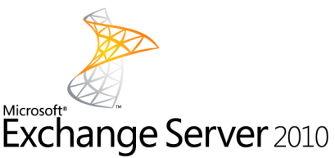
Microsoft Exchange
Cloned itself to The Cloud
Enterprise version had 70,000 tests running in 5000 lab servers
How to test cloud version in production?
  Same tests can run
    In lab for Enterprise version
    In Azure for Cloud version
Azure Test in Production Framework
  Outside Corp Net
  Capacity
  Cost
  Manageability
Notes:
Clones, not Migrated, as needed to support both Service/Cloud and Enterprise versions

Slide 73
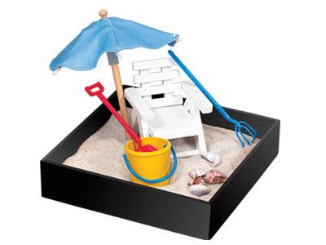
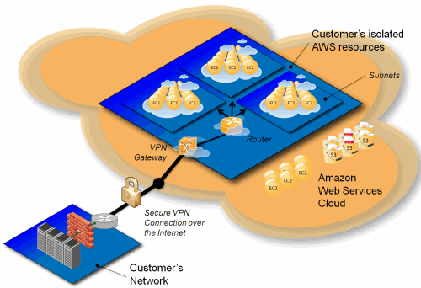
Virtual Sandbox
Production Environment
Staging Environment
Dev and Testing Environment
Can you have it all in one big Cloud?
Amazon Virtual Private Cloud (Amazon VPC)
Provision a private, isolated section of AWS
IP addresses, subnets, routing tables
Even Sandbox for Non-Cloud services
And remember the power of zero!
Notes:
power of zero = only pay for test resources when testing

Slide 74
Test Oriented
Architecture
  Even Cloud Services need Testing
Notes:
Amazon - Savings of Elasticity
Bing Travel / FareCast - Business Continuity Perils
SmugMug - Design for Business Continuity
Netflix - Design for Fault Tolerance
Amazon - Security

Slide 75
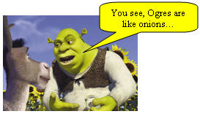

Ken’s Services Theorem
Services are like Ogres
Ogres are like Onions
Onions have Layers
Therefore services have Layers
The Problem is
The layers of a service spin at different rates
Movement toward continuous deployment

Slide 76
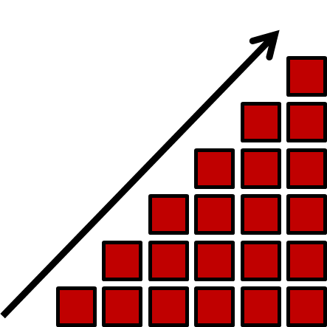
Maximum Risk is v-Current
Code Churn as a Measure of Risk
Code churn is cumulative
Six week coding milestone
Stabilization phase
Drive to Zero Bug Bounce

Slide 77
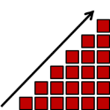
Code Churn Example 1
Maximum point of risk at end of milestone
Code churn is cumulative
Layer 1
Imagine this as part of a larger multi-layered project
Layer 2
Layer 3
Six week coding milestone
Tightly coupled layers
Long stabilization phase
Complicated end-to-end integration
Sim-ship increases risk

Slide 78
Enter Continuous Deployment
CD is not necessarily agile development
  Cloud often promotes more agile development
  Kanban certainly would promote a service to move toward CD
  If you move to the cloud explore CD
Continuous Deployment stats from Amazon
  Mean time between deployments weekday – 11.6 seconds)
  Max # of deployments in a single hour - 1,079
  Mean # of hosts simultaneously receiving a deployment – 10,000

Slide 79
Code Churn Example 2 (CD)
Max Risk is Production
Rapid release cadence
(weekly or daily)
Layer 1
Risk per release decreases because of more incremental change
Change builds over time in production
Next release is always the most risky
Layer 2
Layer 3
Layer N

Slide 80

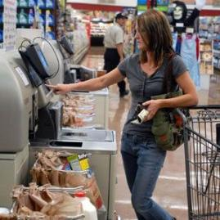
Practical TOA
More Loose Coupling across stack
  Your service in the Cloud
More Self Service Deployments
  Automated roll forward
  Rollback triggered by live site monitors
  Canary deployment zones

Slide 81
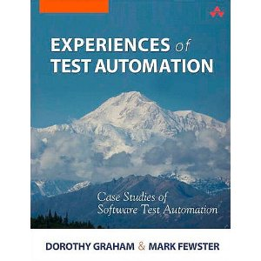
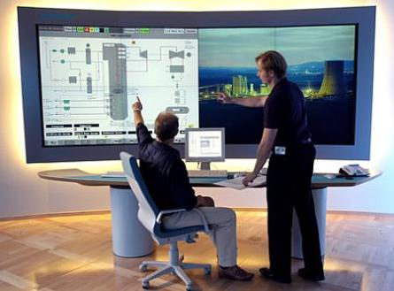
Practical TOA
Automated Tests and Monitors are the same thing
Heavy Test Automation
Big Live Service Monitors
=

Slide 82


Practical TOA
Ship Test Hooks into production
  Runtime Flags to access test path
  Isolated Data Centers and Hosts
  Runtime routing of traffic from v-Current to v-Next
System During Test
U
X
A
P
I
System Under Test
Test Code
From Alan Myrvold “Patterns of Testability”
Rich Telemetry
  Your services telemetry
  Runtime flags for richer debug telemetry
  Fix the bugs users are seeing

Slide 83
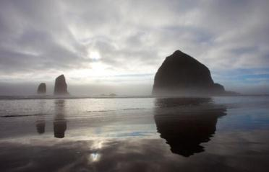
Summary
About Clouds
Cloud Rewards
Getting Into The Cloud
5 Amazing Cloud Case Studies
  Rewards, Risks & Mitigations
Testing in The Cloud
The latest version of this slide deck can be found at:
http://www.setheliot.com/blog/bsc-east-2011/

Slide 84
References
[Staten, 2010] | Could Cloud Computing Get Any More Confusing? http://blogs.forrester.com/james_staten/10-05-20-could_cloud_computing_get_any_more_confusing James Staten, Forrester Research; May 20, 2010
[Intel, 2011] | Intel Labs Invests $30M in the Future of Cloud and Embedded Computing with the Opening of Latest Intel Science and Technology Centers, August 3, 2011; http://intel.ly/oGmubX
[Hinchcliffe, 2009] | http://www.zdnet.com/blog/hinchcliffe/cloud-computing-and-the-return-of-the-platform-wars/303 , March 2009
[R&M, 2010] | http://www.researchandmarkets.com/reportinfo.asp?cat_id=0&report_id=1395650 , Oct 2010
[Forbes, 2011] | http://www.forbes.com/sites/kevinjackson/2011/04/19/cloud-to-command-90-of-microsofts-rd-budget/ , April 2011
[CCJ, 2011] | http://cloudcomputing.sys-con.com/node/1662284 , Feb 2011
[FISMA, 2002] | http://en.wikipedia.org/wiki/Federal_Information_Security_Management_Act_of_2002
[Cloud Tweaks, 2011] | http://www.cloudtweaks.com/2011/08/3-handy-cloud-computing-price-comparison-engines/, August 2011

Slide 85
References
[Google Cluster, 2008] | Jeff Dean, Google IO Conference 2008, via Stephen Shankland, CNET http://news.cnet.com/8301-10784_3-9955184-7.html
[MAP Toolkit] | Microsoft Assessment and Planning (MAP) Toolkit for Windows Azure Platform http://technet.microsoft.com/en-us/solutionaccelerators/gg581074
[AWS Whitepaper] | Migrating your Existing Applications to the AWS Cloud (with 3 example scenarios) Oct 2010 http://d36cz9buwru1tt.cloudfront.net/CloudMigration-main.pdf
[Berkeley 2009] | Above the Clouds: A Berkeley View of Cloud Computing Feb 2009 http://www.eecs.berkeley.edu/Pubs/TechRpts/2009/EECS-2009-28.pdf
[Microsoft DC, 2011] | Microsoft GFS Datacenter Tour (4:53) http://www.youtube.com/watch?v=hOxA1l1pQIw
[Cloud SLAs] | http://www.microsoft.com/windowsazure/sla/ http://aws.amazon.com/ec2-sla/ http://www.rackspace.com/cloud/legal/sla/ http://www.google.com/apps/intl/en/terms/sla.html

Slide 86
References
[Microsoft Security, 2010] | Information Security Management System for Microsoft’s Cloud Infrastructure, http://www.globalfoundationservices.com/security/documents/InformationSecurityMangSysforMSCloudInfrastructure.pdf November 2010
[Cloud Security 2008] | Is Your Amazon Machine Image Vulnerable to SSH Spoofing Attacks?, July 2008 http://cloudsecurity.org/tags/ssh.html
[IT World, 2011] | Amazon's cloud is full of holes, June 2011 http://www.itworld.com/security/175927/researchers-aws-users-are-leaving-security-holes
[Amazon geo, May 2010] | Expanding the Cloud - Amazon S3 Reduced Redundancy Storage, Werner Vogels May 2010 http://www.allthingsdistributed.com/2010/05/amazon_s3_reduced_redundancy_storage.html
[SmugMug April 2011] | How SmugMug survived the Amazonpocalypse, April 2011 http://don.blogs.smugmug.com/2011/04/24/how-smugmug-survived-the-amazonpocalypse/
[Netflix AWS, Dec 2010] | 5 Lessons We’ve Learned Using AWS , Dec 2010 http://techblog.netflix.com/2010/12/5-lessons-weve-learned-using-aws.html
[Twilio AWS, Apr 2011] | Why Twilio Wasn’t Affected by Today’s AWS Issues, April 2011 http://www.twilio.com/engineering/2011/04/22/why-twilio-wasnt-affected-by-todays-aws-issues/

Slide 87
References
[Netflix Army, July 2011] | The Netflix Simian Army; July 2011 http://techblog.netflix.com/2011/07/netflix-simian-army.html
[FB Heroku, 2011] | Facebook and Heroku http://blog.heroku.com/archives/2011/9/15/facebook/, Sept 15 2011
[FB Test, 2011] | Making it easier to create and manage Test Users http://developers.facebook.com/blog/post/527/ , July 27 2011
[SOASTA, 2010] | How MySpace Tested Their Live Site with 1 Million Concurrent Users http://highscalability.com/blog/2010/3/4/how-myspace-tested-their-live-site-with-1-million-concurrent.html, March 4 2010
[Amazon Growth, 2011] | Amazon S3 - 566 Billion Objects, 370,000 Requests/Second, and Hiring! Oct 4, 2011 http://aws.typepad.com/aws/2011/10/amazon-s3-566-billion-objects-370000-requestssecond-and-hiring.html
[Jenkins, 2011] | Velocity 2011: Jon Jenkins, "Velocity Culture" , June 2011 http://www.youtube.com/watch?v=dxk8b9rSKOo

Slide 88

Thank You
Session BW7
Leaping into “The Cloud”:
Rewards, Risks, and Mitigations
Ken Johnston, Seth Eliot
Thank you for attending this session.
Please fill out an evaluation form.

