Slide 1
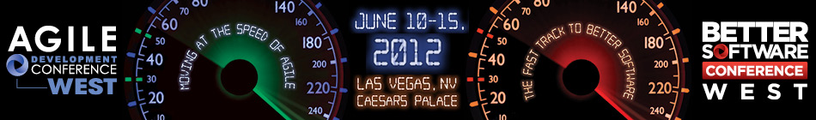

Leaping into
“The Cloud”
Rewards, Risks, and Mitigations
Ken Johnston, Principal Group Program Manager, Bing
Seth Eliot, Senior Knowledge Engineer, Test Excellence
Better Software West – June 13, 2012
Notes:
1.0 April 9, 2012 – Updated from BSC East 2011 Presentation
1.1 May 24, 2012 – Seth’s tweaks and updates
1.2 Jun 11, 2012 – Seth updates
1.3 Jun 12 2012 – Ken updates

Slide 2


About Us
Seth
Microsoft Engineering Excellence: Best practices for services and cloud
Bing: Massive, distributed, data processing service
Microsoft ExP: Data Driven Decision Making
Amazon.com: Video, Music, and Kindle eBook services
Ken
Principal Group Program Manager, Bing
Office 2010, MSN, Hosted Exchange
Director of Test Excellence

Slide 3

What Do You Know?
Just beginning with cloud?
Who has a major project coming up?
Who has already implemented a cloud service?
Anything ever gone wrong?

Slide 4

Introduction
About Clouds
Cloud Rewards
Getting Into The Cloud
5 Amazing Cloud Case Studies
  Rewards, Risks & Mitigations
Testing in The Cloud
The latest version of this slide deck can be found at:
http://www.setheliot.com/blog/bsc-west-2012/

Slide 5
About Clouds

Slide 6

Three Ingredients of The Cloud
Standardized IT capability or service
  No customizing for each customer
  Economies of Scale - rote, repeatability
Pay Per Use
  The power of zero
Self-Service Deployment
  Fully Automated
  DevOps, NoOps
[Staten, 2010]
Notes:
Utilities analogy
Explain References convention here
Power of zero may be diminished for SaaS and LT contracts
Self-Service deployment = self-service Ops (DevOps, NoOps)

Slide 7

The Cloud’s
Secret Sauce
Virtualization
Elasticity
Happiness
Power
Automatically.....?
Notes:
Virtualization: enables abstraction of stuff you do not want to worry about
message is being able to slice and dice arbitrarily and abstract away underlying infrastructure
Elasticity:
The Power of Zero – no use = no cost
But also the power to scale out when needed, on demand

Slide 8
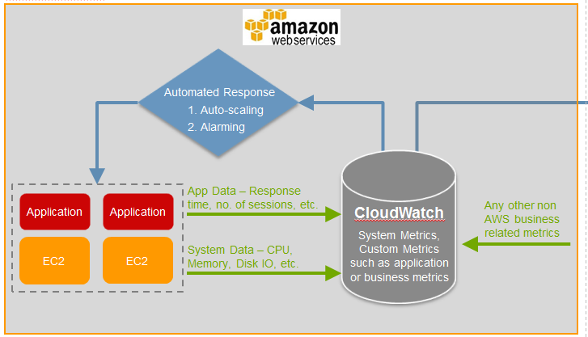
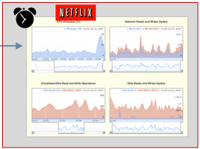
Yes, Like This…
[Netflix Autoscaling, 2012]
Scale Up: alarm at 75% of target threshold with a 5-10 minute delay before automated action takes place
Scale Down: slowly, using time as a proxy to avoid removing capacity too quickly

Slide 9



Three Layers of of Clouds
Cloud Category | The Cloud handles... | Examples
Cirrus | 16,500 to 40,000 ft
Altocumulus | 6,500 to 23,000 ft.
Cumulus | Surface to 10,000 ft
Notes:
Builds with next slide
Cirrus & Altocumulus photo credit: http://en.wikipedia.org/wiki/List_of_cloud_types
Cumulus = XP background ☺

Slide 10
Three Layers of of Clouds
Cloud Category | The Cloud handles... | Examples
SaaS: Software | e.g., Office Application Functionality | Microsoft Office Web Apps Google Docs
PaaS: Platform | Relational Database Management Systems | Microsoft SQL Azure Amazon RDS
 | Frameworks and Runtimes | Microsoft Windows Azure - .NET Google App Engine – Java, Python
 | Messaging Queue | Microsoft Azure Queue Amazon SQS
IaaS: Infrastructure | Servers | Amazon EC2 - Linux, Windows Rackspace Cloud Servers - Linux
 | Storage | Amazon S3 / SDB - BLOB / Table Microsoft Windows Azure Storage
 | CDN | Windows Azure CDN Amazon CloudFront
 | Network | Amazon Virtual Private Cloud
XaaS = …as a Service
Notes:
It’s a STACK
Start with SaaS – easiest to relate: Gmail, Office web apps. Hosted Exchange
Then IaaS – best physical/virtual analog
Then PaaS
Use Key examples that we can refer back to throughout the presentation
Not a clear delineation
Servers (IaaS) have OS (PaaS)
CDN and Table storage (IaaS) are more then just ‘I’, the include software (P)
SquareSpace is hosting (PaaS) plus tools (SaaS)

Slide 11
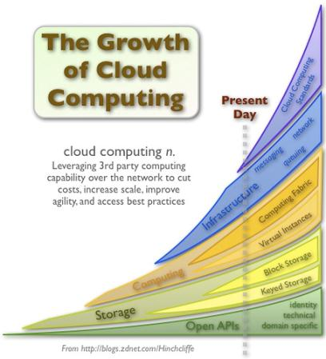
Are Clouds for Real?
Unparalleled Market Growth
Massive Adoption
  Global cloud computing to grow from $37.8 billion 2010 to $121.1 billion in 2015
  [R&M, 2010]
  By 2015, business revenues from IT innovation enabled by the cloud could reach US$1.1 trillion a year
  [Microsoft, March 2012]
[Hinchcliffe, 2009]
Notes:
CAGR of 26.2% from 2010 to 2015.
Annual US Federal cloud computing spending to hit $7 billion landmark by 2015

Slide 12
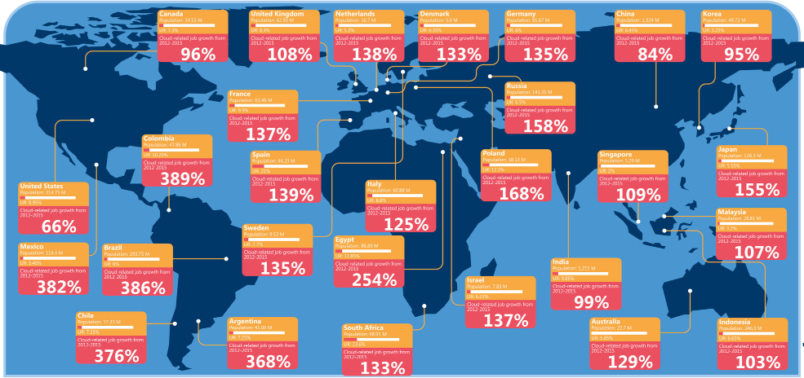
14 Million New Jobs by 2015
[Microsoft, March 2012]
Notes:
[Microsoft Jobs, March 2012] http://www.microsoft.com/en-us/news/features/2012/mar12/03-05CloudComputingJobs.aspx
Cloud Computing to Create 14 Million New Jobs by 2015
Study by analyst firm IDC

Slide 13
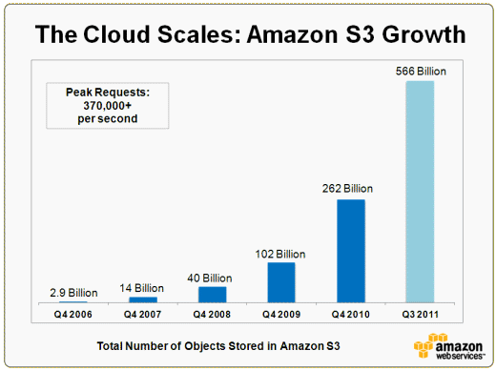










Really? Are Clouds for Real?
Massive Investments
  Cloud To Command 90% of Microsoft's R&D Budget [Forbes, 2011]
    ~8.6 Billion in 2011
Amazing Growth
  [Amazon Growth, 2011]
Steep competition
  90 Cloud Computing Companies to Watch in 2011 [CCJ, 2011]
Notes:
Amazon doubles objects stored in 9 mos
Many names you’ll recognize and some you wont

Slide 14
Cloud Rewards
The Promise of the Cloud

Slide 15


Promises, Promises…
The Cloud Makes Many Promises
You are Empowered to Leverage These
You Have an active role
Cloud Promise + Your Actions = Rewards
Notes:
Responsibilities and Rights respectively
Their Promise + Your Design = Reward

Slide 16


Rewards, A 40,000 ft. View
1. On demand capacity | Elasticity
2. Lower Cost | The Cloud is your data center
3. Disaster Recovery | Backups
4. Fault tolerance | Redundancy
5. Ease of management | Automation and APIs
6. Rewards Guaranteed | SLA – Service Level Agreement
7. Easy Integration | Many Services - One Provider
Notes:
Elastic Scalability – fundamental advantage. Already mentioned, reinforce here
The Cloud makes a lot of promises
But you need to take actions to take advantage of them

Slide 17
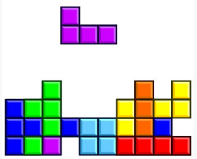
2. Lower Cost -
The Cloud is your data center
Asset Utilization
  Data center server utilization averages 5%-20% [Berkeley 2009]
Hardware Costs
  Data center performance - only increases with additional investment.
Power Efficiency
  Power Usage Effectiveness (PUE) for Data Center
  Industry average 2.0
  Microsoft Chicago:1.22
  Microsoft Quincy 1.15 [Microsoft DC, 2011]
Continued….
Notes:
For Asset Util: call ahead to Amazon story that Ken will tell (Jon Jenkins – Velocity)
- Asset util CPU graph – internal Microsoft
PUE = Total power / IT equipment power – lower better, 1 = perfect

Slide 18
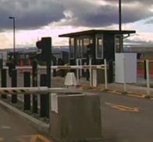

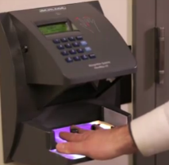
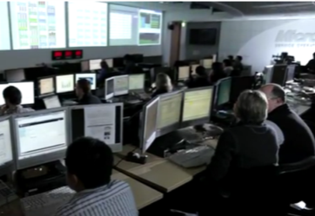
Lower Cost - The Cloud is your data center (cont)
Security
  Network security devices
  Security software licenses
  Staffing
  Regulatory compliance
  Physical security requirements
Supply Chain Management
  Ordering servers and components costs money and time
Personnel
  Operating data centers
  Scaling and managing physical growth
Notes:
Hassle of running your own DC – cover 3 points and out
Pictures are all from Microsoft Data Centers

Slide 19
Economies of Scale
Larger datacenters have almost 50% lower TCO per server
MAIN DATA CENTER COST BUCKETS
ANNUAL TCO/SERVER DECLINES W/SCALE
Server hardware costs (~45% of total costs)
Facility & operations (~25%)
Hardware labor costs (~15%)
Power costs (~15%)
47% Savings
Source: Microsoft

Slide 20

3. Disaster Recovery &
4. Fault Tolerance
Service Robustness Enabled by The Cloud
Multiple, smaller servers for Redundancy
Handle load spikes via Elastic Scalability
Backups leverage IaaS storage
Use the tools via API – Automate
But how about when clouds turn stormy?
Notes:
Smaller servers – create many smaller virts instead of being a few large servers.
Automate
Netflix example for scaling
Or spawn new instances to replace dead ones
Monitoring and management – next page

Slide 21
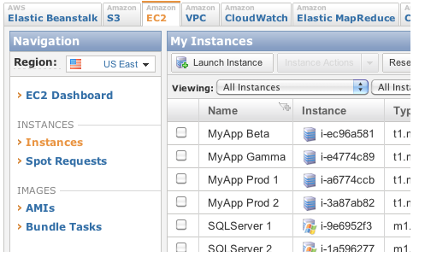

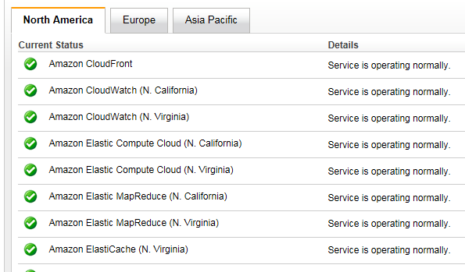
5. Ease of management -
Automation and APIs
APIs
  Configure Instances, Load Balancers.. Everything
  Monitor via Amazon CloudWatch
Notes:
CloudWatch
Alarms, graphs, and stats
EC2: CPU utilization, data transfer, and disk usage activi
Load Balancers: request count and latency
RDS: freeable memory and available storage space
SQS: messages sent and received
Application: CUSTOM metrics
Amazon status: http://status.aws.amazon.com/

Slide 22
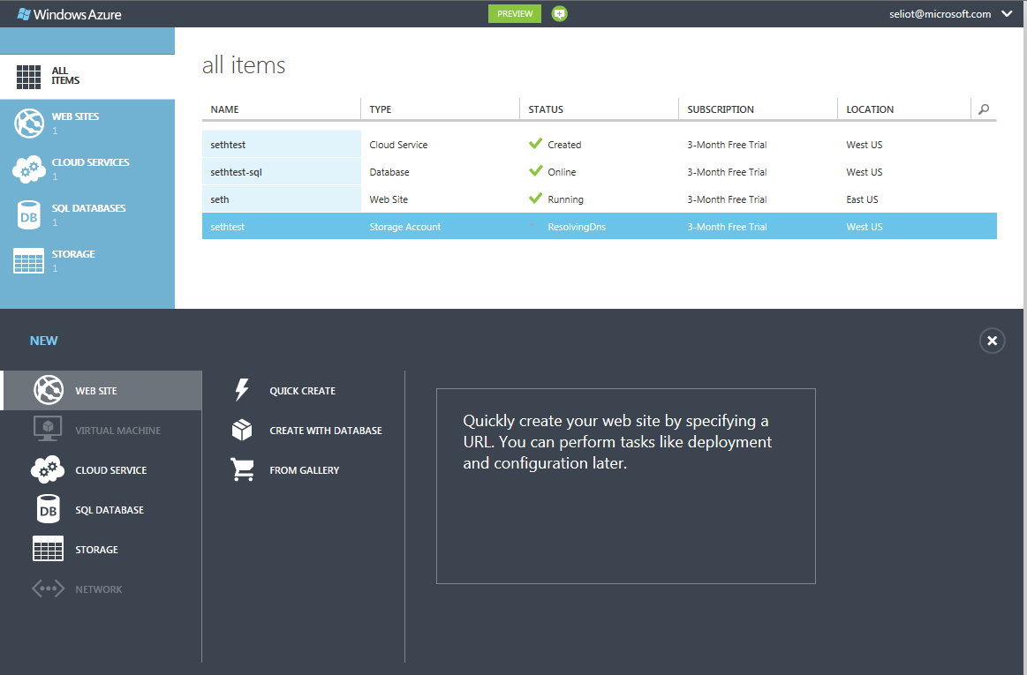
New Azure Portal
Notes:
Azure Portal/Dashboard: https://manage.windowsazure.com/
New as of June 7 2012

Slide 23
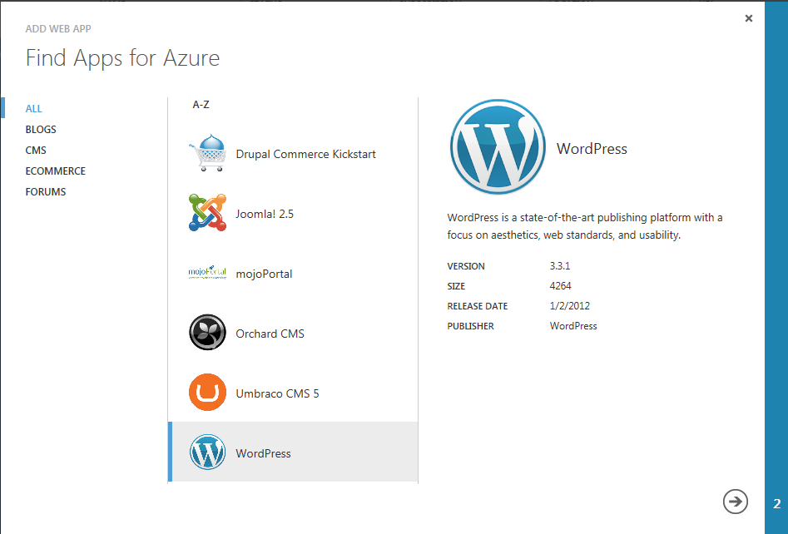
Notes:
Very quickly – show the simplicity of creating a website from the gallery

Slide 24
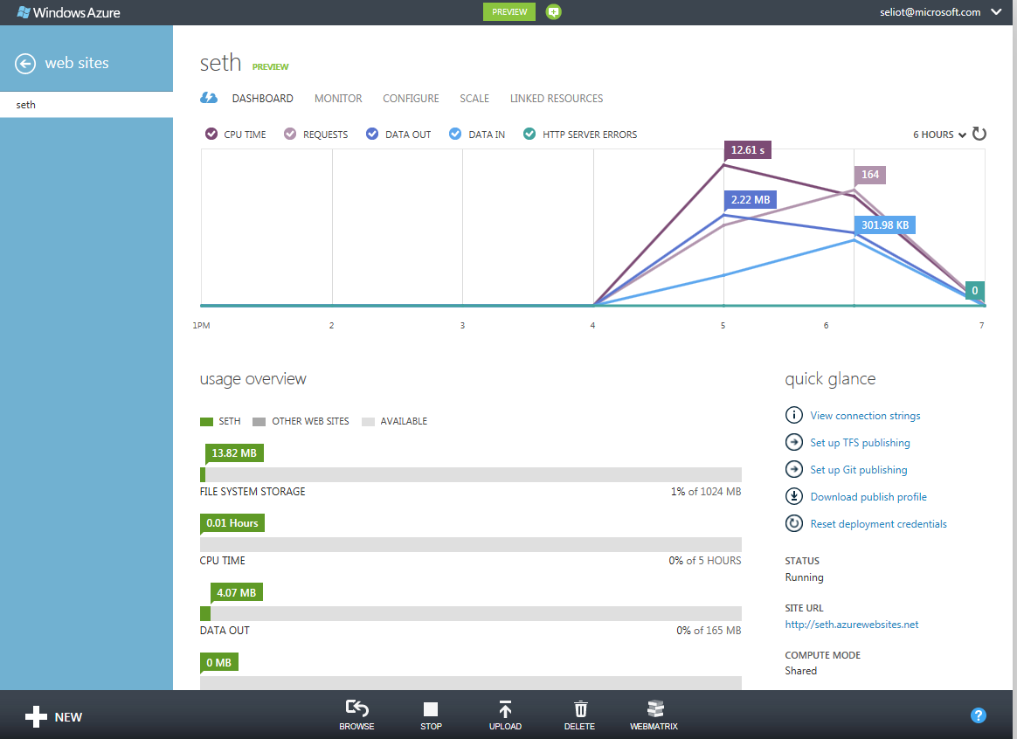
Notes:
And quickly, how you can monitor and manage the website through the UI

Slide 25

Manage Azure via REST APIs
Operations on Hosted Services
Operations on Storage Accounts
Operations on Service Certificates
Operations on Affinity Groups
Operations on Locations
Operations for Tracking Asynchronous Requests
Operations for Retrieving Operating System Information
Operations for Retrieving Subscription History
Operations on Management Certificates
Operations for Traffic Manager
Operations on Virtual Machines
Operations on Virtual Machine Images
Operations on Virtual Machine Disks
Operations on Virtual Networks
Operations on Virtual Network Gateways
  List Hosted Services
  Create Hosted Service
  Update Hosted Service
  Delete Hosted Service
  Get Hosted Service Properties
  Create Deployment
  Get Deployment
  Swap Deployment
  Delete Deployment
  Change Deployment Configuration
  Update Deployment Status
  Upgrade Deployment
  Walk Upgrade Domain
  Reboot Role Instance
  Reimage Role Instance
  Rollback Update Or Upgrade
  Check Hosted Service Name Availability
  Get Package
Notes:
Azure Management REST APIs: http://msdn.microsoft.com/en-us/library/windowsazure/ee460812.aspx
New as of June 7 2012
Same control as portal UI

Slide 26
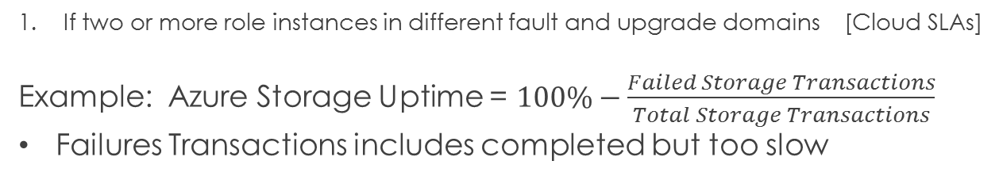
6. Rewards Guaranteed - Cloud SLAs
 | Microsoft | Amazon | Rackspace | Google
Service | Azure Compute | EC2 | Cloud Servers | Apps for Business
SLA | 99.9% 99.95%¹ | 99.95% | 100% | 99.9%
Service Credit | 10%-25% | 10% | 5%-100% | 3-15 days
Storage | Azure Storage | S3 | Cloud Files
SLA | 99.9% | 99.9% | 99.9%
Service Credit | 10%-25% | 10%-25% | 10%-100%
If two or more role instances in different fault and upgrade domains [Cloud SLAs]
Example: Azure Storage Uptime = $100\%−\frac{Failed Storage Transactions}{Total Storage Transactions}$
Failures Transactions includes completed but too slow
Notes:
Service Credits are calculated as a percentage of the total charges paid by you for Amazon S3 for the billing cycle in which the error occurred
If in a given month, the uptime percentage < SLA, then customer gets x% service credit, in dollars, for that month

Slide 27
SLAs, What are They Good For?
Service Credits will likely not compensate for lost business and negative customer impact.
Providers pay out service credits, but the cost in publicity is more.
  The market will reward those that keep their SLAs
  But Enterprise cloud users cannot afford to bet on the wrong provider.
99.9% uptime = 9 hrs/yr down
Must architect defensively
  More when we get to case studies
Notes:
SLA sets expectations, rest is up to you

Slide 28
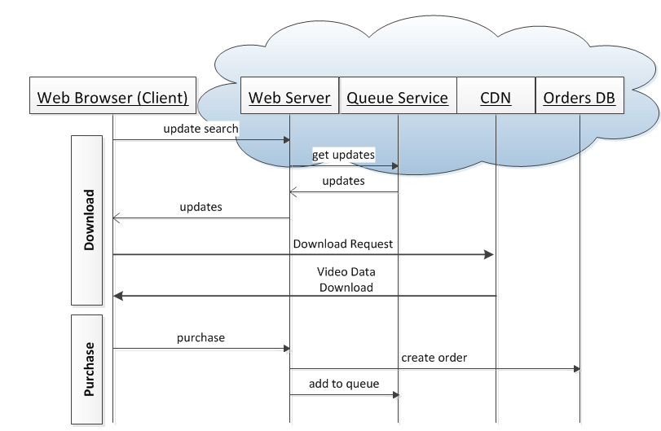
7. Easy Integration -
Many Services, One Provider
A Video Download Service
Your Application, plus:
Storage
Databases
Web Servers
CDN
….all in the Cloud
Availability and
Interoperability
within a single
cloud provider
Simpler than building full solution.
Notes:
Describe PURCHASE scenario first – it makes more sense that way
- Culminates in video added to queue of videos to download now
DOWNLOAD scenario
Update search → get updates – Do I have anything in my queue to download now?
Updates → updates – Here is the URL of a video you should download now
Download Request / Video Data Download – Actual video download from CDN

Slide 29
Getting Into The Cloud
Plan Pick and Execute

Slide 30
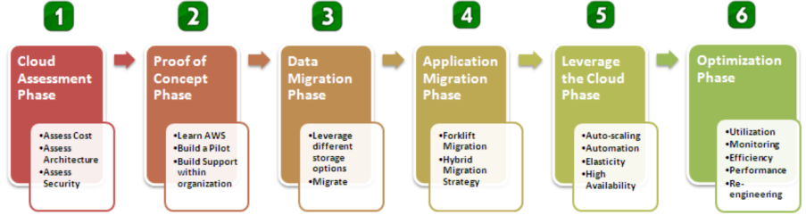
Plan Your Cloud Migration
Model courtesy of Amazon
  Six step model
  Plan, proof of concept, execution, optimize
Leaping into the Cloud is mostly about planning and execution
[AWS Whitepaper]

Slide 31
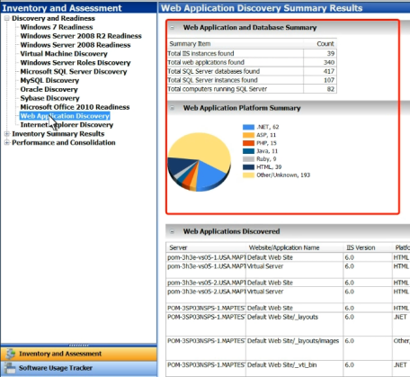
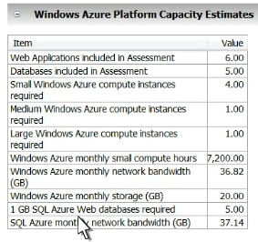
Plan for each Application
The cloud providers want you there
Microsoft Azure
  Microsoft Assessment and Planning (MAP) Toolkit [MAP Toolkit]
    Automatically finds your web apps, web servers and DBs
Estimates what you need
Azure compute instances
SQL Azure DBs
Bandwidth
Storage

Slide 32
Execute you plan
Proof of Concept
  Build a trial version in the cloud
  Plan for data Migration and App Migration
To do this, you will need to pick a cloud provider
[AWS Whitepaper]

Slide 33
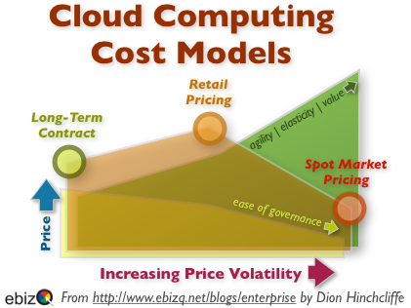
Pick the Services you need
Types of Services you need (Window/Linux)
Type of Contract
  Different pricing
  Different SLAs
Security Levels
  FISMA Compliant – Federal Information Security Management Act [FISMA, 2002]
  Other Security compliance
Dynamic Pricing Models

Slide 34
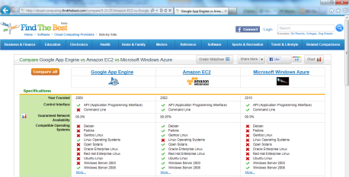
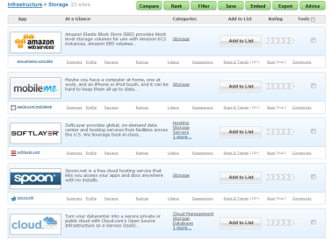
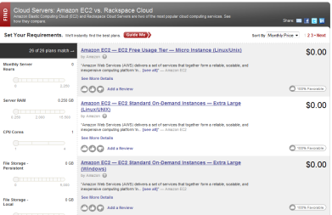
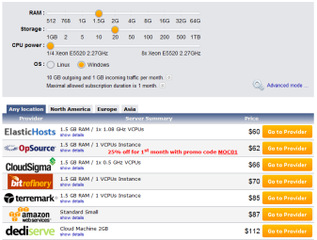
Pick the Right Cloud Provider
Handy Cloud Computing Price Comparison Engines [Cloud Tweaks, 2011]
FindTheBest.com
ServDex.com
CloudSurfing.com
Cloudarade.com
Notes:
Cloud Comparison Tools

Slide 35
5 Amazing Cloud Case Studies
  Rewards, Risks & Mitigations
Notes:
Amazon - Savings of Elasticity
Bing Travel / FareCast - Business Continuity Perils
SmugMug - Design for Business Continuity
Netflix - Design for Fault Tolerance
Amazon - Security

Slide 36
Reward
Risk
Mitigation

Slide 37
Reward
Risk
Mitigation

Slide 38
Reward
Risk
Mitigation

Slide 39
Reward
Risk
Mitigation

Slide 40
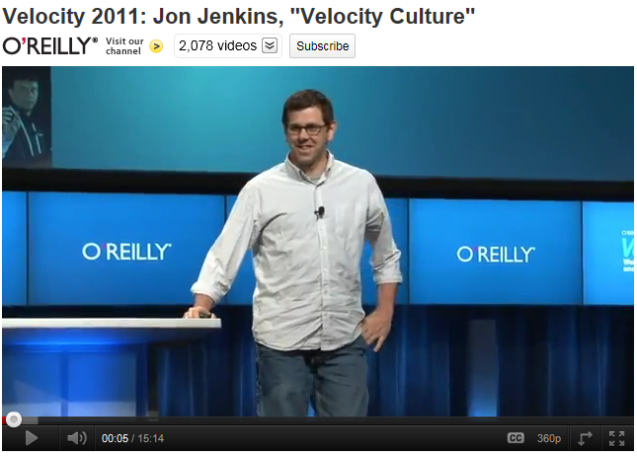
Amazon.com Elasticity and Cost Savings
Reward
Risk
Mitigation
[Jenkins, 2011]

Slide 41
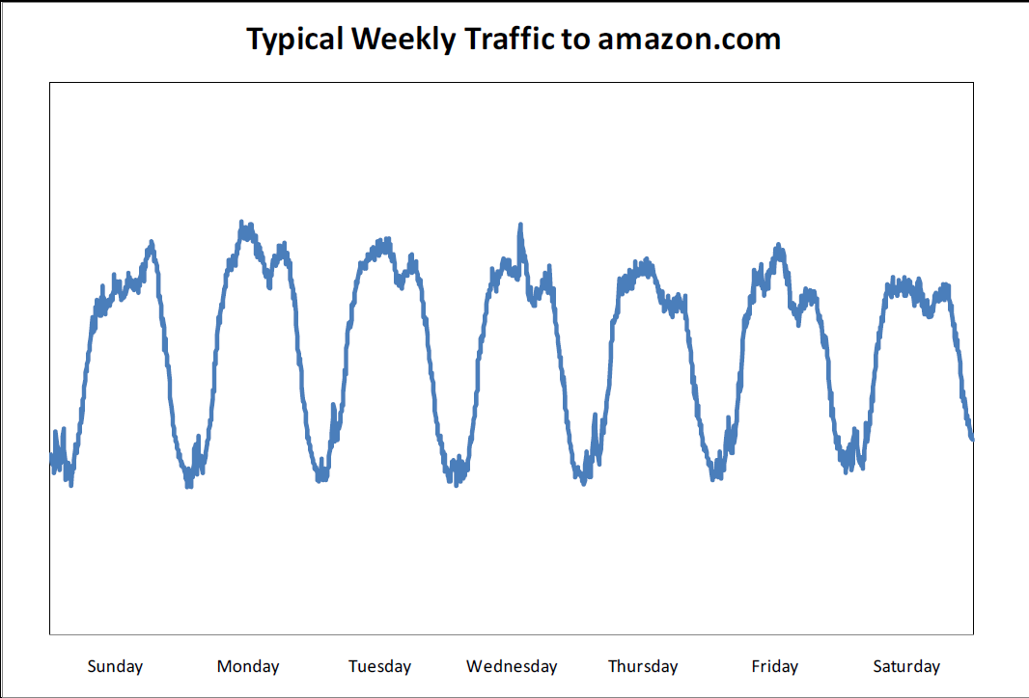
Website Traffic is Spikey
Reward
Risk
Mitigation

Slide 42
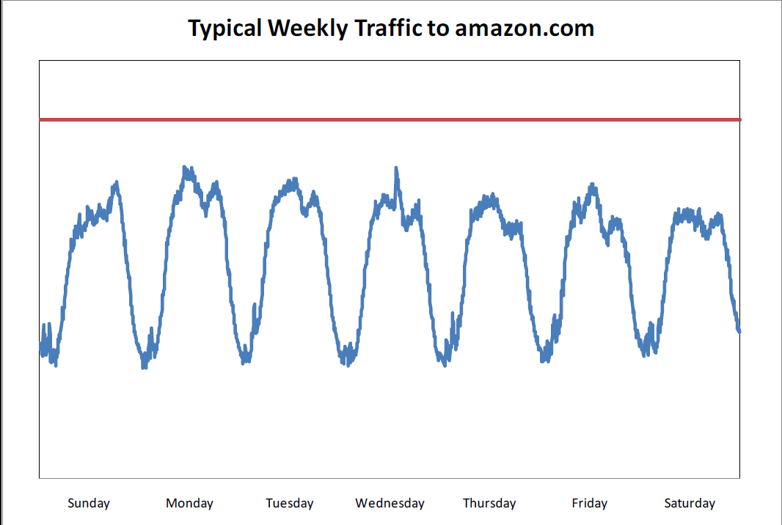
Add a Buffer
Reward
Risk
Mitigation

Slide 43
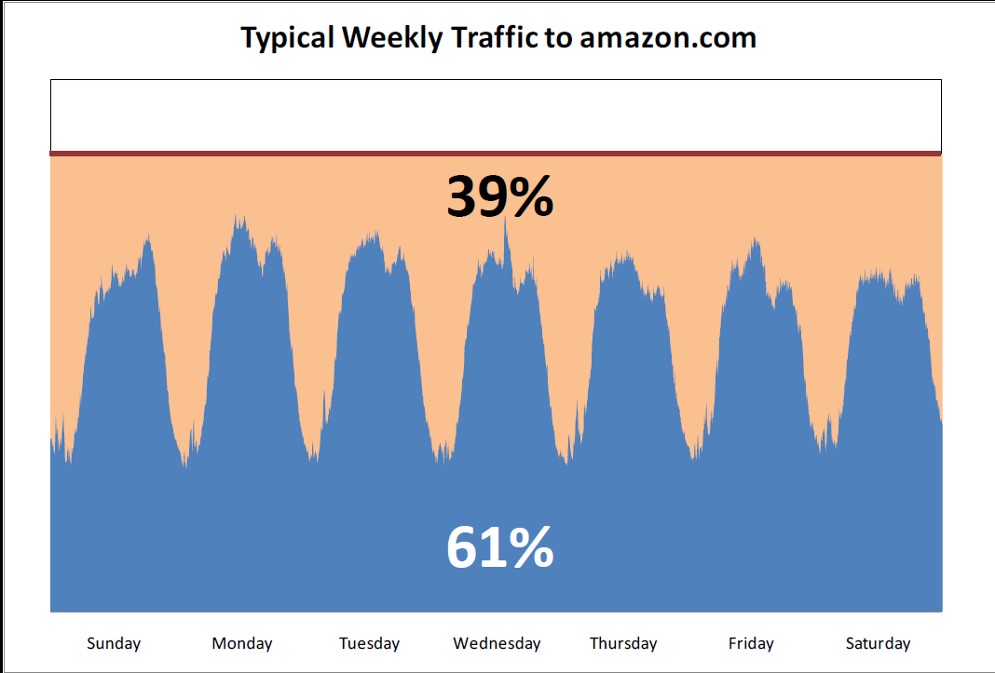
Major Waste!
Reward
Risk
Mitigation

Slide 44
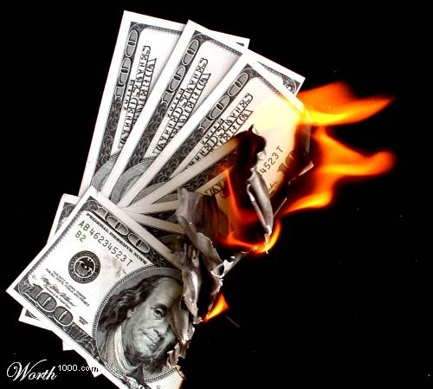
But it’s Even Worse
Reward
Risk
Mitigation

Slide 45
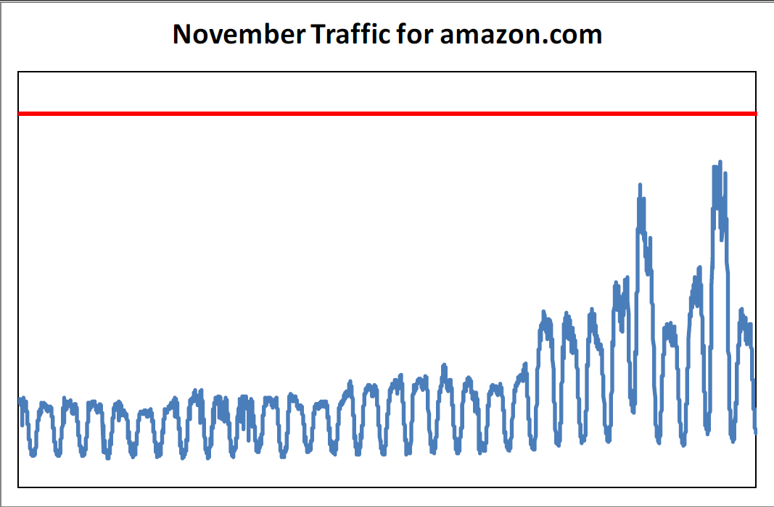
Seasonality Spikes
Reward
Risk
Mitigation

Slide 46
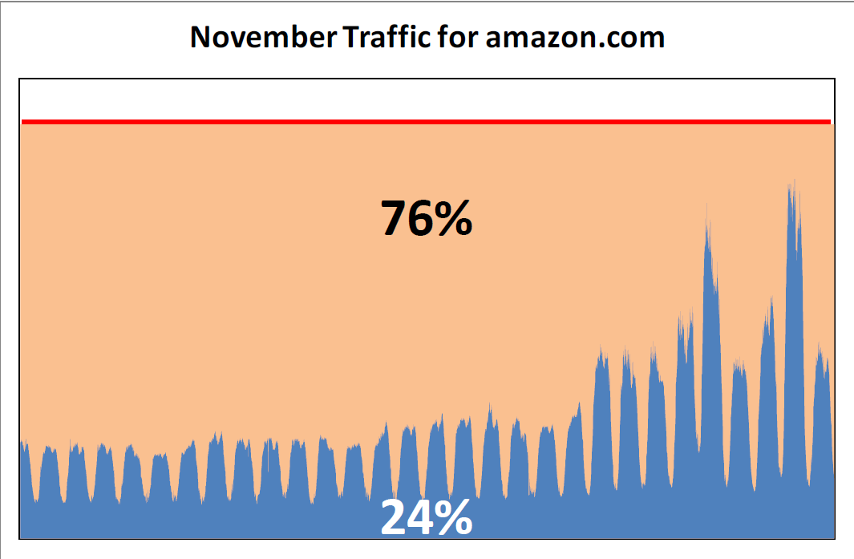
Big Waste
Reward
Risk
Mitigation
Notes:
Ken TBD: want to improve transition from this slide to the conclusion on the next one

Slide 47
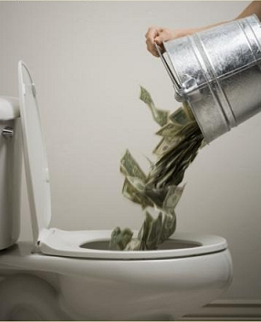
Might as well be Flushing $$
Reward
Risk
Mitigation
Must have Active Passive Failover
Let’s Build for Peak + Buffer
You Can’t Survive if your COGS are the highest
Give me a Break

Slide 48
Let’s Move to the Cloud
Reward
Risk
Mitigation
November 10th 2010 full migration to EC2
Reduced spending on server capacity
Fleet scales dynamically in increments as small as a single host
Traffic spikes handled with ease
Cultural change – aim for small server footprints
Notes:
So does Amazon, Google…..

Slide 49
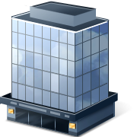

Business Continuity
Reward
Risk
Mitigation
Notes:
RISK
This is your Office…In it is your data center…..
(drought? Sure…can cause power outages…)

Slide 50
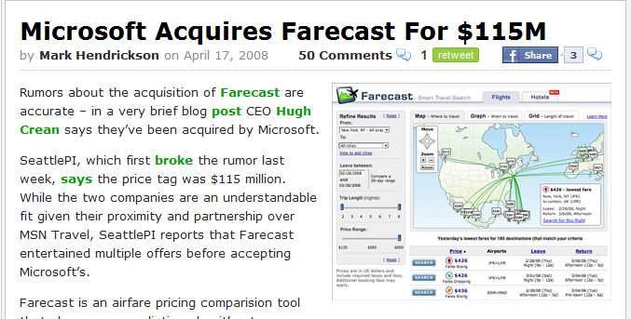
A Cautionary Tale
Reward
Risk
Mitigation
April 2008
Farecast becomes Bing Travel

Slide 51

No Safety Net
Reward
Risk
Mitigation
Service housed in a single Datacenter.
No Budget for 2nd DC Buildout.

Slide 52
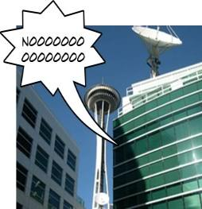
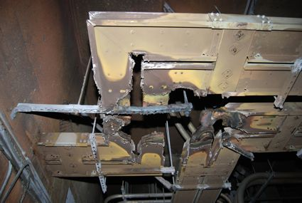
July 2009
Disaster Strikes!
An Electrical Fire @ Fisher Plaza
Reward
Risk
Mitigation
TV Stations, Radio Stations, Online Games, & Bing Travel

Slide 53


Bing Travel is now
Reward
Risk
Mitigation
2+ Datacenters

Slide 54
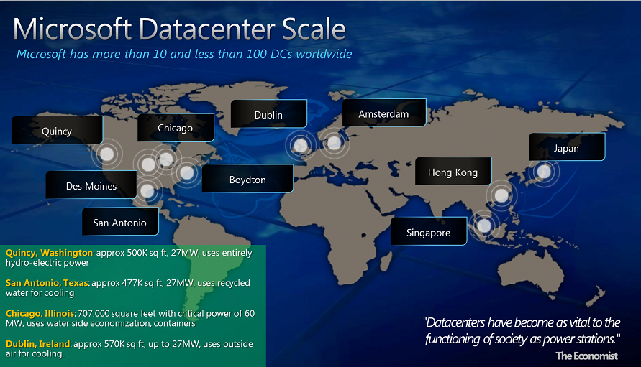
Microsoft has Geo-Redundancy
Reward
Risk
Mitigation
Notes:
So does Amazon, Google…..

Slide 55

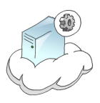
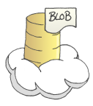

…Therefore YOU have
Geo-Redundancy
Reward
Risk
Mitigation
…in The Cloud
Windows Azure Traffic Manager
  Automatically load balance traffic to the best data center
    Performance
    Failover
Amazon S3 Storage
  “data is replicated over multiple locations such that failure modes are independent of each other. The locations are chosen with great care to achieve this independence”
  [Amazon geo, May 2010]
  Google Cloud Storage
  “We replicate data to multiple data centers and serve an end-user’s request from the nearest data center that holds a copy of the data”
  [Google Cloud Storage]
[Images: http://thejoyofcode.com]
Notes:
Click: for services
Click: for data
S3: Werner Vogels, Amazon CTO
Image credits: Josh Twist - http://www.thejoyofcode.com/cloud_artwork.aspx
Another example:
RackSpace Cloud???
Three full copies of data across multiple "zones" within the same data center
RackSpace not geo-redundant.. Leads to next slide to design around this.

Slide 56

…Or Do You?
Reward
Risk
Mitigation
April 21, 2011 –
Again, you are responsible for good design
Skynet begins it’s attack against humanity
http://en.wikipedia.org/wiki/Skynet
Credit to Don MacAskill for pointing this out
Notes:
RISK Part 2
This slide builds with the next – careful if you move anything

Slide 57




…Or Do You?
Reward
Risk
Mitigation
April 21, 2011 – Amazon AWS EC2/RDS Outage
Took down
But one website had reason to be Smug
  …minimally impacted, and all major services remained online during the AWS outage
Netflix stayed up too… more later…
Again, you are responsible for good design
Notes:
RISK Part 2
This slide builds with the previous– careful if you move anything
EC2: Elastic compute cloud
RDS: Relational DB Service

Slide 58
…Or Do You?
Reward
Risk
Mitigation
April 21, 2011 – Amazon AWS EC2/RDS Outage
Took down
But one website had reason to be Smug
  …minimally impacted, and all major services remained online during the AWS outage
Netflix stayed up too… more later…
Again, you are responsible for good design
You must…
Design for Redundancy
Notes:
This slide builds with the previous– careful if you move anything

Slide 59
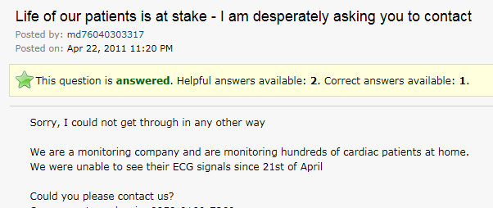
Don’t Be This Guy
Reward
Risk
Mitigation
Notes:
OK for critical software to use cloud.
NOT OK for them to not be aware of cloud risks and need for fault tolerant design
Note the photo sharing site knew this, but the heart monitoring site did not

Slide 60

How Did SmugMug Do It?
Reward
Risk
Mitigation
Availability Zones (AZs)
Failures Should Not Span AZs
  In this case they did!
SmugMug uses Three AZs
Designed to fail and recover
  Any of our instances, or any group of instances in an AZ, can be “shot in the head” [SmugMug April 2011]
Incident Response
  We updated our own status board, and then I tried to work around the problem…. 5 minutes [later] we were back in business
Notes:
MITIGATION
Image only – Ask Audience What is This?

Slide 61
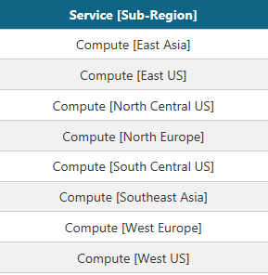

How Do You Do It?
Reward
Risk
Mitigation
Multiple Amazon AZs or Azure Regions
Plus Traffic Management
  Multiple service instances costs more
Azure LRS: Local Redundant Storage
  Protects against common failures (disk, node, rack)
Azure GRS: Geo-Redundant Storage
  Protects against Data Center outage
  Costs 23%-34% more
Choose how to spend your $$$
  Resiliency or Response
Notes:
Click – services
Click – data/storage
Click - Resiliency or Response – Both are valid choices depending on business need
Spend money up-front to avoid business continuity issues
Or spend money once an issue happens
To recover
“spent” on lost business
On GRS and LRS:
<http://blogs.msdn.com/b/windowsazure/archive/2012/06/08/introducing-locally-redundant-storage-for-windows-azure-storage.aspx>

Slide 62

Fault Tolerance
..or What Do You Need to Worry About When Running Your Own Data Center
Reward
Risk
Mitigation
Failure is Always an Option
For Example….

Slide 63

First Year -New Data Center
Reward
Risk
Mitigation
1 Power Distribution Unit failure (500-1000 machines)
1 rack-move (500-1000 machines)
1 network rewiring (rolling 5% of machines)
20 rack failures (40-80 machines)
8 network maintenances (~30-min connectivity losses)
12 router reloads
3 router failures
Dozens of minor 30-second blips for DNS
1000 individual machine failures
1000s of hard drive failures
[Google Cluster, 2008]
Notes:
Imagine how much this will cost you?
RISK
Caveat: Google does use lower quality hardware at a MUCH lower cost…
“Failure is Always an Option” – Adam Savage (although earlier reference here: http://www.angryflower.com/crisis.html)

Slide 64


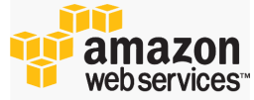

How Does The
Cloud Help?
Reward
Risk
Mitigation
The Cloud is better
Fault-tolerant hardware and network infrastructure
Advanced Ops personnel and processes
State of the art: Power, Cooling, Security
The Cloud is not better
but gives you better tools to….
Notes:
Benefits of Cloud infrastructure
But Clouds have outages too
Azure Leap Day outage Feb 2012 - http://www.networkworld.com/news/2012/031212-azure-outage-credits-257173.html
Amazon AWS (previously discussed)
Use Cloud tools to…. (next slide)… Embrace Failure (design defensively)

Slide 65

…Embrace Failure
Reward
Risk
Mitigation
aka
design defensively
[http://despair.com]
Notes:
MITIGATION
Refer Back to SmugMug Slide

Slide 66

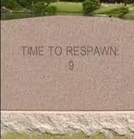
Embrace Failure
Reward
Risk
Mitigation
Design Defensively
Each System has to succeed, even on its own
  Small Stateless Services
  Recommendation System Down? Show popular titles instead of personalized picks
Assume host failures happen
  Remember, “shot in the head”
  Cloud Advantage: Re-Spawn!
Short Timeouts and Quick Retries – Fail Fast
  Co-tenancy can introduce variance in throughput at any level of the stack.
  Requires Idempotent Interfaces
Research and Test with Full Scale / Real Data
  Cloud Advantage: Elasticity
[Netflix AWS, Dec 2010]
[Twilio AWS, Apr 2011]
Notes:
MITIGATION
Refer Back to SmugMug Slide

Slide 67

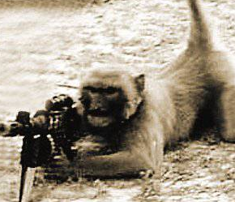

Destructive Testing
Reward
Risk
Mitigation
[Netflix Army, July 2011]
Netflix Simian Army
  Chaos monkey randomly disables production instance in AWS
  Chaos Gorilla simulates an outage of an entire Amazon AZ
  Janitor Monkey, Security Monkey, Latency Monkey…..
Amazon Game Day
  An entire Data Center is “wiped out”:
Notes:
Comment: surprisingly easy to find images of monkeys with rifles

Slide 68

Reward
Risk
Mitigation

Slide 69

Security
Reward
Risk
Mitigation
"...every cloud customer retains responsibility for assessing and understanding the value and sensitivity of the data they may choose to move to the cloud. As the owners of that information, cloud customers also remain accountable for decisions regarding the protection of that data wherever it may be stored."
[Microsoft Security, 2010]
For Example….

Slide 70
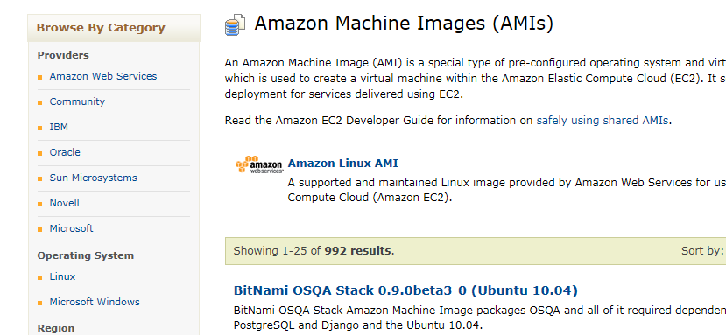








Amazon AMIs
Reward
Risk
Mitigation
Amazon Machine Image
Create and share virtual server configurations
Like Open Source –Give a little, Get a lot
Notes:
REWARD: Flexibility, re-usability, leverage work of others (open-source)
992 when talk first given in Nov 2011
In June 2012, there were 996 – I would have expected more. I wonder if they get deprecated?

Slide 71

AMI Key Vulnerability
Reward
Risk
Mitigation
AMI = House
SSH Key to House
June 2008 [Cloud Security 2008]
User creates AMI
AMI uploaded to AWS
Other users use AMI
Amazon Closes “Hole”
SSH
SSH
SSH
SSH
SSH
SSH
Notes:
After “Other users use AMI” explain
Having all SSH keys same is insecure
User can regen their own key, but only if they know to do that
Whose fault is this – Amazon or User?
[click] Amazon decided to be pro-active (going forward)

Slide 72

Abundant Security Problems?
Reward
Risk
Mitigation
June 2011
Users Publish AMIs containing API Authentication Keys
Amazon’s or User fault?
  User Violated Amazon Security Guideline
[IT World, 2011]
Notes:
Amazon did not take action on this
STILL up to user to not give away their API Authentication Keys
RTFM on next slide

Slide 73
Amazon AMI Mitigation
Reward
Risk
Mitigation
RTFM? :-)
Notes:
MITIGATION
Mitigation for 1 was possible, but hard to detect
For 2 was easy to detect once documented
Even Security expertise might not have helped, this is specific to the Cloud.

Slide 74
Testing in The Cloud

Slide 75



Facebook is a Cloud Platform
Reward
Risk
Mitigation
Apps power Facebook
Deploy and Run FB Apps [FB Heroku, 2011]
This is PaaS
Rewards:
Supports Ruby, Node.js, Python, or PHP
No need to setup host
Instant Scaling
Notes:
Heroku is a tightly integrated solution.
You can choose to use AWS if you wanted to also

Slide 76


What are the Risks?
Reward
Risk
Mitigation
How do We Test it?
Does it work?
Is it stable?
Users getting a Good Experience?
These risks are not cloud specific.
But the mitigation is….

Slide 77

Facebook Imaginary Friends
Reward
Risk
Mitigation
Notes:
Builds with next slide

Slide 78







Facebook Imaginary Friends
Reward
Risk
Mitigation
…they call them Test Users
Invisible user accounts
Not visible by others; can only be friends with other Test Users
Experience your app as a regular user
Power of the Cloud
Automated:
  Programmatic interface
  Web UI
Create up to 500 of them
[FB Test, 2011]
Notes:
500 users…. Leads into next slide with 1 million users

Slide 79

Control 1 Million Users
Notes:
This slide builds with next

Slide 80


Control 1 Million Users
SOASTA CloudTest
Uses Cloud IaaS Providers:
  GoGrid, Windows Azure, Amazon EC2
Generate high scale load from geo-dispersed origins
MySpace
1 million concurrent virtual users
  Plus Live Traffic
6 gigabits per second
6 terabytes of data transferred per hour
Over 77,000 hits per second Plus Live Traffic
800 Amazon EC2 instances / 3200 cloud computing cores
[SOASTA, 2010]
Notes:
Office.com
http://www.microsoft.com/casestudies/Case_Study_Detail.aspx?casestudyid=4000006979
March 2010
10,000 concurrent virtual users
25RPS, 3TB analytics

Slide 81
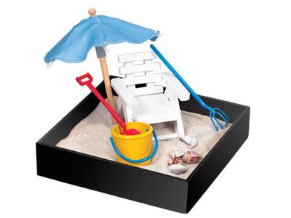
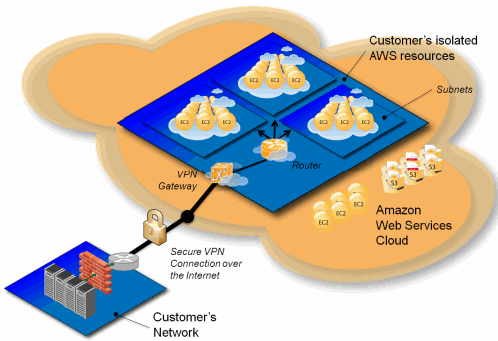
Virtual Sandbox
Production Environment
Staging Environment
Dev and Testing Environment
Can you have it all in one big Cloud?
Amazon Virtual Private Cloud (Amazon VPC)
Provision a private, isolated section of AWS
IP addresses, subnets, routing tables
Even Sandbox for Non-Cloud services
And remember the power of zero!
Notes:
power of zero = only pay for test resources when testing

Slide 82
Netflix “Canary” Deployment
1B API requests per day
Notes:
Typical problem found: memory leak
Move all users to Vnext and let bake – that is big data
http://perfcap.blogspot.com/2012/03/ops-devops-and-noops-at-netflix.html
Joe Sondow, Building Cloud Tools for Netflix
Slides: http://www.slideshare.net/joesondow/building-cloudtoolsfornetflix-9419504
Talk: http://blip.tv/silicon-valley-cloud-computing-group/building-cloud-tools-for-netflix-5754984

Slide 83
Test Oriented
Architecture
  Even Cloud Services need Testing
Notes:
Amazon - Savings of Elasticity
Bing Travel / FareCast - Business Continuity Perils
SmugMug - Design for Business Continuity
Netflix - Design for Fault Tolerance
Amazon - Security

Slide 84
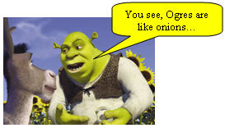

Ken’s Services Theorem
Services are like Ogres
Ogres are like Onions
Onions have Layers
Therefore services have Layers
The Problem is
The layers of a service spin at different rates
Movement toward continuous deployment

Slide 85
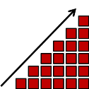
Code Churn Example 1
Maximum point of risk at end of milestone
Code churn is cumulative
Layer 1
Imagine this as part of a larger multi-layered project
Layer 2
Layer 3
One week of coding
Six week coding milestone
Tightly coupled layers
Long stabilization phase
Complicated end-to-end integration
Simultaneous ship increases risk
Notes:
TBD: Ken, fix initial label “six week…”

Slide 86
Code Churn Example 2 (CD)
Max Risk is Production
Rapid release cadence
(weekly or daily)
Layer 1
Risk per release decreases because of more incremental change
Change builds over time in production
Next release is always the most risky
Layer 2
Layer 3
Layer N

Slide 87


Practical TOA
More Loose Coupling across stack
  Splitting can be a good thing
  Your service in the Cloud
More Self Service Deployments
  Automated roll forward
  Rollback triggered by live site monitors
  Canary deployment zones
Notes:
TBD:
Ken avoid sim-ship, developers like to ship
Change self-serv image

Slide 88


Practical TOA
Automated Tests and Monitors are the same thing
Heavy Test Automation
Big Live Service Monitors
=

Slide 89


Practical TOA
Ship Test Hooks into production
  Runtime Flags to access test path
  Isolated Data Centers and Hosts
  Runtime routing of traffic from v-Current to v-Next
System During Test
U
X
A
P
I
System Under Test
Test Code
From Alan Myrvold “Patterns of Testability”
Rich Telemetry
  Your services telemetry
  Runtime flags for richer debug telemetry
  Fix the bugs users are seeing
Notes:
Amazon VPC does indeed allow for ACL restricted access to a service
http://docs.amazonwebservices.com/AmazonVPC/latest/UserGuide/VPC_ACLs.html
On the Azure side, it seems you can set an ACL for access to blob storage, but not to the service (role) itself
http://msdn.microsoft.com/en-us/library/windowsazure/dd179391.aspx
Amazon S3 allows similar ACL restricted blob storage access
http://docs.amazonwebservices.com/AmazonS3/latest/dev/ACLOverview.html
Question: Is there a way to ACL restrict access to an Azure service (web role)? How about if you are using a VM role

Slide 90

Summary
About Clouds
Cloud Rewards
Getting Into The Cloud
5 Amazing Cloud Case Studies
  Rewards, Risks & Mitigations
Testing in The Cloud
The latest version of this slide deck can be found at:
http://www.setheliot.com/blog/bsc-west-2012/

Slide 91
References
[Amazon geo, May 2010] | Expanding the Cloud - Amazon S3 Reduced Redundancy Storage, Werner Vogels May 2010; http://www.allthingsdistributed.com/2010/05/amazon_s3_reduced_redundancy_storage.html
[Amazon Growth, 2011] | Amazon S3 - 566 Billion Objects, 370,000 Requests/Second, and Hiring! Oct 4, 2011 http://aws.typepad.com/aws/2011/10/amazon-s3-566-billion-objects-370000-requestssecond-and-hiring.html
[AWS Whitepaper] | Migrating your Existing Applications to the AWS Cloud (with 3 example scenarios) Oct 2010; http://d36cz9buwru1tt.cloudfront.net/CloudMigration-main.pdf
[Berkeley 2009] | Above the Clouds: A Berkeley View of Cloud Computing; Feb 2009; http://www.eecs.berkeley.edu/Pubs/TechRpts/2009/EECS-2009-28.pdf
[CCJ, 2011] | http://cloudcomputing.sys-con.com/node/1662284 , Feb 2011
[Cloud Security 2008] | Is Your Amazon Machine Image Vulnerable to SSH Spoofing Attacks?, July 2008; http://cloudsecurity.org/tags/ssh.html
[Cloud SLAs] | http://www.microsoft.com/windowsazure/sla/; http://aws.amazon.com/ec2-sla/; http://www.rackspace.com/cloud/legal/sla/; http://www.google.com/apps/intl/en/terms/sla.html
[Cloud Tweaks, 2011] | http://www.cloudtweaks.com/2011/08/3-handy-cloud-computing-price-comparison-engines/, August 2011
[Deschamps 2012] | Experiences of Test Automation; Dorothy Graham; Jan 2012; ISBN 0321754069; Chapter: “Moving to the Cloud: The Evolution of TiP, Continuous Regression Testing in Production”; Ken Johnston, Felix Deschamps
[FB Heroku, 2011] | Facebook and Heroku; http://blog.heroku.com/archives/2011/9/15/facebook/, Sept 15 2011 ; https://devcenter.heroku.com/articles/facebook
[FB Test, 2011] | Making it easier to create and manage Test Users ; http://developers.facebook.com/blog/post/527/ , July 27 2011
[FISMA, 2002] | http://en.wikipedia.org/wiki/Federal_Information_Security_Management_Act_of_2002
[Forbes, 2011] | http://www.forbes.com/sites/kevinjackson/2011/04/19/cloud-to-command-90-of-microsofts-rd-budget/ , April 2011
[Google Cloud Storage] | http://googledevelopers.blogspot.com/search/label/google%20storage
[Google Cluster, 2008] | Jeff Dean, Google IO Conference 2008, via Stephen Shankland, CNET http://news.cnet.com/8301-10784_3-9955184-7.html

Slide 92
References
[Hinchcliffe, 2009] | http://www.zdnet.com/blog/hinchcliffe/cloud-computing-and-the-return-of-the-platform-wars/303 , March 2009
[IT World, 2011] | Amazon's cloud is full of holes, June 2011; http://www.itworld.com/security/175927/researchers-aws-users-are-leaving-security-holes
[Jenkins, 2011] | Velocity 2011: Jon Jenkins, "Velocity Culture" , June 2011; http://www.youtube.com/watch?v=dxk8b9rSKOo
[MAP Toolkit] | Microsoft Assessment and Planning (MAP) Toolkit for Windows Azure Platform ; http://technet.microsoft.com/en-us/solutionaccelerators/gg581074
[Microsoft DC, 2011] | Microsoft GFS Datacenter Tour (4:53); http://www.youtube.com/watch?v=hOxA1l1pQIw
[Microsoft Jobs, March 2012] | http://www.microsoft.com/en-us/news/features/2012/mar12/03-05CloudComputingJobs.aspx
[Microsoft Security, 2010] | Information Security Management System for Microsoft’s Cloud Infrastructure, http://www.globalfoundationservices.com/security/documents/InformationSecurityMangSysforMSCloudInfrastructure.pdf November 2010
[Netflix Army, July 2011] | The Netflix Simian Army; July 2011; http://techblog.netflix.com/2011/07/netflix-simian-army.html
[Netflix Autoscaling, 2012] | http://techblog.netflix.com/2012/01/auto-scaling-in-amazon-cloud.html
[Netflix AWS, Dec 2010] | 5 Lessons We’ve Learned Using AWS , Dec 2010; http://techblog.netflix.com/2010/12/5-lessons-weve-learned- using-aws.html
[R&M, 2010] | http://www.researchandmarkets.com/reportinfo.asp?cat_id=0&report_id=1395650 , Oct 2010
[SmugMug April 2011] | How SmugMug survived the Amazonpocalypse, April 2011; http://don.blogs.smugmug.com/2011/04/24/how-smugmug-survived-the-amazonpocalypse/
[SOASTA, 2010] | How MySpace Tested Their Live Site with 1 Million Concurrent Users; http://highscalability.com/blog/2010/3/4/how-myspace-tested-their-live-site-with-1-million-concurrent.html , March 4 2010
[Staten, 2010] | Could Cloud Computing Get Any More Confusing?; http://blogs.forrester.com/james_staten/10-05-20-could_cloud_computing_get_any_more_confusing James Staten, Forrester Research; May 20, 2010
[Twilio AWS, Apr 2011] | Why Twilio Wasn’t Affected by Today’s AWS Issues, April 2011; http://www.twilio.com/engineering/2011/04/22/why-twilio-wasnt-affected-by-todays-aws-issues/

Slide 93

Thank You
Session BW7
Leaping into “The Cloud”:
Rewards, Risks, and Mitigations
Ken Johnston, Seth Eliot
Thank you for attending this session.
Please fill out an evaluation form.

