Slide 2

Your Path To Data-Driven Quality
Seth Eliot
Principal Knowledge Engineer, Test Excellence

Slide 3




About Seth
Digital Media Services
A/B Testing of Services
Petabytes Processed
Services and
Cloud and
Data-Driven Quality and...
Notes:
Take-away: I have been working with data and services for a while.

Slide 4



Roadmap
Notes:
Let’s talk about roadmaps. Why might you need a Roadmap?
Without a Roadmap you can get lost, end up at the wrong place or wrong time
[CLICK] (pause) for example this is near this very spot, just a scant 4 days ago. There I am, and there are my daughters.
[CLICK] It was the Emerald City Comicon
Now I was happy to be there, but if I had intended to be here instead, then the distinct lack of software development methodologies at comicon may have put me off
So……
[NEXT SLIDE]
In this session will learn how to create your roadmap to data-driven quality

Slide 5


…how to create your “roadmap” to DDQ
Roadmap
Road, Car, Gas
At destination
Application (service or product)
Environment
Engineering Processes
Roadmap
You and your...
DDQ Strategy
Notes:
DDQ=Data-Driven Quality
A road-map is NOT a solution. It enables you to find a solution
A road-map alone cannot get you home… you also need the road and the car and the gas
[CLICK] similarly to get to your DDQ solution, I can help you build a roadmap, but you need to bring in knowledge of….
I cannot tell you what those are for your “world”
Roadmap is complimentary to thise
I cannot give you a prescriptive solution, but I can give you a way to find your solution

Slide 6
Data-Driven Quality
What is it? Why is it important?

Slide 7

Data, where have we been?
The HiPPO
Highest Paid Person’s Opinion
Engineering Data
    Test pass/fail results
    Bug counts
    Delivery cadence
    Code coverage
    Code Churn
Notes:
HiPPO story: 2/3 of decisions where the wrong ones – catch and fix before you commit
Ref: R, Kohavi, T. Crook, R. Longbotham; Online Experimentation at Microsoft, https://expplatform.sharepoint.com/Pages/expMicrosoft.aspx

Slide 8

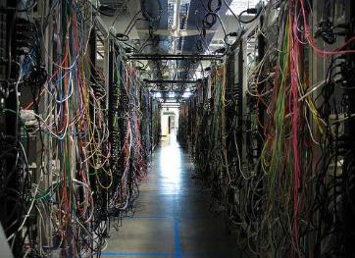
Data, where are we going?
Engineering data
  Test results → Scoring engines using Bayesian analysis
Production-quality data
  You may have heard of TiP
  Not as difficult as you might think
    Lots of solutions for lots of application types
Real Users
Production Environments
Notes:
Scoring engines using Bayesian analysis allow us to focus on the history of test results to determine go/no-go rather than individual test results from a single test pass (which can be flakey).
Production-quality data include production data and data appreciably like production (in terms of quality assessment results)
Production Data is also known as Operational Data
TiP = Testing in Production
Do It In Production - Testing Where It Counts, Test Bash 2.0 http://blogs.msdn.com/b/seliot/archive/2013/05/01/do-it-in-production-testbash-video-now-available.aspx
*CLICK* In today’s talk I will focus on production-quality data
It is the newest / emerging area
Folks are less familiar with it (therefore this learning is more needed)
There is a lot of value to unlock here
Users are weird, they do unexpected things. – real data lets leverage this behavior
Real environments, whether data center or desktop always contain the unexpected, leverage that too

Slide 9
The roadmap
Determine your questions
Design for production-quality data
Select your data sources
Use the right data tools
Get answers to your questions
Learn new questions
Repeat

Slide 10
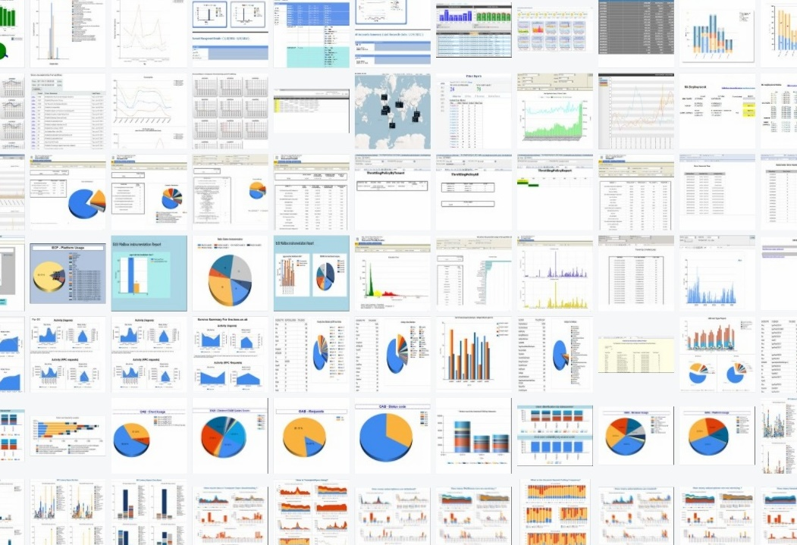
“Big Data” is hot, let’s start with that
Performance
Availability
“Big Data” is hot, let’s start with that
Usage
?
GQM - 1994
Start at the beginning
Notes:
These are real graphs and charts from Exchange online – it is overwhelming
*click* The breadth of *what* we can determine about our system using data is quite vast
*click* “Big Data” is hot, let’s start with that
*click* No, start at the beginning, start with the questions (not a new idea – formalized in 1994)
GQM = Goal, Question, Metric
So our first stop on the road map is….
[next slide]…determine what questions we need answers to
GQM Reference
Basili, Victor; Gianluigi Caldiera, H. Dieter Rombach (1994). ftp://ftp.cs.umd.edu/pub/sel/papers/gqm.pdf

Slide 11
Determine your questions
Prioritize answers you seek
Notes:
Determine your questions based on your goals (GQ of GQM)

Slide 12

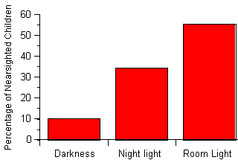
Why not just get data and look for answers?
Does sunscreen increase chance of drowning?
Quinn, et al, 1999
Do night-lights cause
near-sightedness in children?
Notes:
The alternative to determining your questions in advance would be to just get data and look for answers
Diving into the data can have value, but is an advanced method
If you just delve into the data statistical correlation does not always lead to a meaningful results – does not always show you causation
Sunscreen is correlated with drowning deaths, but it is not causal. They both have a common cause – warm sunny days
That may seem a silly example, but this actually is an easy mistake to make
*click* consider this much less absurd example. It turns out the room lighting did NOT cause the near-sightedness. Again there was a common cause: the fact that the parents were near-sighted (and needed more light in the kid’s room)
Refs for near-sightedness studies
Quinn, et al,1999
Quinn GE, Shin CH, Maguire MG, Stone RA (May 1999). "Myopia and ambient lighting at night". Nature 399 (6732): 113–4..
Zadnik, et al, 2000
Zadnik K, Jones LA, Irvin BC, et al. (March 2000). "Myopia and ambient night-time lighting". Nature 404 (6774): 143–4..

Slide 13

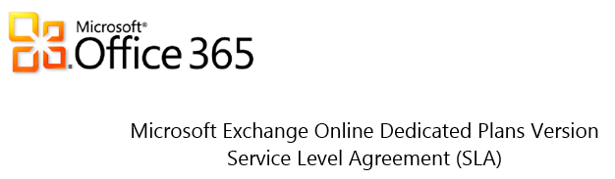
What questions does EXO ask?
Monthly Uptime Percentage | Service Credit
< 99.9% | 25%
< 99% | 50%
< 95% | 100%
“Downtime” is defined as any period of time when users are unable to send or receive email via all supported mailbox access
Notes:
Exchange cares about uptime
They have a direct financial commitment tied to it
http://download.microsoft.com/download/0/4/0/04054360-DC5E-4AB8-B3AB-6BF01BB3946C/Exchange%20Online%20SLA_Office%20365%20Dedicated%20Plans_Oct%202012.docx

Slide 14
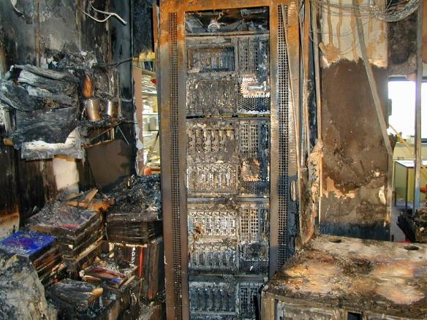
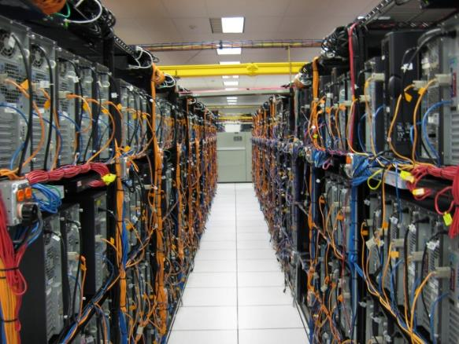
Is it available?
Often a Pri 0
Is the application (product, service) there for the user?
“Dialtone”
Critical work stoppage for user
Notes:
Availability is what we measure to insure uptime.
EXO asks “Is it available”
We often think of available as the difference between being live and
*Click* …offline

Slide 15

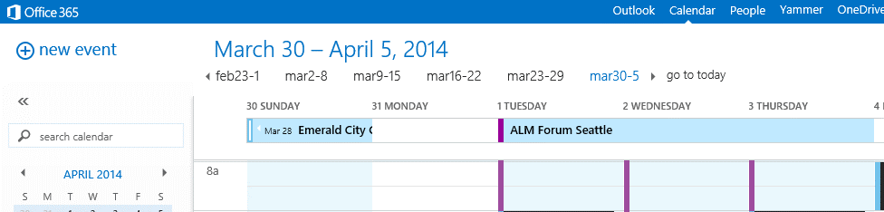
How do users perceive availability?
Application works, but feature does not
Occasionally does not render/load properly
違った言語
Notes:
…but you do not have to be offline to be perceived by the user as having availability problems
“Wrong Language” (written in Japanese)
Exchange had an “outage” where the silent deployment failure caused the Japanese language pack to not deploy
Users of EXO in Japan would see English instead
The product works, it is fully functional, but it is a perceived outage as it is not usable by the users who do not speak English
Another point: it is possible to misread your data. Data would show an increase in English usage in Japan – Is it caused by error, or are there just a bunch of English speaking businessmen in the country?

Slide 16
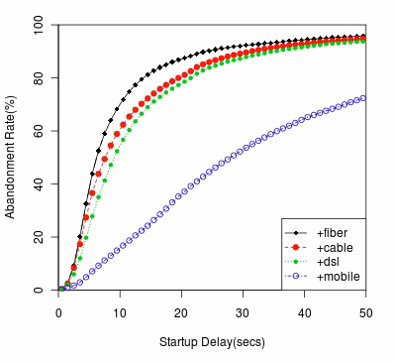




How is performance?
Huge Impact
Power of Production Data
Real users
Multiple environments
End to end
Scale &
geo-diversity
Notes:
Startup delay for video: Ref: http://people.cs.umass.edu/~ramesh/Site/HOME_files/imc208-krishnan.pdf
Performance is important, it translates to user SAT and therefore into dollars
[CLICK] You can test performance without production data, but Production data gives you the advantages of
Real usage
Scenarios traverse multiple systems
Multiple environments (OS, browsers, location etc.)
End to End
Thousands or Millions of users

Slide 17

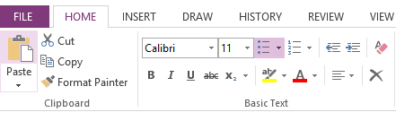

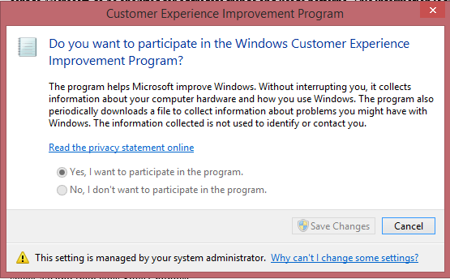
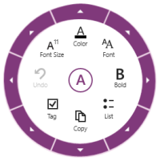
What do users do?
Customer Experience Improvement Program (CEIP)
Notes:
CEIP is Microsoft’s company-wide (multi-application) usage data collection platform
Opt-in
Anonymous
*CLICK* Was used to determine which features used most in OneNote to create the OneNote “wheel” in the modern app (Win 8) version of OneNote

Slide 18


Your turn - Determine your questions
What type of answer are you looking for?
  Availability, performance, usage?
  Prioritize
  When does availability NOT come first?
Notes:
When does availability NOT come first?
*click* Think about a consumer v1 startup, like Twitter or Facebook. They likely prioritize usage (and feature adoption) above all else

Slide 19
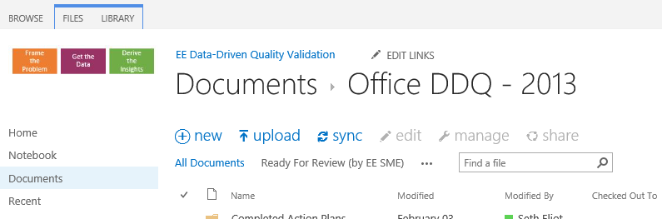

Your turn - Determine your questions
What are the key scenarios for the type you selected?
SharePoint
  What is high priority?
Notes:
Understanding a low priority might help you understand a high priority
This is a SharePoint page
*click* How important is it that this image show up every time? You could test that with production data, should you?

Slide 20
Design for production-quality data
Get data from or near production
Notes:
Data that is production data or has the qualities of production data

Slide 21
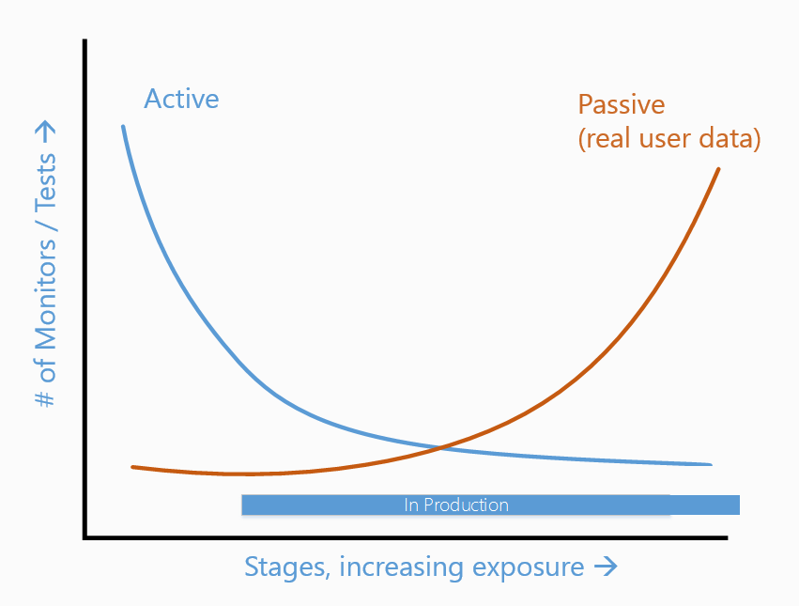
Two types of data to acquire
Active: synthetic
Passive: real (RUM)
  Active data in prod
  For services only?
  Client: is the service there?
Notes:
Active when no or few users
Active for Hi-Pri scenarios only
Passive finds the edge cases – the power of TiP
SOASTA
CloudTest: Active / Synthetic
mPulse: Passive/organic (real time)

Slide 22
Staged data acquisition mitigates risk
Service
Product (client, on-prem server)
Stage 1: In prod, no users
Stage 2: Dogfood
Stage 3: Some servers in prod
Stage 4: Some more servers in prod
Stage 5 : World-wide prod
Deployment Validation
Service Validation
Scale Validation
Real-time service quality
Stage 1: Partial or whole product team
Stage 2: Dogfood
Stage 3: Technology Adoption Programs (TAP)
Stage 5: All Customers
Stage 4: Some clients in production
Notes:
Explain difference between services and products
To the “left” of this is any pre-production testing
TAP means select external partners
The purpose of this is to mitigate RISK
This is *easier* for services, but is also practiced to good effect with clients
Not ALL stages are necessary, customize to your product or service

Slide 23


Staged data acquisition - Netflix
1B API requests per day
Canary Deployment
Notes:
Let’s look at an example of staged data acquisition at Neflix
Netflix is a streaming video service hosted on Amazon AWS Cloud
Available in both North and South America, the Caribbean, United Kingdom, Ireland, Sweden, Denmark, Norway, Finland
1B API requests = Big Data
Blue is Vcurr – smiley face represents customer traffic is carried on that (virtual) server
Red is Vnext, [click] Netflix spins up Vnext in the cloud carrying no user traffic
[click] They then put one red/Vnext server live carrying user traffic and let it run to test code quality
[click] They then switch user traffic to red/Vnext servers but keep blue/Vcurr ones around while they run overnight and check for problems
[click] Finally if all is well with Vnext, the release the Vcurr resources.
Typical problem found: memory leak
Move all users to Vnext and let bake – that is big data
Although not truly random and un-biased, there is still value here, especially to see large changes
http://perfcap.blogspot.com/2012/03/ops-devops-and-noops-at-netflix.html
Joe Sondow, Building Cloud Tools for Netflix
Slides: http://www.slideshare.net/joesondow/building-cloudtoolsfornetflix-9419504
Talk: http://blip.tv/silicon-valley-cloud-computing-group/building-cloud-tools-for-netflix-5754984

Slide 24
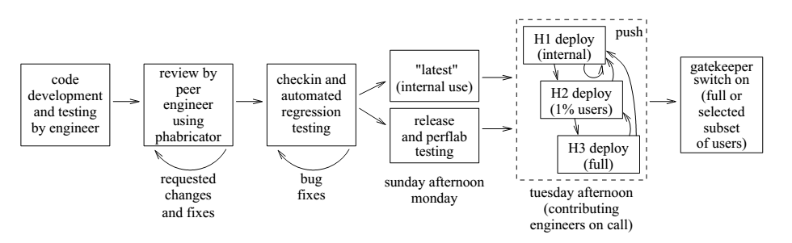

Staged Data Acquisition - Facebook
    Dogfood
    In prod, no users (except internal ones)
    Some servers in Production
    World-wide deployment
    Feature light-up
Notes:
Ref: Development and Deployment at Facebook https://www.facebook.com/publications/514128035341603
Feature light-up is something we did not yet discuss
“The deployed code includes all that’s been developed, both in production and under test,
using Gatekeeper to control what code paths are actually active. Thus, engineers can turn tests on
and off at will, and also apply them to only select user groups based on criteria such as country
or age group. Gatekeeper can also be used to turn off new code that’s causing problems”

Slide 25
Speed of deployment
Usually easy for services
Client apps may have a deployment capability
Or may make use of feature light-up
Deploy
Detect
EaaSy - Everything is now connected and thus updatable
Notes:
Virtuous cycle to enable acting on production data: Reaction time function of time to deployment and time to detect
*CLICK* focus on deployment
Deployment easy for services
Clients may have a deployment capability, such as Microsoft Update – but even this is not on-demand
Feature light-up gives an on-demand way to activate code paths for users
Still not 100% reliable like service (off-line machines)
*CLICK* EaaSy - Everything as a Service
Ref: Modern testing is becoming EaaSy, Ken Johnston, ALM Forum 2014 – Tue 11AM
(note EaaSy specifically refers to modern apps… it may not apply to your product… but you should think about how it should)

Slide 26

Staged data acquisition - Outlook
Filtering and aggregation at client
  Be kind to the client
Pipeline to collect and process data
  Make it easy
Staged Data Acquisition
Feature Crew
Outlook Team
MS Office Team
Microsoft
Customers
Scale Validation
Notes:
A Client example
- Aggregation can collect filter by event aggregate averages (or better percentiles) to dramatically lower bandwidth used
Microsoft Dogffod provides at-scale validation, but may not be representative of all real users

Slide 27
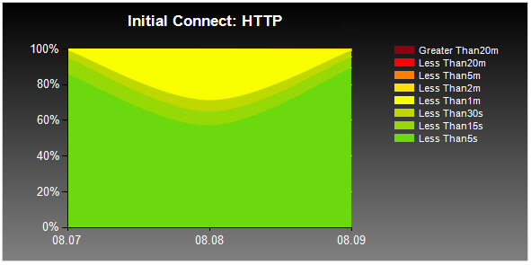
Notes:
(continuing the Outlook example)
This is the type of data we can get
Latency: Measure over time of how long it takes for Outlook to connect the service
Note how the latencies are divided into buckets – this can be done client side using the rules-based aggregation

Slide 28
Your turn - Design for production-quality data
What might be your stages for risk mitigated data acquisition?
Role of active and passive monitoring?
How can you engineer for EaaSy deployment?

Slide 29
Select your data sources
Determine the data necessary to answer your questions

Slide 30
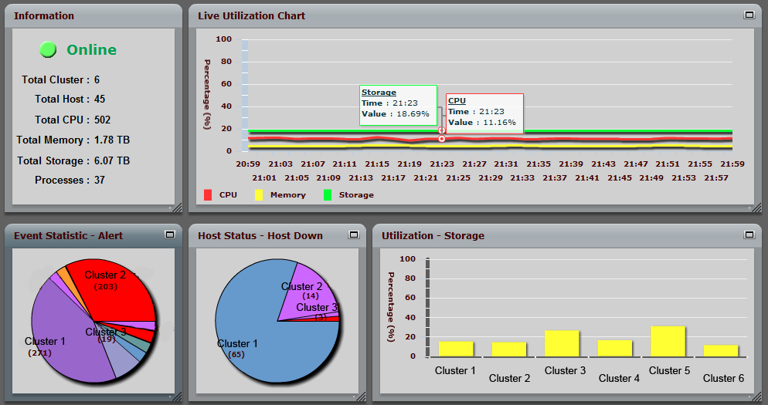
Infrastructure data
CPU
Memory
Storage
Network
Notes:
Screen shot from Ganglia monitoring system http://ganglia.sourceforge.net/
Screenshot from James Ong: http://comcrazy-devcenter.blogspot.com/2011/06/grid-monitoring-tool.html

Slide 31

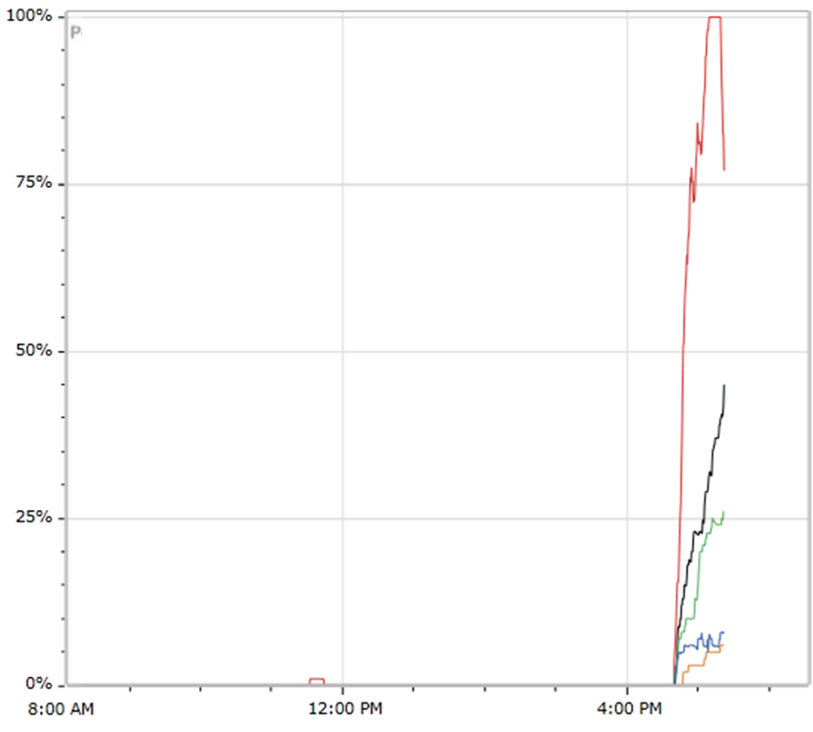
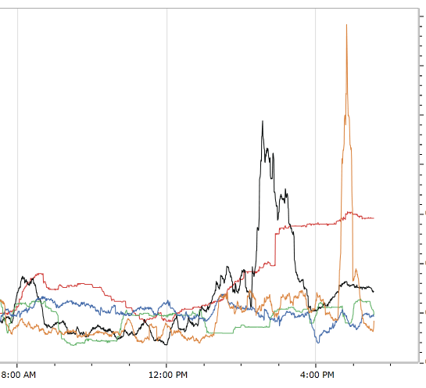

Application data
Failure Rate
Average Time
New and Open
Download Template
Notes:
This data is for office web apps
For application data we can focus on an API, a scenario, a code path, resource usage, etc
Something “bad” is happening around 4:30PM – failures and latency issues
Another good example how some problems can only be found in production
Everything looked fine from corpnet, but due to an errant whitelist connection from any endpoint other than corpnet was blocked

Slide 32

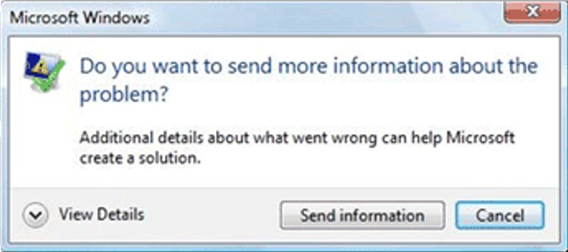
Hang and crash data
Specialized application data
  Most frequently encountered conditions
  Bucket the Big Data and find the offenders
  Get offending code and function calls (stack)
But it worked in Dogfood
  Culprit was a old version add-in
  Harden against this
Notes:
*CLICK*
For Microsoft word we started seeing crashes we never saw in Dogfood
Our telemetry allowed us to easily correlate these with the existence of a crufty oild add-in
DF users did not have this add-in
We could find in production using Microsoft Problem Reports / Windows Error Reporting
Refs:
- OSS spec on error reporting: http://msdn.microsoft.com/en-us/library/dd942170.aspx
- Vista/Win 7 implementation: http://windows.microsoft.com/en-US/windows-vista/Report-problems-and-check-for-solutions-automatically

Slide 33
Usage data
Client-side instrumentation
  Proprietary
  Javascript: clicks, hovers [web apps]
  Get 1x1 GIF: Page Views [web apps]
Combine into more complex scenarios
  How did user get to shopping cart checkout?
Notes:
We talked about this, and Microsoft CEIP previously, when we were discussing prioritizing your questions
Usage is also a data source…
… often requires sufficient customization to make it distinct from other application logging
*CLICK* Can be combined with A/B testing to see effect of different features and versions of the app

Slide 34
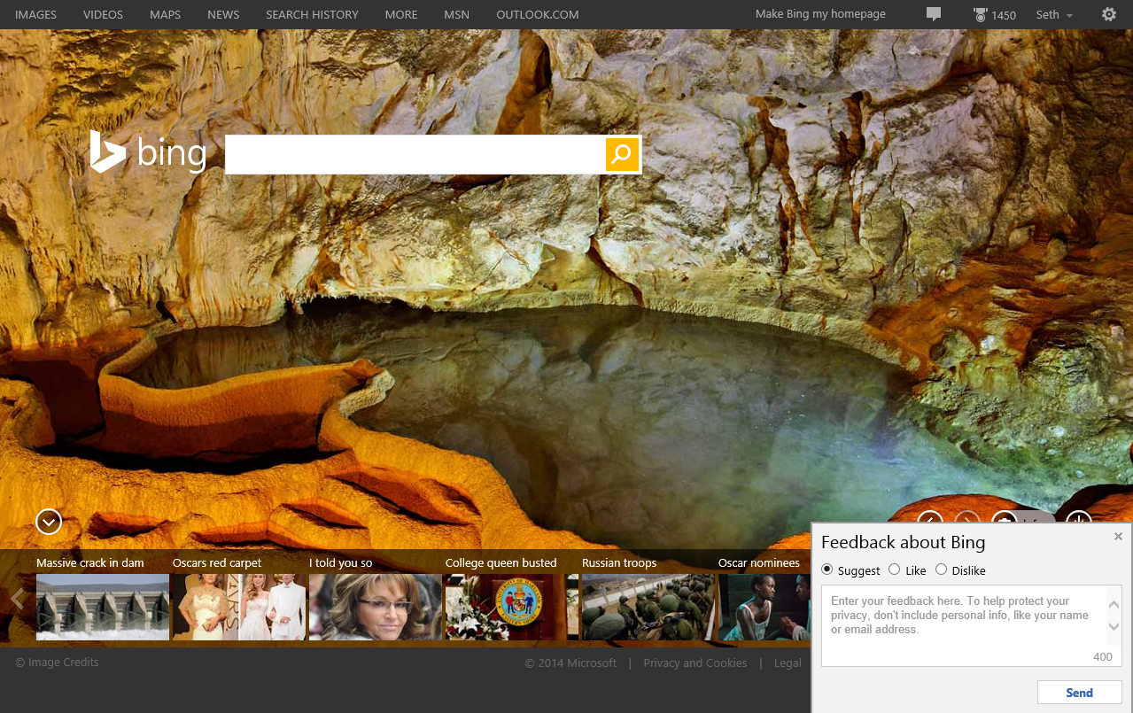
Feedback data
Notes:
Feedback includes quantitative (Like/Dislike, Likert Scale) and qualitative (text) data
Here is an example from Bing
NEXT PAGE And for internal Microsoft users, we can offer even more detailed feedback, including marking up the page
Image:
Cave of the Lakes, Greece http://www.bing.com/?FORM=HPBATW&ssd=20140302_0800

Slide 35
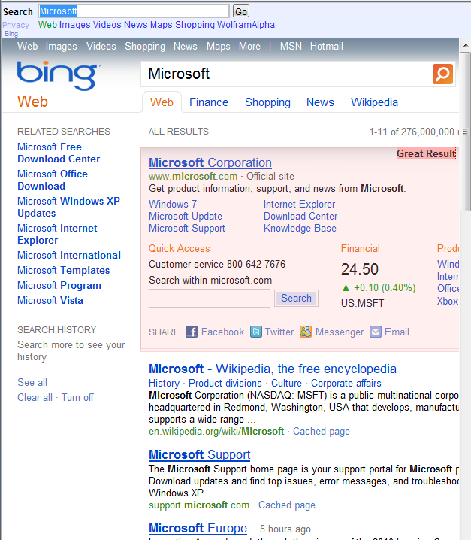
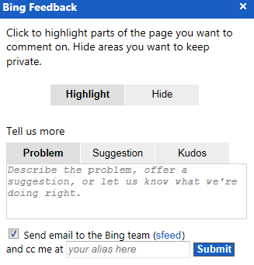
Feedback data
Notes:
And for internal Microsoft users, we can offer even more detailed feedback, including marking up the page

Slide 36
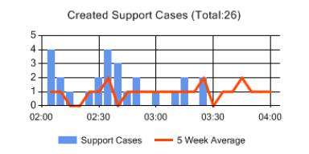
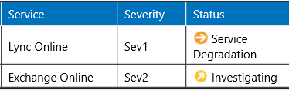
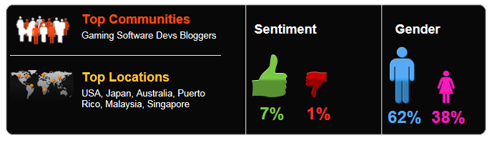
Feedback data also includes…
Customer Support Data
Social Media Mining
Xbox Kinect

Slide 37


Active monitoring data
Data Center X
Dependency Service(s)
AM2
Data Center Y
Client
Service
AM3
AM1
Notes:
Three types
AM1 On the box
AM2 In the data center
AM3 External
AM1 is good for deployment roll-outs where per server checks are required
AM2 avoids data transfer fees and external hosting expense vs AM3
AM2 can also access non-public APIs
AM3 is closer to real user experience
*CLICK* if you do not have another DC, you can pay someone else to host this testing – SOASTA Cloud Test
*CLICK* For Defense in depth, also test services you depend on – Don’t trust, but verify
*CLICK* Clients can also actively monitor the services they depend on

Slide 38
Ease of detection
Again services have it easy
Many clients are always connected
On prem servers (enterprise) require partnerships
Deploy
Detect
EaaSy – Rich near real-time telemetry
Notes:
Virtuous cycle to enable acting on production data: Reaction time function of time to deployment and time to detect
*CLICK* focus on detection
Many enterprises will partner to share data when they see the value for them
Faster support
Better quality product
Shared test efforts
*CLICK* EaaSy – Everything as a Service
Ref: Modern testing is becoming EaaSy, Ken Johnston, ALM Forum 2014 – Tue 11AM
(note EaaSy specifically refers to modern apps… it may not apply to your product… but you should think about how it should)

Slide 39
Data handling - privacy
Transparency and Control
Collection and Retention
Depends on Type
anonymous Data
pseudonymous
personally identifiable info (PII)
sensitive PII
Depends on Purpose
provide the service
improve the current service
improve a future version service
improve non-associated services
content personalization
ad targeting
Notes:
Not all data requires users have control, but all requires transparency on what is collected and how

Slide 40
Data handling – non-service products
Client and on-prem server considerations
User owned resources: bandwidth
battery
disk, cpu, etc…
Correlations
end-to-end across clients and services
by user , by session

Slide 41

Your turn - Select your data sources
Infrastructure data
Application data
Hang and crash data
Usage data
Feedback data
Active monitoring data
Design to handle your data

Slide 42

Use the right data tools
A 50,000 foot view

Slide 43
Data storage and processing systems
Database | Table storage (SQL) | Optimized for CRUD – (create, read, update, delete) of single records
Data Warehouse | Table storage (SQL) | Table structure optimized for queries and bulk insert
OLAP Cubes (Online Analytical Processing) | Multidimensional Cube (MDX) | Aggregations of measures for multiple dimensions
Hadoop / Map-Reduce | Distributed File System (HDFS) | Big Data TB-PB-EB Unstructured Data
Notes:
Data Warehouses
Often contain extra tables for aggregations Ex: Sales, Monthly Sales, Yearly Sales
Star schemas – will duplicate (de-normalize) to improve query speed
Cubes
Cache of aggregations tied to a DB or DW
Need to be explicitly updated
First 3 (blue) are based on a common technology (SQL, DB)
Last is newer, let’s explore it *NEXT SLIDE*

Slide 44


Hadoop in 60 Seconds
Hadoop
HDFS
Map-Reduce
ADDFCAECC
ADD
FCA
ADD
FCA
1xA
2xD
1xA
1xC
1xF
2xA
0xB
3xC
2xD
1xE
1xF
ADD
FCA
ADD
FCA
ECC
☹☹☹
1xE
2xC
ECC
ECC
ECC
Notes:
Hadoop is a tool for processing large data sets
Processing = what you might do with a SQL SELECT – combine, sort, count
Imagine this data set of 9 chars is actually 10s of trillions of chars
First we need to store massive amounts of data
Distributed storage: HDFS = Hadoop Distributed File System
Break file into pieces. Each piece stored multiple times (3) for redundancy
Then we need to process massive amounts of data
Distributed computing
Map-Reduce and similar algorithms
Bring the compute to the data in its split-up form
Map-Reduce can operate on the pieces
The processing is MAP’ed to the smaller subsets
The output of these many operations is then re-combined (REDUCED) into a single answer
"The map stage isn't really about moving execution to the data. It's more doing a parallel transformation of the data to another form. In the char count example, the map stage would take "aab" and map that to (a, 1), (a, 1), (b, 1). The reduce stage would sum the values for each key."
(remembering input is 10s of trillions) Output is a much smaller file than input
------------------------------------------
Hadoop is part of a rich eco-system of tools
- Hive - Data warehouse for Hadoop - http://hive.apache.org/
query the data using a SQL-like language called HiveQL
- Pig - http://pig.apache.org/
high-level language for expressing data analysis….compiler that produces sequences of Map-Reduce programs
Mahout - machine learning library - http://mahout.apache.org/
Scribe: log aggregation
HDInsight is Hadoop running on Microsoft Azure
Ref:
http://www.windowsazure.com/en-us/manage/services/hdinsight/
http://hadoop.apache.org/

Slide 45
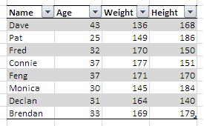
A common data flow
Power BI in Excel
SQL DW
Cube
Telemetry
System
Programmatic access
Real-time
Monitoring
Other Visualizations
Notes:
Common data flow
Hadoop and big data tools can take time to process. Results in DW/Cube give fast access to powerful results
Power BI is good for ad-hoc “desktop” analysis
But the above flow is not real-time – we take time to process and analyze the data
*CLICK* Real-time monitoring is another tool in our toolbox (generally for services only, but that will not always be the case)
*NEXT PAGE* Let’s see an example

Slide 46
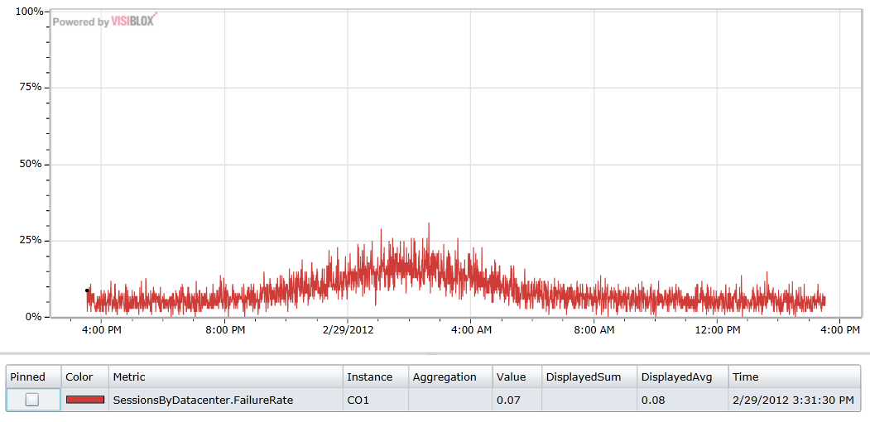


Real-time monitoring
Web Apps integrated with OneDrive, FB, web mail, etc
Notes:
This is real-time monitoring
Metric is the failure rate per session for a specific North America Data Center
Errors going up at night, when N. America should be asleep
*CLICK* tracked errors to servers serving mail.ru users in Russia and was able to fix
Why is failure rate non-zero at other times?
- There are legitimate reasons for a failure to be recorded, such as when a user closes the browser without a clean exit
N America saw usage down at night like we would expect, but failure rate going up. Dug in to find out who’s using us in the middle of the night. Detected traffic from Russia was dominating. Without having to write specific monitors for all of these partners, we were able to deduce the problem. In the end, it turned out that the acl’s between mail.ru and the n America hardware had problems. Fix was operational fix.

Slide 47
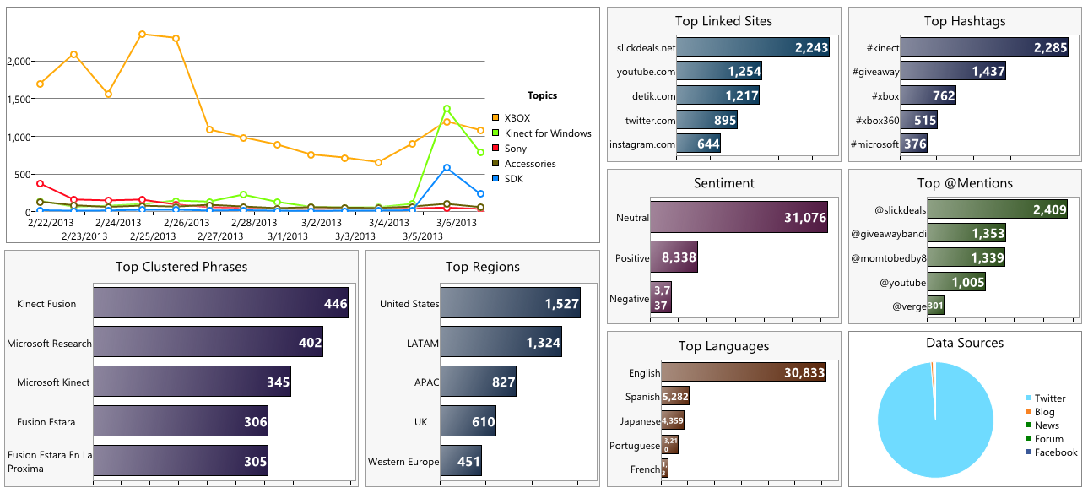
Feedback
Twitter
Xbox Kinect
Notes:
Feedback sometimes requires advanced analysis
*Do not try to read this entire slide*
This is an internal Microsoft tool. Public tools exist to do similar things
******* Turn Tweet stream into actionable metrics
Sentiment is positive 2:1; there was a spike in certain topics around TechFest (MSFT R&D showcase)
Can be used to find bugs too: version over version issues
-----------------------------
be used to find issues with released product.

Slide 48


Your turn - Use the right data processing tools
DB, DW, Cube, Big-Data platforms
  Put it all together
Do you need real-time monitoring?
…sentiment analysis?

Slide 49
Get answers to your questions
and learn new questions

Slide 50

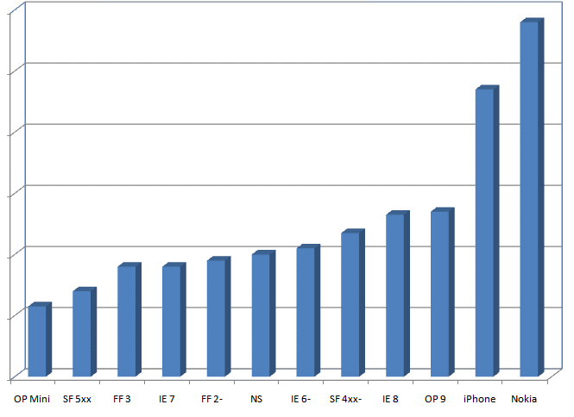
Outlook.com prioritizes performance
View Inbox – Page Load Time (PLT) by Browser
As experienced by actual users
JSI
JavaScript Instrumentation
500 Million measurements per month
Notes:
Instead of a huge matrix, you can use production to get the data you need
Of end to end performance under real operating conditions
In this case PLT for Outlook.com (Hotmail at the time) – from millions of actual users
Get data on every OS, browser, Geographic location, or data center used – instead of testing a huge matrix in the lab
Identified and remedied performance bottlenecks
They use JSI
This is Big Data
Not just a PLT, but a round trip for everything – data you can’t get in a lab
Public internet
Load balancers
LAN switches
Partner Services
This is (old) data from Hotmail (now Outlook.com). Based on this and similar measurements they
Identified and remedied performance bottlenecks
Such as upstream bandwidth constraints
By using more caching and static images

Slide 51
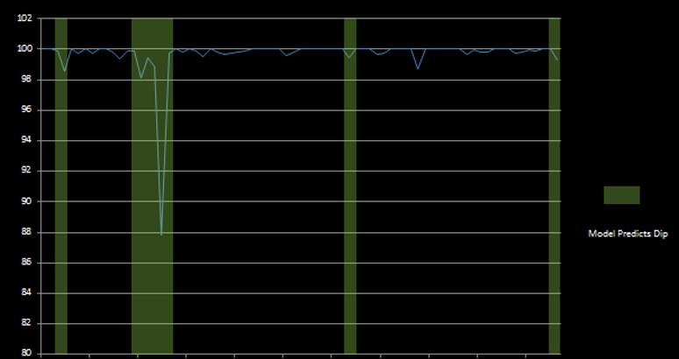

Availability
Prioritizes availability
Predict 75% of dips 24 hours ahead of time
Time
Notes:
Microsoft Exchange Online
Availability Big Data from
Over 8000 Servers instrumented
…to collect 1000 Metrics
- This is passive (analytic) application logging used in a proprietary formula to calculate availability
Machine Learning – It’s about fitting your data to a model
Think about simple linear regression y=mx + b, it is like that but can get much more advanced

Slide 52
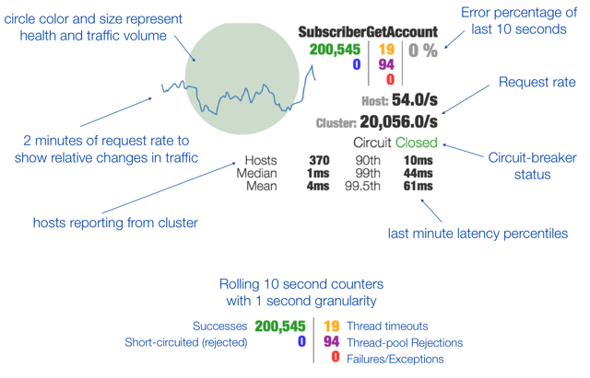
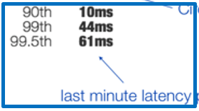
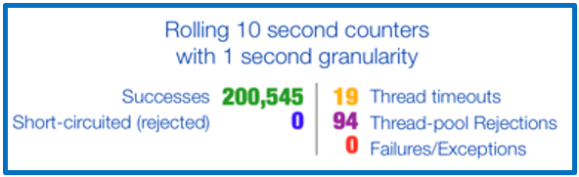
Netflix prioritizes perceived availability & performance
Notes:
Netflix: Perceived availability (errors) and Performance together
Ref: http://techblog.netflix.com/2012/12/hystrix-dashboard-and-turbine.html
“The Hystrix dashboard has significantly improved our operations by reducing discovery and recovery times during operational events.”

Slide 53
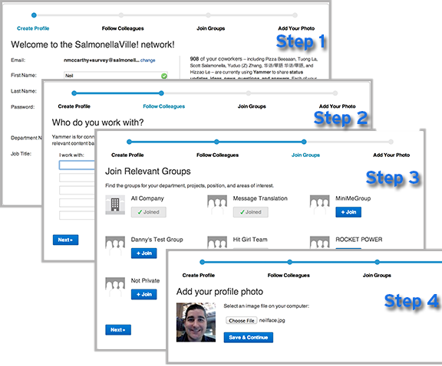

Yammer prioritizes usage
What happens to new user retention when you shorten the signup flow?
It goes down!
Don’t ship that feature
Notes:
https://medium.com/yammer-product/13eeb6435a73
Shorter signup makes it easier to signup
But experiment showed user retention went down.
Can “guess” why (less committed), but all you really have is the result data

Slide 54
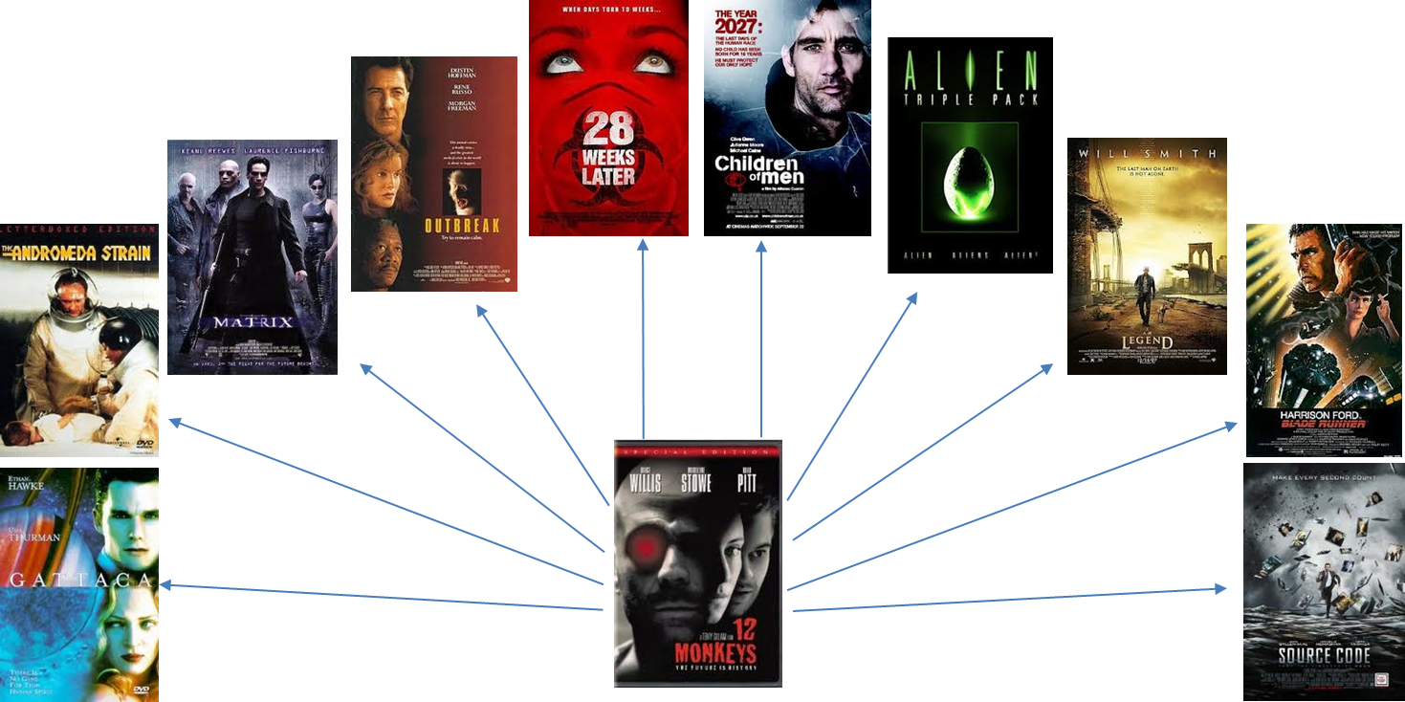

Find new questions and repeat
Xbox recco
Try algo
Collect data
Adjust algo
Collect data
repeat
Notes:
Xbox recommendation system surfaces personalized picks for movies, TV, games, and music
Uses sophisticated Machine Learning algorithms
New questions in this case are usually along the lines of why did this [work/not work] for this case?

Slide 55
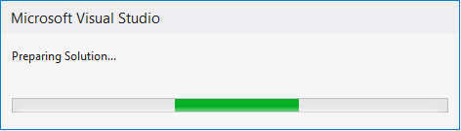

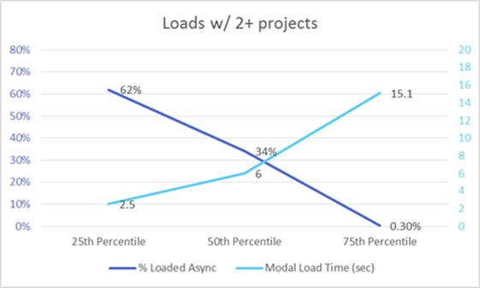
Find new questions and repeat
We also added Telemetry
Results look good
In Visual Studio 2012 we added asynchronous loading for solutions
Notes:
Initial telemetry was Feedback data, then we added application data
Entire story here:
http://blogs.msdn.com/b/visualstudio/archive/2013/10/14/asynchronous-solution-load-performance-improvements-in-visual-studio-2013.aspx
Feedback data said solutions load too slowly
Customer complaints on VS load time: http://visualstudio.uservoice.com/forums/121579-visual-studio/suggestions/2197975-make-solutions-load-faster
Problem for solutions with multipleprojects
In VS 2012 we added asynchronous loading
We also added telemetry to assess this
These numbers are pretty promising. We see that for a quarter of all solution loads, we defer loading over 60% of the solution and only block the IDE for around 2 seconds

Slide 56
Your turn – Get Answers, more questions
Where are the answers to your quality assessment questions?

Slide 57
Challenges for different products
Deploy at will?
Un-assured deployment - is a spectrum
  Traditional client
    Dual client/service: service accrues to the client
    Availability of the service as seen by the client
  Apps – AaaS, EaaSy
  Mobile apps - Amazon Debuts A Cross-Platform App Analytics Service With A
If not deploy at-will
  Engineering Data Only
  your road map is to evolve to be able to use production data - Get EaaSy
  Rings prior to release
Limited access
  Was typically enterprise, but this is changing for enterprise
Notes:
This is hidden.
Could have been another section if there was more time

Slide 58
Determine your questions
Design for production-quality data
Select your data sources
Use the right data tools
Get answers to your questions
Learn new questions
Repeat
The most recent version of this deck can be found at http://setheliot.com

Slide 59

Special thanks to these folks
Ravi Vedula
Andrea Jesse
Bill Hodghead
Danny Thayer
Joseph Sefair
Kitty Thomas
Amanda Reinke
Heather Lader
David Brooks
Mike Tholfsen
Jodie Draper
Brian Mueller
Tara Roth
Dror Cohen
Nathan Halstead
Lori Oviatt
Monica Catunda
Lynette Skinner
Joe Schumacher
Donny Luu
John Hoegger
Alain Anyouzoa
Any questions?
Thanks!

